Slide 1
Dr Gail Brenda Cross
Consultant in Infectious Diseases
National University Hospital, Singapore
Thursday 15th April 2021 12:30-13:30pm
https://global.gotomeeting.com/join/180472637
YOUR PHOTO HERE
VIRTUAL
SESSION!
ROSETTA trial: Adjunctive Rosuvastatin in Pulmonary TB
Gail is an Infectious Diseases physician with interest in Tuberculosis, HIV and COVID-19. She graduated with BSc (UNSW, 2000) and MBBS (Monash University, 2006). She has worked in multiple hospitals around Australia including several in Melbourne, Brisbane and in the Northern Territory. Part of her Infectious Diseases training included a 6-month epidemiological study of Tuberculosis in the remote Gulf Province of Papua New Guinea. She became a Fellow of the Royal Australasian College of Physicians (Infectious Diseases) in 2014, and moved to Singapore to undertake a research fellowship at the National University of Singapore with Prof Nick Paton in Clinical Trials TB research. She is currently a consultant physician in Infectious Diseases at the National University Hospital, Singapore. She is also currently a PhD candidate through the Kirby Institute, University of New South Wales, with the ROSETTA trial as the basis for her PhD.
Today’s topic
Gail will give an overview of the ROSETTA trial, including the rationale for the use of statins as host directed therapy, the trial progress thus far and an overview of biomarker sub-studies.
Prof James Chalmers
Chair of Respiratory
Research
University of Dundee
Thurs 13th December, 2-3pm
CTID Boardroom, LSTM

Slide 2
ROSuvastatin Evaluation as a Tuberculosis Treatment Adjunct
Sponsor: National University Hospital, Singapore
Funded: National Medical Research Council, Singapore
Chief Investigator: Prof Nick Paton
Project Lead: Dr Gail Cross

Slide 3
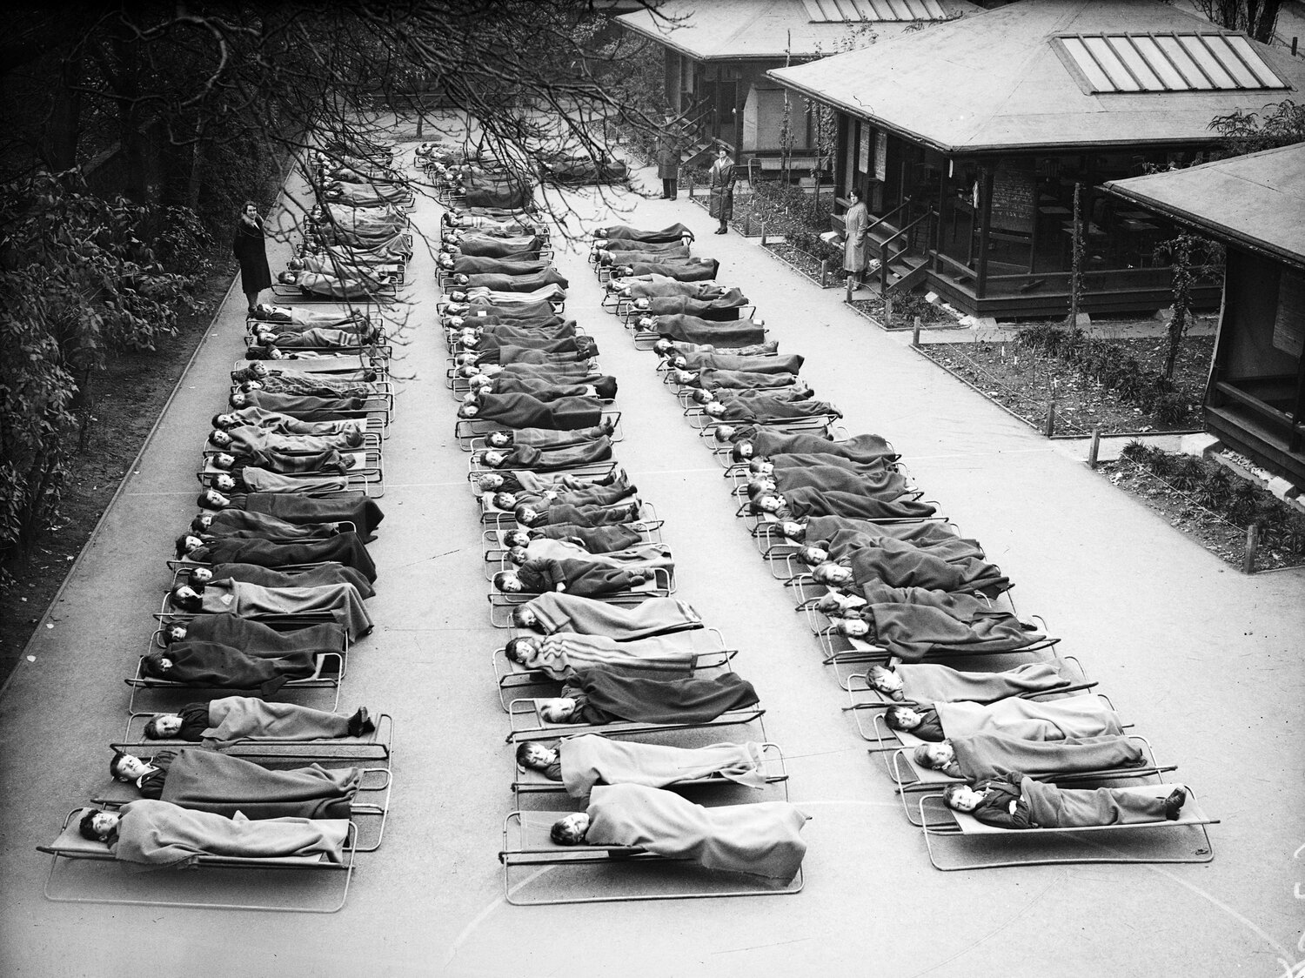
Children with TB sleep outside at Springfield House Open Air School in London 1932
Npr.org, Getty images
Notes:
In the pre-antibiotic era, some patients, possibly those with minimal disease, survived TB.
Whether or not this was as a consequence of the “fresh air, nutritious food, sun treatments and exercise” prescribed, I’m not sure anyone knows.
But it does remind me, that prior to the advent of effective antibiotic treatment, people used a form of host directed therapy, with varying success, to treat TB.

Slide 4
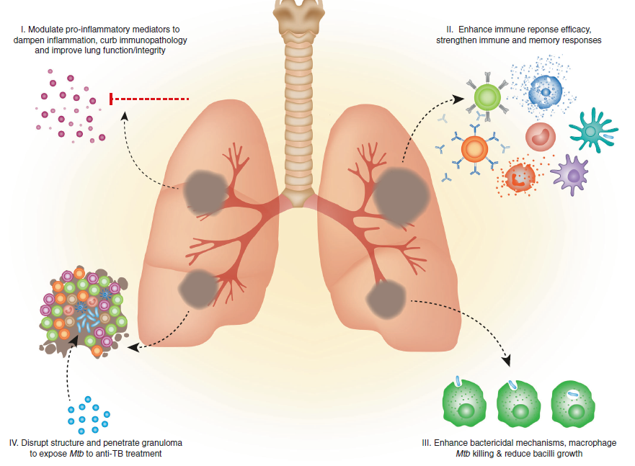
Host Directed Therapy (HDT) for TB
Young C et al. Therapeutic host-directed strategies to improve outcomes In tuberculosis. Mucosal Immunology, 2020
Notes:
These days when we think about HDT, there are really 4 strategies to improve outcomes from TB
Modulating the pro-inflammatory response which is results in substantial amount of lung damage. Many HD therapies from Steroids, Vit D, anti-inflammatory thought to work through this mechanism.
Enhancing or developing host adaptive immune responses, much like vaccination.
Enhancing innate immune responses which are primarily bactericidal
Distrupting the structure of granulomas which harbour and protect TB bacilli, from the host immune response as well as anti-TB drugs.

Slide 5
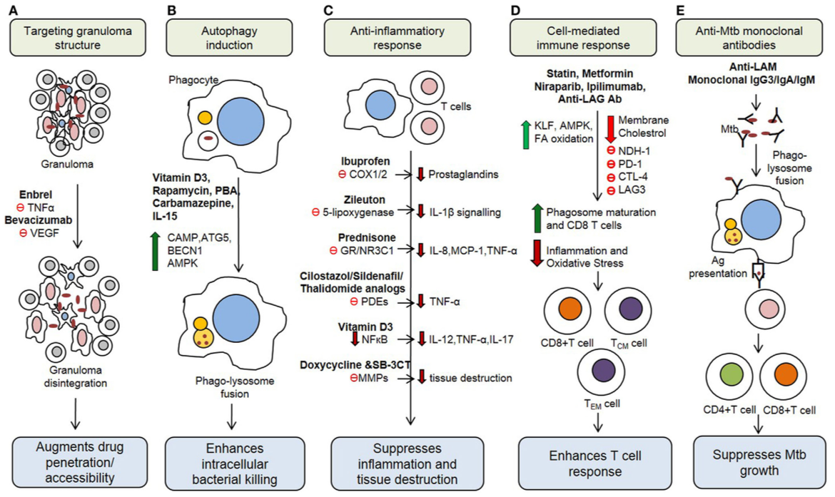
Considering a Choice of HDT
mTOR
Kolloli, FIM 2017
Notes:
There are many many candidate drugs which have been considered to be repurposed for HDT
Naomi talked a few weeks ago about the 4 drugs Bob Wallis and his group trialled, some of which I have circled in red.

Slide 6
Statins showed improved outcomes in patients with bacterial infections
Henessey, Is There Potential for repurposing statins as Novel Antimicrobials. AAC 2016
Notes:
1) The repurposing of statins as antimicrobial agents was shown to hold potential promise when numerous clinical studies revealed that patients on cholesterol-lowering statins showed improved outcomes from bacterial infections.
2) Statins have been shown to, in vitro, reduce bacterial growth, motility, attachment.
3) In cell culture it has been postulated that they do this through key antivirulence mechanisms
4) In vivo at physiological concentrations statins have been shown to reduce bacterial load and dissemination and increase clearance in mouse models of infection.
5) despite what this slide suggests, it is probable that the effect statins have on bacterial infections is indirect, with some suggesting that co-treatment with statins results in the silencing of bacteria or may selectively target pathogenesis rather than true anti-microbial activity.
6) The benefit of it not being directly antimicrobiocidal, i.e. the effect on bacteria is both direct and indirect; is it removes the selective pressure that underpins the continued spread of antibiotic resistance among populations.
But we need to explore how specifically Statins can impact on Tuberculosis…

Slide 7
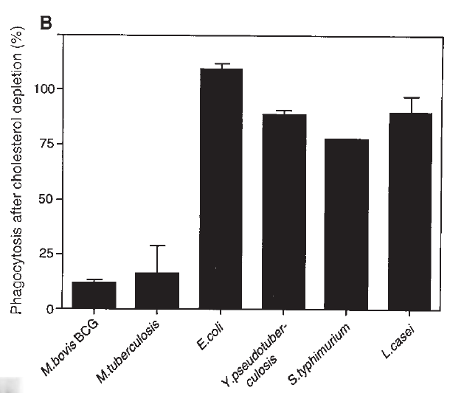
Timeline: Cholesterol, TB and statins
YEAR | FINDING | Ref
1913 | Mycobacteria grow on cholesterol | Sohnen
1998 | Mtb whole genome sequence, +++ genes relating to lipid metabolism | Cole
1999 | MTB survives within phagosome coated with TACO protein | Ferrari
2000 | Mtb required cholesterol to infect macrophages, Reduce cholesterol = limit entry | Gatfield Pieters
Gatfield and Pieters, Essential Role for Cholesterol in Entry of Mycobacteria into Macrophages, SCIENCE Vol 288, 2 June 2000
Notes:
Experiments by Gatfield and colleagues, showed that when macrophages were substantially depleted of cholesterol after culture with lovastatin, mycobacterial uptake into these macrophages was inhibited.

Slide 8
TACO protein (Coronin-1) prevents phagolysosomal fusion
Tryptophane aspartate-containing coat protein
Cholesterol
Image from: Jean Pieters, Entry and survival of pathogenic mycobacteria in macrophages, Microbes and Infection Vol 3, 2 June 2000
Notes:
1) After mycobacteria have gained access to macrophages, they occupy the mycobacterial phagosome, which has
many features in common with the plasma membrane.
2) Phagocytosis of living mycobacteria (blue) into macrophages triggers the recruitment of TACO (yellow) (also known as coronin 1 around the phagosome.
3) In the case of killed mycobacteria, the TACO coat is removed in order to allow delivery of the phagosomal content to lysosomes, where this material is degraded.
4) living mycobacteria have the capacity to retain TACO at the phagosomal membrane, thereby preventing their delivery to lysosomes, allowing them to survive within the phagosome. Association of TACO to phagosomal membranes occurs via cholesterol.
5)Gatfield and Pieters isolated phagosomes from murine macrophaes infected with BCG and showed that a cholesterol sequestering agent, 0.02% digitonin, resulted in the solubilisation of TACO from the phagosome, concluding that TACO was associated with membranes in a cholesterol dependent manner.
A little later I will show you data supporting how statins can promote phagolysosomal fusion of MTB infected macrophages.

Slide 9
Timeline: Cholesterol, Statins and TB
YEAR | FINDING | Ref
2000 | Cholesterol needed for MTB to infect macrophages, Reduce cholesterol = limit entry TACO protein associated with phagosome membrane in a cholesterol dependent manner | Gatfield and Peiters
2005 | Depletion of cholesterol from M. avium infected macrophages enabled phagolysosomal fusion | de Chastellier and Thilo
2007 | Genes encoding cholesterol catabolism are turned on, enabling MTB to survive in macrophages | Van der Geize
2008 | Mce4 operon needed to import cholesterol into Mtb Mtb degrade sterol rings and the side chain of cholesterol to be used for energy, carbon and for virulence factors | Pandey
2008 | Mycolic acid triggers differentiation of macrophages into foamy phenotype (large number of lipid filled bodies) | Peyron
Notes:
Electron microscopy of a macrophage infected with M Avium. M. Avium within a phagosome membrane, which would be immature and thus un-able to fuse with the lysosome.
B showed after treatment resulting in cholesterol depletion, the phagosome membrane becomes loose and undulates around the mycobacterial surface
C: Phagosome containing MAC is seen fusing with a lysosome to form a phagolysosome.

Slide 10
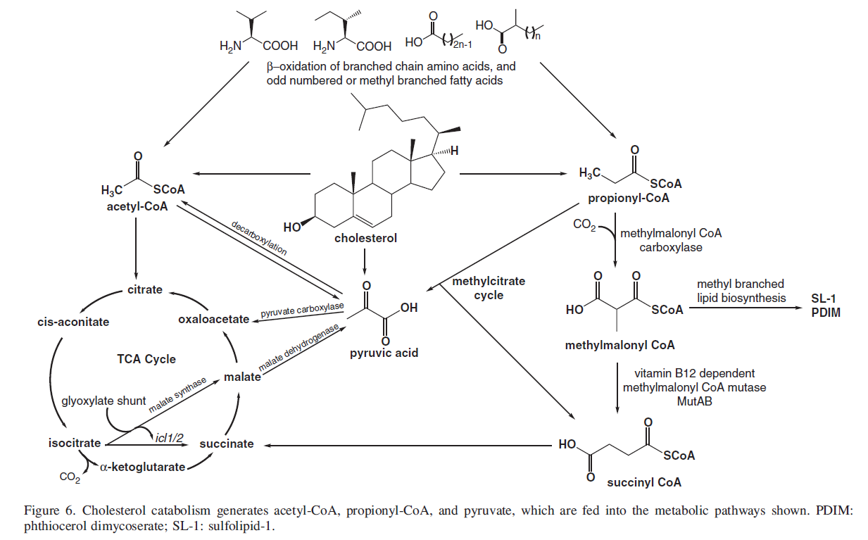
Cholesterol is essential for growth and virulence of Mtb
Lovewell. Chewing the fat: lipid metabolism and homeostatis during M. tuberculosis infection. Current Op in Micro 2016
Wipperman et al. Pathoen Roid rage: Chlolesterol utilisation by Mycobacterium tuberculosis. Critical reviews in Biochemtistry and Molecular Biology, 2014
Notes:
Cholesterol is essential for growth and virulence of Mtb
1) MTB is able to catabolise both fatty acids and cholesterol for multiple metabolic functions: including i)energy synthesis, ii)virulence factor expression, iii) cell wall and outer membrane construction.
2) Cholesterol is catabolized by MTB into acetyl-CoA and pyruvate which is shunted into the TCA cycle to generate carbon and energy.
3) Secondly Cholesterol is also catabolized into Propionate, which is in fact toxic to bacterial cells and requires detoxification to prevent accumulation. Mtb can incorporate propionate into the biosynthesis of new lipids, including sulfolipid (SL-1) and phthiocerol dimycocerosates PDIM-, which contribute to sustaining infection and virulence.
4) In the absence of carbon sources, when Mtb is grown in vitro on cholesterol alone, there is an increase in the molecular weight of PDIM, which supports the hypothesis that in a cholesterol rich environment, this is an adaptive strategy to deal with a toxic catabolic product in a way that might enhance virulence.

Slide 11
Timeline: Cholesterol, Statins and TB
YEAR | FINDING | Ref
1913 | Mycobacteria grow on cholesterol | Sohnen
1956 | Mtb isolated from mice vs. cultured in vitro grew only in the presence of lipids and not carbohydrates | Segal and Bloch
1976 | Mycobacteria grow on Lecithin/ cholesterol | Kondo
1998 | Mtb whole genome sequence, +++ genes relating to lipid metabolism | Cole
1999 | MTB survives within phagosome coated with TACO protein | Ferrari
2000 | Cholesterol needed for MTB to infect macrophages TACO associated with phagosome membrane in a cholesterol dependent manner | Gatfield and Pieters
2005 | Depletion of cholesterol from M. avium infected macrophages enabled phagolysosomal fusion | de Chastellier, Thilo
2007 | Transcriptomics: Genes encoding cholesterol catabolism are turned on which enables MTB to survive in macrophages | Van der Geize
2008 | Mycolic acid triggers differentiation of macrophages into foamy phenotype (large number of lipid filled bodies) | Peyron
2008 | Mce4 operon needed to import cholesterol into cell Mtb is able to degrade both the sterol rings and the side chain of cholesterol to be used for energy, carbon and for virulence factors | Pandey
2014 - 2016 | First in vitro and in vivo data supporting the use of Statins in controlling Mtb infection
Notes:
\

Slide 12
Statins mechanism of action in tuberculosis
1. Statins limit uptake into macrophages
2. Statins may limit formation of foamy macrophages
3. Statins may limit cholesterol as a energy and carbon source
4.
Parihar et al, Statins: a viable candidate for host-directed therapy against infectious diseases, Nature Reviews 2019

Slide 13
In Vitro and In Vivo data supporting the efficacy of Statins against Mtb

Slide 14
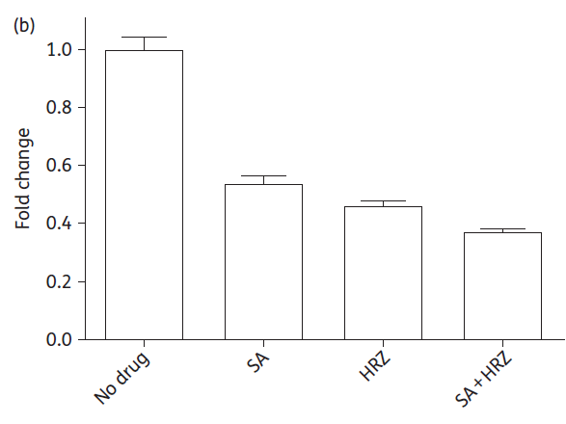
Statins reduce Mtb Viability and work synergistically with anti-TB drugs
Lobato et al, Statins Increase Rifampicin Mycobacterial Effect, AAC, 2014
Dutta et al, Statins activity in the mouse model of TB, JAC, 2016
Parihar et al, Statin Therapy Reduces the Mtb Burden in Human Macrophages and in Mice by enhancing autophagy and phagosome maturation, JID, 2014
Notes:
1) In murine macrophages, compared with control, both atorvaststin and simvastatin showed reduction in H37Rv viability (red),
which was resversed by the addition of mevalonate (precursor to cholesterol) (Blue)
In addition, the effect of the statins was additive to rifampicin (Yellow).
2) A second group in 2016 also showed that simvastatin acid alone and in combination with all 3 anti-TB drugs inhibited growth of MTB in macrophages
3) A third group around the same time showed that mechanistically that statins limited Mtb growth by enducing phagolysosomal fusion and sunsequent autophagy, and this effect could once again be reversed through mevalonate rescue.

Slide 15
Rosuvastatin and Simvastatin reduced bacillary burden in murine model
Parihar et al, Statin Therapy Reduces the Mtb Burden in Human Macrophages and in Mice by enhancing autophagy and phagosome maturation, JID, 2014
Notes:
Besides in vitro data, Mice pretreated with simvastatin or rosuvastatin and infected with Mtb had reduced bacterial burden at 4 weeks and 8 weeks in both lung and spleen tissue.
Statin treated mice also showed fewer and smaller lesions on histological examination of lung tissue.

Slide 16
Statin reduced time to culture negative lungs – Dutta 2016
Dutta, Statin activity in the mouse model of TB, JAC 2016
Notes:
1) Bacillary growth was controlled in the lungs of untreated mice at a level of 5.7 cfu up to 4.5 months of treatment.
The addition of simvastatin to HRZ enhanced the bactericidal activity of 3 drug therapy, reducing bacterial burden, and enhabled sterilisation of the lung by 3.5 months of treatment in comparison to 4.5 months without simvastatin.

Slide 17
Statins reduced risk of relapse in a chronic TB mouse model
Dutta, Statin activity in the mouse model of TB, JAC 2016
Notes:
Additionally in mice treated with HRZ alone:
100% Relapses if that HRZ treatment was for 2.5 months
50% relapsed with treatment for 3.5 months
And were cured at 4.5 months of treatment.
In mice treated with HRZ and simvastatin,
50% relapsed with treatment for 2.5 months,
20% relapsed after 3.5 months and 100% cured after 4.5 months of treatment.

Slide 18
Designing a HDT TB trial
What outcome measure: Clinical, microbiological, other?
Which Statin?
What drug as HDT?
What dose?
Duration of therapy?
Placebo controlled, Double blind RCT?

Slide 19
Current Trials of Statins in TB
Trial | AIM | Design | Primary Outcomes
StAT-TB, recruiting | Safety, tolerability, and pK of pravastatin + TB treatment. | n=40 80 -> 40, 120, 160mg 14 days duration | 1) Number of ≥ Grade 3 AE.
ROSETTA | Efficacy of rosuvastatin + TB treatment; microbiological, safety, clinical | n=154 10mg 24 weeks (8 weeks primary end-point) | Time to SCC within 8 weeks Grade 3/4
ATORTUB, recruiting | Efficacy of atorvastatin + TB treatment; microbiological, safety | n=150 30/40mg 24 weeks (8 week primary end-point) | SCC at 8 weeks EBA (solid culture) Treatment related AE

Slide 20
Which Statin?
 | Rosuvastatin | Pitavastatin | Pravastatin | Atorvastatin | Simvastatin | Fluvastatin
LDL-C lowering Potency | ++++ | ++ | + | +++ | ++ | +
IC₅₀ (nM) for HMG-CoA reductase inhibition | 5.4 | 6.8 | 44.1 | 8.2 | 10.0 | 27.6
Lipophilicity (log P) | 0.13 | 1.49 | -0.23 | 4.06 | 4.68 | 3.24
Bioavailability | 20% | 51% | 17% | 14% | <5% | 24%
Elimination ½ life (hours) | 19 | 9 | 1-3 | 14 | 2-5 | 1-3
CYP P450 metabolism | CYP2C9 (minor) | CYP2C9 (minor) | None | CYP3A4 | CYP3A4 | CYP2C9 (minor)
Interaction with Rifampicin | NO | UNCLEAR | YES | YES | YES | YES
Interaction with Protease inhibitors | NO | Unknown | NO | YES | YES | NO
In vivo mouse model data | YES | NO | NO | YES | YES | NO
Generic available | YES | NO | YES | YES | YES | NO
Notes:
Biochemical Properties of the Drug
Safety of the Drug
Drug Drug Interactions
In Vivo animal model data for use to treat TB
Accessibility and Cost
Pravastatin metabolism although not mediated by CYP 450, has still been shown to have reduced exposure by rifampicin by about 30 – 50%. The authors of the competing trial feel that this can be overcome by doubling the dose of pravastatin when used in combination with rifampicin.
On the other hand when rosuvastatin was administered after multiple doses of rifampicin, the plasma concentration of rosuvastatin and mean AUC dud not significantly change.

Slide 21
The right dose of Rosuvastatin
Target cholesterol levels can be achieved with a dose of 10mg
Increasing to 20mg results in a modest 5% additional decrease in LDL-C.
10mg rosuvastatin has been shown to have potent pleitropic effects in a variety of studies
JUPITER trial used 20mg BUT little Asian representation (3.6%).
>20mg dose was contraindicated in Asian patients.
Asian patients have a ~2-fold increase in exposure vs. Caucasian populations because of genetic variation in the activity of OATP1B1 and Breast cancer resistance protein (BCRP)
OATP1B1/ BRCP = uptake/ efflux transporters which determine the rate of intestinal absorption and excretion of the rosuvastatin.
Starting dose of Rosuvastatin Asian patients = 5mg
Notes:
The recommended starting dose of rosuvastatin is 5-10mg once daily, with progressive dose increases up to 40mg to achieve a prespecified cholesterol target.
The maximum dose of 40mg is only considered in patients at highest risk of cardiovascular disease because of the possible increased risk of myopathy/ myositis at that dose.
Doses above 20mg are contraindicated in Asian patients as they have an approximately 2-fold increase in exposure to rosuvastatin in comparison to Caucasian populations as a consequence of genetic variation in the activity of OATP1B1 and Breast cancer resistance protein (BCRP), two key uptake/ efflux transporters which determine the rate of intestinal absorption and excretion of the rosuvastatin.

Slide 22
What duration of treatment
8 Weeks
Most culture convert by 8 week.
Aiming for 2 month regimen in the future
Greater risk of toxicity with longer use of statins
12 weeks
Greater chance of seeing an effect
Greater precision around primary endpoint estimation
24 weeks
Would maximise effects
Issues with monitoring adherence, toxicity
Mostly interested in effect on culture conversion vs. reducing lung inflammation

Slide 23
Placebo controlled, double blind RCT
Manufacturing Placebo: Contacted 21 manufacturers
Large commercial Drug Co: “excess 5mg placebo tablets” -> never materialised
Large generic Drug manufacturer: Yes -> SILENT NO
Most generic manufacturers did not reply, some did not have GMP
SGD: 40K to 250K for placebo
Unable to pay overseas entities from SG nearly impossible.
Identified an SG manufacturer
Approval from AstraZeneca to manufacture tooling to make matched placebo tablets
Manufacture tooling took 6 months
Approx 2-4 months to manufacture placebo, 2- 4 months to repackage placebo and drug
Regulatory approval (4 countries) of product will only come AFTER placebo has been manufactured

Slide 24
Placebo Controlled Open Label Double Blind RCT
1:1 Randomisation
Standard TB Therapy (8 weeks RHZE + 16 weeks RH)
OR 8 weeks of 10mg Rosuvastatin + Standard TB Therapy
Trial Duration
24 weeks
Microbiological Primary Outcome
Time to Sputum culture conversion in MGIT media within 8 weeks
Safety Outcome
One or more Grade 3 or Grade 4 adverse events by week 24

Slide 25
154 Patients recruited across 5 sites
Inclusion
Smear pos OR Xpert pos PTB
CXR must be abnormal
RHZE treatment only
Exclusion
>7 days treatment already
Known drug resistance
Can’t take rosuvastatin
Inadequately controlled HIV
Current/recent use of statin
Needs a statin because of CVS disease
Pregnancy/Breastfeeding
Sample size calculation
Treatment effect: 1.8 (hazard ratio)
Two-sided α of 0.05
Power of 80%
Required sample size = 65 per arm
5% ineligible (never take Ros, Rif resistant)
10% withdraw/lost-to-follow-up prior to week 8
Total sample size = 154 (77 per arm).

Slide 26
Hanoi, Vietnam, Vietnam Military Medical Hospital – Dr. Dong, Prof Do Quyet
Philippines, Manila, De La Salle Health Sciences Institute – Dr Vicki Dalay
Philippines, Manila, Lung Centre Philippines – Dr Vince Balanag
Philippines, Manila, Tropical Disease Foundation – Dr Rholine Veto
Kampala, Uganda, Joint Clinical Research Centre – Dr Cissy Kityo

Slide 27
Trial Design
Start of Recruitment
Complete Intervention
Final
Analysis
Control Regimen (RHZE)
RH
Up to 7 days TB Rx
Rosuvastatin 10mg + RHZE
Rosuvastatin 10mg + RHZE
RH
Baseline
Week 8
Week 24
Week | 0 | 1 | 2 | 3 | 4 | 5 | 6 | 7 | 8 | 10 | 12 | 24
Visits | X |  | X |  | X |  |  |  | X | X | X | X
Culture | X | X | X | X | X | X | X | X | X | X | X | X
PET-CT | X |  |  |  |  |  |  |  | X
Transcriptomics | X |  | X |  | X |  |  |  | X
Metabolomics | X |  | X |  | X |  |  |  | X
MBL/ Bacterial Transcriptome | X |  | X |  | X |  | X |  | X
PRIMARY ENDPOINTS
Time to sputum culture conversion (liquid media) within 8 weeks

Slide 28
Other outcome measures
Microbiological
TCC (solid media) within 8 weeks
TCC (liquid media) within 12 weeks
Sputum culture negative (liquid media) at 8 weeks
Sputum culture negative (solid media) at 8 weeks
Change in TTP from baseline to 8 weeks
Clinical
Change in score on St George’s Respiratory Questionnaire (SGRQ) from baseline to week 8
Change in FEV1/FVC from baseline to week 8
One of more Serious Adverse Events (SAEs) by week 24
Imaging
Change in proportion of lung affected on CXR from baseline to week 8
Change in the aggregate cavity size on CXR from baseline to week 8
Exploratory
Change in molecular bacterial load (MBL) Change in bacterial transcriptomic profile
Change in host transcriptomic profile
Change in metabolomic profile
Change in cytokine profile

Slide 29
Molecular Bacterial Load
Does rosuvastatin achieves more rapid reduction in MBL?
Honeyborne et al, The MBL assay replaces Solid cultures for measuring Early Bactericidal Response to ATT, JCM 2014
Notes:
Culture based data is problematic:
Takes too long, risk of contamination, culture methologies may be different between laboratories (sloppy)
MBL which is based on 16sRNA is therefore not dependent on actively growing mycobacteria (likely culture), but simultaneously should not detect dead bacteria (like Xpert), but will be able to pick up both dormant as well as actively replicating bacteria.
Assessed 20 patients in Tanzania where they compared the MBL with solid agar CFU and liquid media culture, and showed that at least for EBA during the first 14 days, the MBL assay is at least as good as culture with higher precision and fewer missing data.

Slide 30
Biomarker Sub-study 1. Blood Metabolomics 2. Plasma Cytokine
Can we use metabolomics and plasma cytokine to demonstrate mechanistically the host immune pathways impacted by rosuvastatin in the treatment of TB?
Metabolomics can discriminate between those who achieved SCC by W8 Vs those who remained culture positive in another HDT RCT.
Vrieling et al. Patients with concurrent TB and DM have a pro-therogenic Plasma Lipid Profile, EBioMedicine, 2018
Chong et al. Use of plasma metabolomics at diagnosis to identify metabolic pathways associated with pulmonary tuberculosis (TB) clearance: A pilot study. FASEB 2016
Notes:
There have been 2 studies published thus far which have characterised

Slide 31
Biomarker Sub-study 3. Whole Blood Transcriptomics
Can a transcriptomic signature be able to predict for the treatment shortening efficacy of rosuvastatin?
Penn-Nicholson et al, RISK6, a 6-gene transcriptomic signature of TB disease risk, diagnosis and treatment response, Scientific Reports, 2020
Notes:
Numerous host transcriptome signatures of active TB have been described,
Most recently several groups collaborated to develop a PCR based host blood transcriptomic signature – called RISK6, which could be used as a screening test for TB, as well as demonstrated utility as a treatment response biomarker whilst predicting treatment failure prior to treatment initiation.
In the second panel we see that RISK6 scores were shown to drop with the initiation of TB treatment as early as 1 week into TB treatment, and we see that whilst the score decreased significantly during TB treatment it was still significantly higher than those observed in healthy controls.
It was also shown to correlate with lung immunopathology as measured by PET
A dynamic gene signature which demonstrates response to successful therapy hold promise as an excellent biomarker for treatment monitoring and particularly for clinical trials research in Tuberculosis. However there has been a call for such a diagnostic biomarker to be carefully tested in a multitude of TB cohorts from distinct geographical locations and optimised for specificity to Tuberculosis (97).

Slide 32
Biomarker Sub-study 4. Bacterial transcriptome in sputum
Can the bacterial transcriptome demonstrate mechanistically the bacterial metabolic pathways impacted by rosuvastatin in the treatment of TB?
Walter et al, Transcriptional Adaptation of Drug-tolerant Mtb During Treatment of TB, JID 2015
Notes:
Mtb gene expression was from patients in Uganda treated for DS-TB
Rapid reduction in mRNA abundance,
Treatment markedly altered the bacterial transcriptome.
This figure shows change in key functional categories during treatment and the study effectively showed that during treatment the bacterial transcriptional profiling changes
from one where bacteria are highly metabolically active to that of drug-tolerant bacteria which slowing of growth and metabolism and the upregulation in the stress-response.

Slide 33
Biomarker Sub-study 5. PET-CT
n=25
Week 8 Vs Baseline
18F-G FDG
Measure Total Lesion Glycolysis (TLG)
TLG = SUV_{mean} X volume of the region of Interest with metabolic uptake
Notes:
Quantitative analysis of FDG PET-CT images was able to characterise and predict treatment outcomes in 99 PTB patients
Malherbe, Quantitative 18F-FDG PET-CT scan characteristics correlate with TB treatment response, EJNMMI Research, 2020

Slide 34
Mar 27 - Jun 19
Nov 26 - Dec 13
Mar 12 - Aug 14
Jul 20 - Sep 29
Jan 15 - Feb 26
Oct 11 - Oct 28
Dec 16 - Jun 19
May 22 - Aug 18
Dec 27 - Mar 5
Mar 18 - May 5
Feb 1 - Apr 23
Feb 3 - Jun 10
Mar 9 - Oct 31
Jun 8 - Oct 16
Oct 13 - Nov 3
Oct 22 - Nov 3
Dec 4 - Mar 5
Jan 8 - Mar 2
Mar 1 - Jun 8
111 days
169 days
135 days
66 days
50 days
61 days
35 days
14 days
39 days
59 days
93 days
52 days
31 days
71 days
95 days
63 days
13 days
16 days
94 days
62 days
62 days
9 days
Aug 12
Sep 10
Sep 15
Oct 12
SIV
TOTAL=137
Jan 15
2019
Protocol/ ICF
Protocol/ICF V2.0
Nov 15
Oct 5
2019
2020
2021
Nov
Jan
Mar
May
Jul
Sep
Nov
Jan
2021
Today
Lockdown
Singapore
DSRB
HSA
Lockdown
IRB
UNCST
NDA
Uganda
SIV
Sep 8 - Jan 18
Recruitment
Lockdown
IRB
MOHEC
Vietnam
SIV
Oct 21 - Jan 15
Recruitment
Lockdown
LCP
PFDA prep
PFDA
LCP V2.0
Philippines
DLSMHSI
DLSMHSI V2.0
TDF
SIV
TDF V2.0
Oct 22 - Jan 15
Recruitment

Slide 35
304
pre-screened
172 screened
137 enrolled

Slide 36
174 Patients were screened
37 Screen failed
20 Smear/Xpert criteria not met
1 Did not attend randomisation visit
3 Had >7 days of TB Treatment
1 Had known rifampicin resistance
4 Had abnormal laboratory tests at visit
2 Had uncontrolled HIV
1 Required statin therapy at screening
1 Was breast-feeding
4 Had other diseases which compromised safety
137 Underwent randomisation
XX assigned to Standard of care
XX assigned to adjunctive Rosuvastatin
X Excluded from analysis
X Excluded from analysis
XX included in modified intention-to-treat analysis
XX included in modified intention-to-treat analysis
X Were excluded
X Were excluded
XX included in per-protocol analysis
XX included in per-protocol analysis

Slide 37
Trial Challenges
Delayed Approval
COVID-19
Patients afraid of coming to hospital
Trial team came down with COVID-19 sequentially
Lab shutting because of COVID-19
Consumable delivery dependent on flight availability and costs skyrocketed

Slide 38
Trial Successes
Completed Recruitment
Robust Sample collection
Clinical Outcome Data completeness is good
Trial Run 100% Via Zoom
Able to delivery effective TB management in the setting of a world wide pandemic.
Notes:
Recruitment Completed: 137 patients
Last Patient out approx mid July 2021

Slide 39
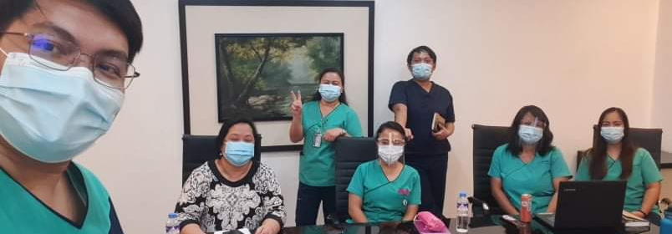
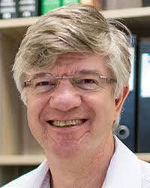
Thanks to Nick Paton, Chris Cousins and Christina Chang in helping with preparation for the presentation

