Slide 1
TUBERCULOSIS AND WELLBEING
Dr Sumona Datta
Liverpool school of Tropical Medicine, UK
IFHAD: Innovation For Health And Development, Peru

Slide 2
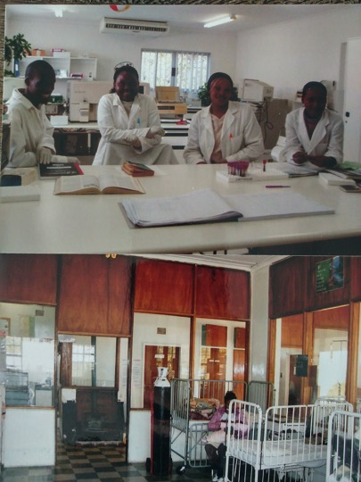
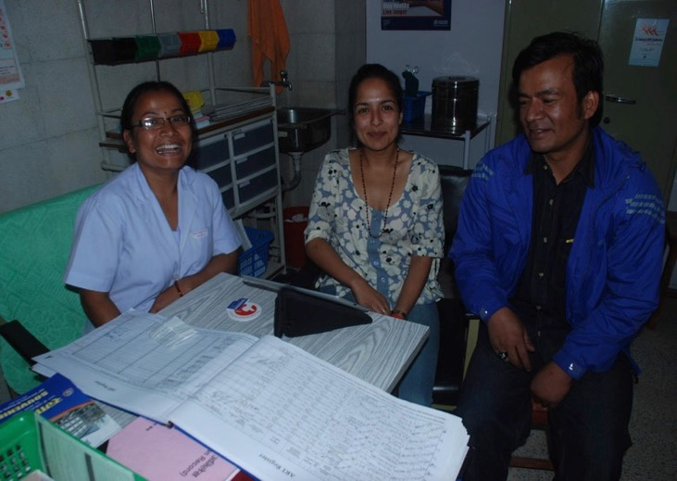
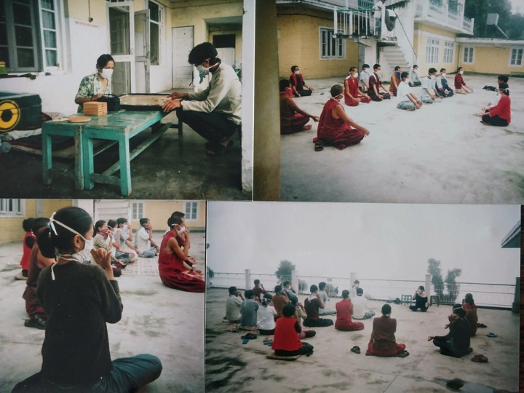
WHO AM I?
A clinical (physician) researcher
IPSYD (PRISMA)
LSTM, Imperial College London and Johns Hopkins University
Worked in UK, India, Nepal, Lestho……..PERU

Slide 3
“Health is a state of complete physical, mental and social
wellbeing and not merely the absence of disease or infirmity”
Constitution of WHO The definition has not been amended since 1948.

Slide 5
So why do we only measure:
TB incidence,
prevalence,
mortality,
% HIV coinfection
catastrophic costs?

Slide 6
WHO Quality of Life measurement
Measures an individual's perception of their position in life in the context of the culture and value systems in which they live and in relation to their goals, expectations, standards and concerns.
15 collaborating centers worldwide
Original WHO-100 available in 29 languages
Shortened to WHO QOL BREF 26 questions
WHO Europe region made a screening tool for health surveillances (EURO HIS). Shortened to 8 questions asking about 4 domains (EUROHIS QOL)

Slide 7
WHO EURO-HIS QOL
We ask that you think about your life in the past two weeks.
Questions | Your response
1. How would you rate your quality of life? | A. Very poor B. Poor C. Neither good nor bad D. Good E. Very good
2. How satisfied are you with your health? | A. Very dissatisfied B. Dissatisfied C. Neither D. Satisfied E. Very satisfied
3. Do you have enough energy for everyday life? | A. Not at all B. A little C. Moderately D. Mostly E. Completely
4. How satisfied are you with your ability to perform your ADLs? | A. Very dissatisfied B. Dissatisfied C. Neither D. Satisfied E. Very satisfied
Questions | Your response
5.How satisfied are you with yourself? | A. Very dissatisfied B. Dissatisfied C. Neither D. Satisfied E. Very satisfied
6.How satisfied are you with your personal relationships? | A. Very dissatisfied B. Dissatisfied C. Neither D. Satisfied E. Very satisfied
7.Have you enough money to meet your needs? | A. Not at all B. A little C. Moderately D. Mostly E. Completely
8.How satisfied are you with the conditions of your living place? | A. Very dissatisfied B. Dissatisfied C. Neither D. Satisfied E. Very satisfied
A
B
C
D
E
Notes:
Study flow

Slide 8
The WHO EUROHIS-QOL tool correlated well with tools that measure separate elements of wellbeing

Slide 9



Slide 10
METHODS
32 community in Callao, Peru between July 2016 until February 2018
Patients starting treatment for TB
N=1812
Patients consented into cohort
N=1650
Contacts censused
N=5885
Controls consented into cohort
N=408
Contacts available and consented into cohort
N=4925
Patients ≥15 years recruited for study
N=1545
Contacts ≥15 years recruited for study
N=3180
Controls ≥15 years recruited for study
N=277
Eligible & complete 6m follow-up
N=925
Notes:
WELLBEING TOOL

Slide 11
 | Controls | Patients | Contacts
Age, median years (IQR) | 35 (24, 54) | 31 (23, 46) | 38 (24, 52)
Gender, % male (n/N) | 38% (102) | 65% (986) | 39% (1210)
Incomplete secondary education, % (n/N) | 14% (37/271) | 16% (236/1516) | 20% (612/3132)
Known HIV seropositivity, % (n/N) | 0% (0/272) | 6.2% (94/1513) | 0.8% (25/3132)
Self-declared drug use, % (n/N) | 2.6% (7/272) | 14% (207/1512) | 3.1% (98/3136)
Low affect, median BDI-II score (IQR) | 3 (0, 5) | 6 (3, 11) | NA
Emotional support, median no. of providers (IQR) | 1 (1, 2) | 2 (1, 2) | NA
TB disease specific
Currently has TB, % (n/N) | 0% (0/272) | 100% (1524/1524) | 3.4% (108/3139)
Previously had TB, % (n/N) | 4% (11/271) | 22% (336/1515) | 11% (355/3134)
TB knowledge, % correct answers (IQR) | 72% (63%, 82%) | 77% (73%, 86%) | NA
Stigma regarding TB, median EMIC score (IQR) | 30 (23, 36) | 30 (22, 35) | NA
Patient specific
Pulmonary TB, % (n/N) | NA | 84% (1278/1516) | NA
Second line therapy, % (n/N) | NA | 6.8% (104/1512) | NA
Microbiological confirmation of TB, % (n/N) | NA | 65% (984/1510) | NA
Number of TB symptoms, median (IQR) | NA | 7 (5, 8) | NA
Duration of TB symptoms, median months (IQR) | NA | 1.5 (1, 3) | NA

Slide 12
Control
Patient
Contact

Slide 13
Patients
(N=1524)
TB new
(N=1524)
On treatment
(N=266)
TB treatment
(N=266)
Patients at 6 month follow-up
(N=925)
Not on treatment
(N=659)
Current TB
(N=105)
Excluded from multilevel regression analysis*
35 with current TB
Contacts
(N=3141)
Caregiver to current patient (N=1376)
TB carer
(N=1341)
Previously had TB and neither caregiver nor current TB
(N=166)
TB previously
(N=836)
Never been diagnosed with TB and not a caregiver
(N=1529)
Previously had TB
(N=11)
Controls
(N=272)
TB never
(N=1790)
Never been diagnosed with TB
(N=261)
Notes:
Contacts with current TB (N=105) were excluded as days and type of treatment as well as other characteristics of TB disease were unknown.

Slide 14
Relationships

Slide 15
What contributes to poor wellbeing in newly diagnosed patients?
 | Univariate |  | Multivariate model
 | EUROHIS QOL score (95%CI) | p | EUROHIS QOL score (95%CI) | p
Age (every decade) | -0.4 (-0.5, -0.2) | <0.0001 | -0.21 (-0.37, -0.05) | 0.009
Female | -0.9 (-1.4, -0.4) | 0.001 | -1.5 (-2.0, -0.97) | <0.0001
HIV co-infection | -1.4 (-2.6, -0.2) | 0.02 | -1.6 (-2.7, -0.41) | 0.008
Reported drug use | -2.2 (-2.9, -1.4) | <0.0001 | -2.1 (-2.9, -1.4) | <0.0001
TB specific
Previous TB | -1.6 (-2.2, -1.1) | <0.0001 | -1.4 (-2.0, -0.77) | <0.0001
TB knowledge | 0.02 (0.004, 0.04) | 0.02 | 0.030 (0.01, 0.05) | 0.003
TB perceived stigma | -0.10 (-0.1, -0.08) | <0.0001 | -0.10 (-0.13, -0.07) | <0.0001
Pulmonary disease | -0.5 (-1.3, 0.2) | 0.2
Starting 2nd line therapy | -0.9 (-1.9, 0.06) | 0.07
Number of symptoms | -0.4 (-0.5, -0.3) | <0.0001 | -0.36 (-0.46, -0.26) | <0.0001
Microbiological confirmation | -0.8 (-1.3, -0.2) | 0.005
Duration of symptoms (weeks) | -0.1 (-0.2, -0.05) | 0.001 | -0.065 (-0.12, -0.011) | 0.02

Slide 17
Control
Patient
Contact

Slide 19
Relationships

Slide 20
Contacts had low wellbeing if they:
- also had TB (p <0.0001)
- female (p <0.0001)
- older (p <0.0001)
- the patient’s caregiver (p = 0.01)
- the patient had low wellbeing ( p <0.0001)

Slide 21
REGRESSION
All analyses adjusted for clustering in the community and household
 | Adjusted difference in EUROHIS QOL score | 95% CI | p value
TB (newly diagnosed) | -3.8 | -4.1, -3.5 | <0.0001
TB (6 months) | -1.0 | -1.6, -0.37 | <0.0001
TB carer | -0.73 | -1.0, -0.39 | <0.0001
TB previously | -0.086 | -0.45, 0.28 | 0.6
TB never | reference
Age (per decade) | -0.36 | -0.44, -0.28 | <0.0001
Female | -1.1 | -1.3, -0.86 | <0.0001
Less than secondary education | -0.51 | -0.85, -0.17 | 0.004
Known HIV seropositivity | -1.9 | -2.6, -1.2 | <0.0001
Self-declared drug use | -1.8 | -2.3, -1.3 | <0.0001

Slide 22
Very satisfied
Satisfied
Not satisfied
Very dissatisfied

Slide 23
Could QOL predict treatment outcome?

Slide 25
Predictors of death or loss to follow-up
 | Adverse treatment outcome
 | OR | 95% CI | p value
QOL score at recruitment | 0.93 | 0.90, 0.96 | <0.0001
Age (per decade) | 0.95 | 0.87, 1.1 | 0.3
Male | 2.2 | 1.5, 3.2 | <0.0001
Incomplete secondary education | 1.30 | 0.86, 2.0 | 0.2
Known HIV seropositivity | 2.3 | 1.4, 3.5 | <0.0001
Self-declared drug use | 4.4 | 2.8, 6.8 | <0.0001
TB specific variables:
Previously had TB | 3.4 | 2.5, 4.6 | <0.0001
Pulmonary disease | 1.4 | 0.65, 2.3 | 0.2
Second line therapy | 3.0 | 1.8, 5.0 | <0.0001
Microbiological confirmation of TB | 1.3 | 0.89, 1.8 | 0.2

Slide 26
Non MDR TB treatment
Very satisfied
Successful treatment
On treatment
Satisfied
Incomplete treatment
x
Death
Not satisfied
Very dissatisfied
QOL score
MDR TB treatment
Very satisfied
Satisfied
Not satisfied
Very dissatisfied

Slide 29
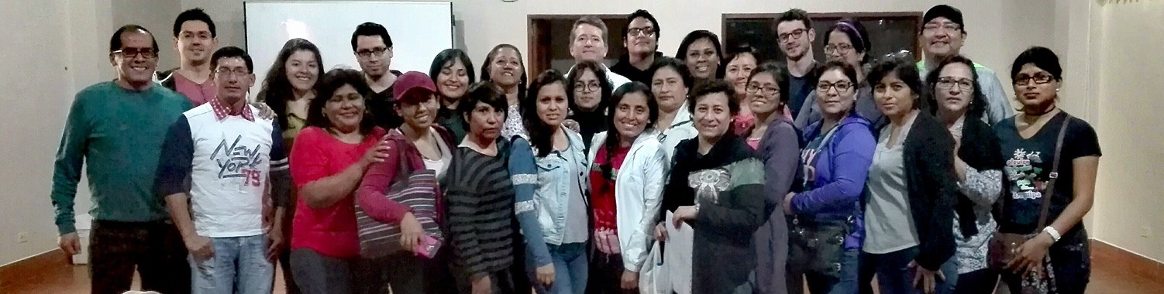

Wellbeing can be measured with a simple QOL measurement tool
TB disease, diagnosis and treatment affects all elements of wellbeing
Do not forget the caregiver!

Slide 30
Clinically significant score
tabstat wellbeing_diff if participant==0 & interest==1, statistics( mean sd p50 p25 p75 count ) by(symptoms_3_FU)
symptoms_3_FU | mean sd p50 p25 p75 N
--------------+------------------------------------------------------------
better | 3.727273 5.28675 4 0 7 869
no change | 1.24 4.594199 1 -2 5 25
worse | -.0952381 5.430513 -1 -3 5 21
--------------+------------------------------------------------------------
Total | 3.571585 5.312557 4 0 7 915
---------------------------------------------------------------------------
Notes:
.
tabstat wellbeing_score if participant==0 & interest==1, statistics( mean sd p50 p25 p75 count ) by(symptoms_3_FU)
Summary for variables: wellbeing_score by categories of: symptoms_3_FU
symptoms_3_FU | mean sd p50 p25 p75 N
--------------+------------------------------------------------------------
better | 14.22958 4.792518 14 11 17 906
no change | 14.35714 5.012682 13.5 11.5 18 28
worse | 11.59091 4.953682 11.5 9 16 22
--------------+------------------------------------------------------------
Total | 14.17259 4.813868 14 11 17 956
---------------------------------------------------------------------------
tabstat wellbeing_score_fu_UPDATE if participant==0 & interest==1, statistics( mean sd p50 p25 p75 count ) by(symptoms_3_FU)
Summary for variables: wellbeing_score_fu_UPDATE by categories of: symptoms_3_FU
symptoms_3_FU | mean sd p50 p25 p75 N
--------------+------------------------------------------------------------
better | 17.9298 4.488685 18 15 21 869
no change | 15.96 4.868949 17 12 18 25
worse | 11.57143 5.491552 11 8 16 21
--------------+------------------------------------------------------------
Total | 17.73005 4.627281 18 15 21 915
---------------------------------------------------------------------------
Patients who felt their symptoms improved (n/N=869/925) had a mean 3.7-point QOL score increase (SD=5.2 95%CI=3.3,4.1), whereas those who felt worse at follow-up (n/N=21/925)_ reported a mean 0.10-point QOL score decrease, (SD=5.4, 95%CI=-0.46,0.26, Appendix table 4).

