Slide 1
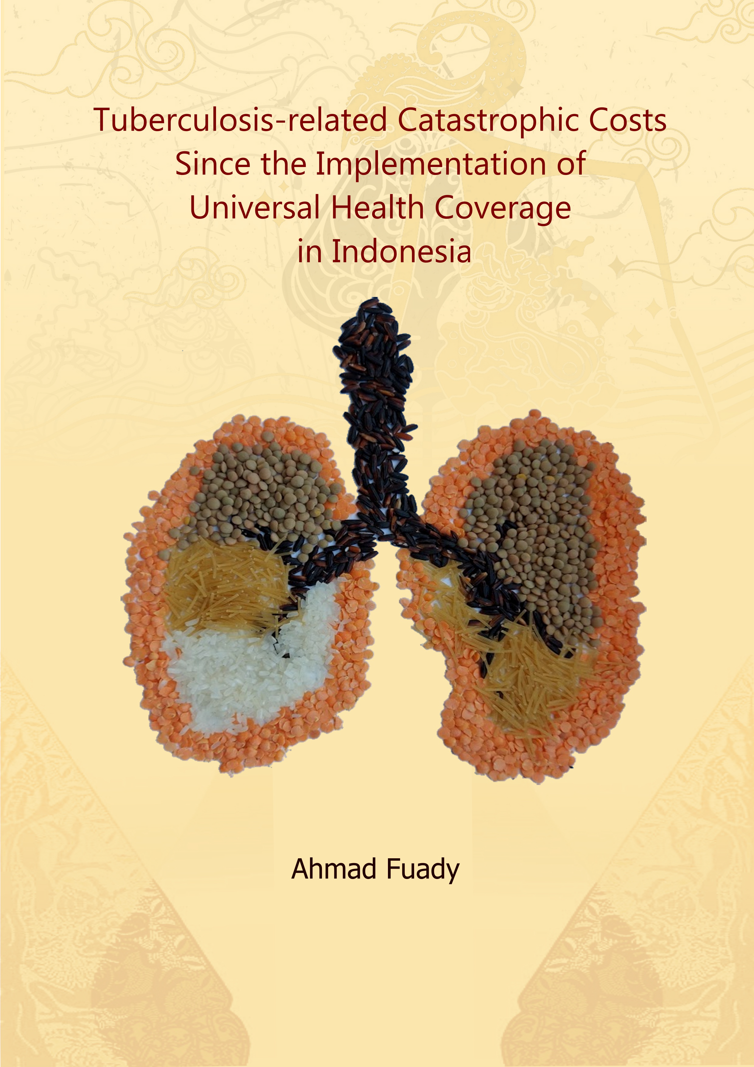
Tuberculosis-related Catastrophic Costs Since the Implementation of Universal Health Coverage in Indonesia
Ahmad Fuady
Department of Public Health, Erasmus MC University Medical Center Rotterdam, the Netherlands
Department of Community Medicine, Universitas Indonesia, Indonesia
Liverpool School of Tropical Medicine
16 September 2021

Slide 2
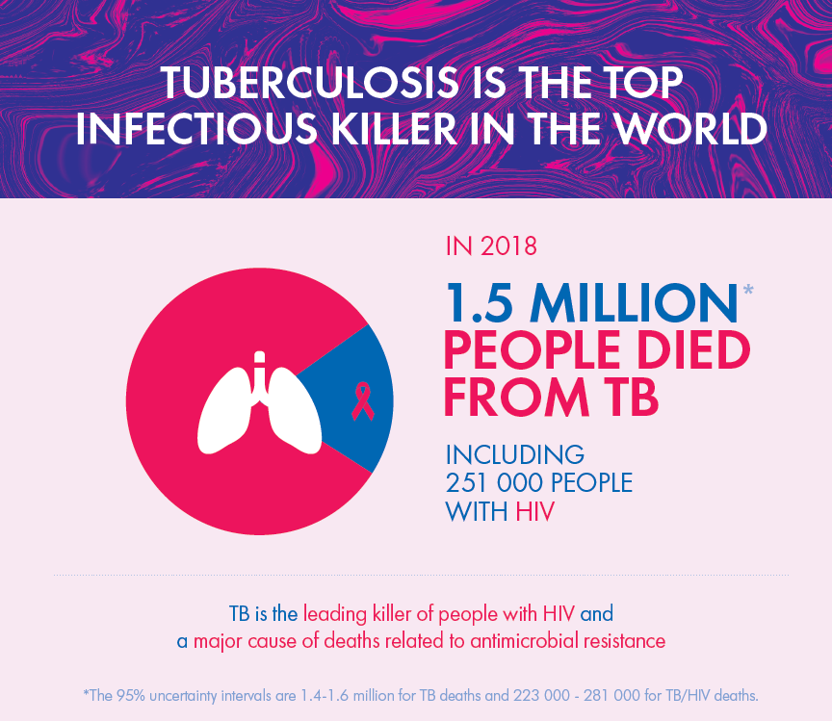
Introduction
Indonesia:
Second rank, 8.5% of TB cases worldwide, +27% (2017-2019)

Slide 3
Introduction
2 months
4 months
Free TB drugs, but other costs :
direct costs: transportation, food, food supplements
indirect costs: income and/or job loss
Notes:
…. is a risk factor for….
Financial hardship: adherence barrier for diagnostic procedures & treatment → poor outcomes, increasing risk of transmission
Economic consequences: job/income loss, diminished financial capacity, (deeper) poverty

Slide 4
End TB Strategy
VISION | A WORLD FREE OF TB – zero death, disease and suffering due to TB
GOAL | END THE GLOBAL TB EPIDEMIC
INDICATORS | 2020 | 2035
Reduction in absolute # of TB deaths (compared with 2015) | 35% | 95%
Reduction in TB incidence rate (compared with 2015) | 20% | 90%
TB affected households experiencing catastrophic costs due to TB (2015 level unknown) | 0% | 0%

Slide 5
2014: new national health insurance scheme (Jaminan Kesehatan National) with a single payer (BPJS Kesehatan).
Private healthcare providers
Public healthcare providers

Slide 6
Fragmented system

Slide 8
Research questions
In the context of national health insurance in Indonesia,
What is the economic impact of TB faced by TB-affected households?
What is the contribution of private health care providers to this economic impact of TB?
Do catastrophic costs affect patients’ TB treatment adherence and treatment outcomes?
What is the potential effect on the incidence of catastrophic costs of further social protection measures beyond UHC?

Slide 9
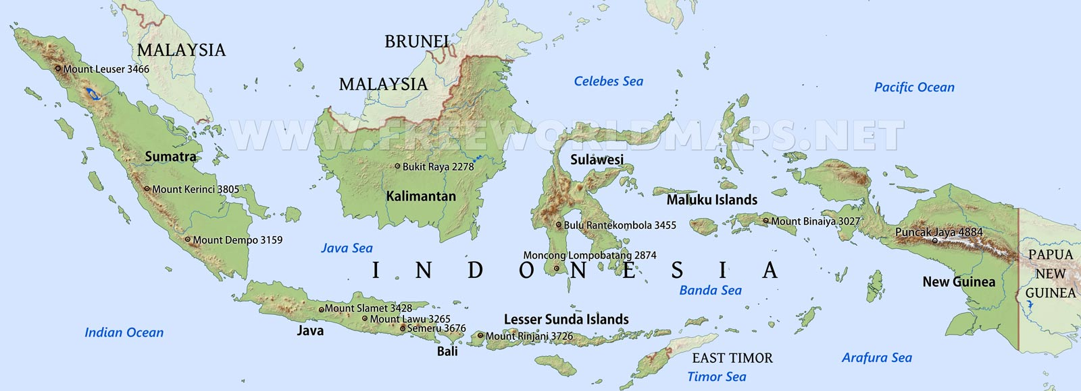
Study Design
Urban: Jakarta
Suburban: Depok
Rural: Tasikmalaya

Slide 10
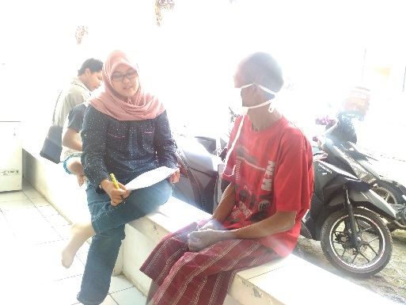
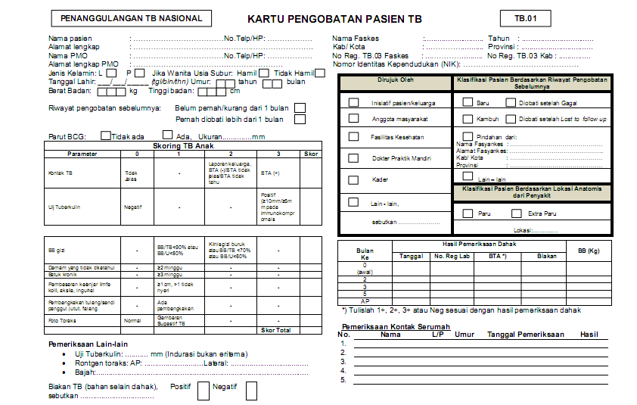
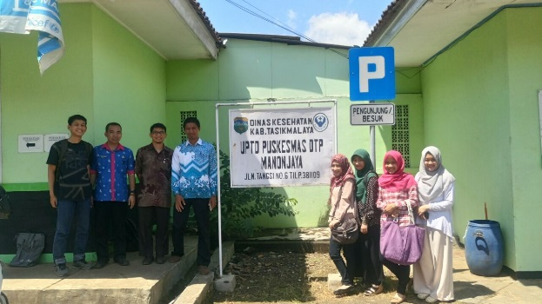
2016
2017

Slide 11
Economic impact of TB
Job loss after diagnosis:
32% in TB and 69% in MDR TB
Borrowing money: 32%, 50%
Selling property: 12%, 28%

Slide 12
High costs during TB treatment; mostly due to income loss

Slide 13
Incidence of
catastrophic costs
36%
83%
TB-affected
households
MDR-TB-affected
households
Fuady et al., 2018
The poor suffered the most

Slide 14
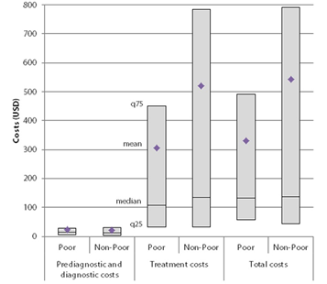
Private providers
First seeking care at private clinics (33%) and private hospitals (7%)
In rural area and low income households
Higher average number of healthcare visits (3.06 vs. 2.18).
Higher costs (USD 32 vs. USD 14).
Fuady et al., 2020
Notes:
Limited number of PHCs
Inconvenient consultation hours
Unawareness of the free TB service
Perceptions of low quality of care

Slide 15
Adherence and outcomes
CATASTROPHIC COSTS
Negative effect on treatment outcomes (aOR 3.86) at the threshold of 30% of annual household income
Non adherence
Failure
Outcomes
Died
Lost to follow up
Adherence
Negative effect on treatment adherence at the threshold of 10% (aOR 2.11) and 15% (aOR 2.06).
Prolonged treatment period
Fuady et al., 2020

Slide 16
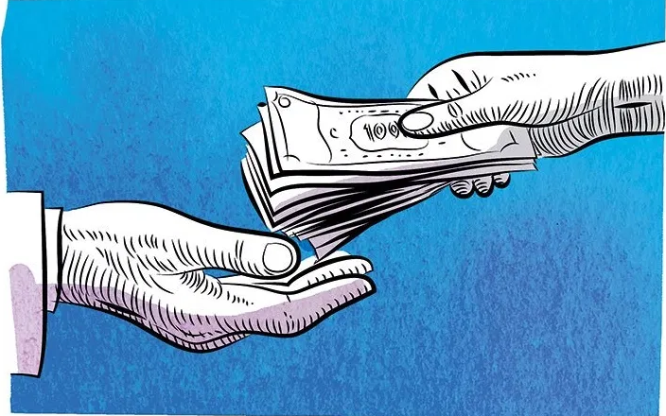
Additional social protection
Baseline:
no cash transfer
Survey for needs assessment
36%
11%
83%
23%
TB
MDR-TB
Three prominent cost items that
still need to be covered:
income loss
transportation costs
food supplement costs
Cash transfers: 8 simulated scenarios
Fuady et al., 2019
Scenario 8:
Cash transfer to cover
income loss, transportation costs,
food supplement costs

Slide 17
Conclusions
Despite the UHC, TB-related financial impact remains high.
Private health care providers contributed to this economic impact of TB, particularly in pre-diagnostic phase.
Integration between the TB control programme and the national health insurance programme.
Catastrophic costs negatively affected patients’ TB treatment adherence and treatment outcomes.
Further social protection measures beyond UHC are needed to reduce the incidence of catastrophic costs.

Slide 18
Tuberculosis-related Catastrophic Costs Since the Implementation of Universal Health Coverage in Indonesia
Ahmad Fuady
Department of Public Health, Erasmus MC University Medical Center Rotterdam, the Netherlands
Department of Community Medicine, Universitas Indonesia, Indonesia

