Slide 1
A career in TB and current landscape of TB care and control
Prof Peter Ormerod
UCLAN and Manchester Uni

Slide 2
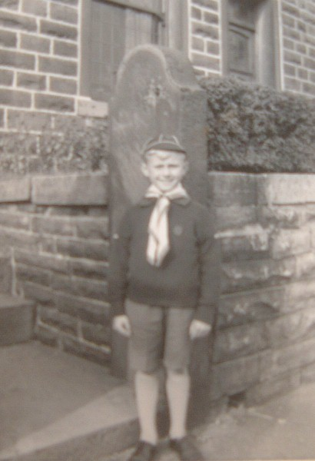

Slide 4
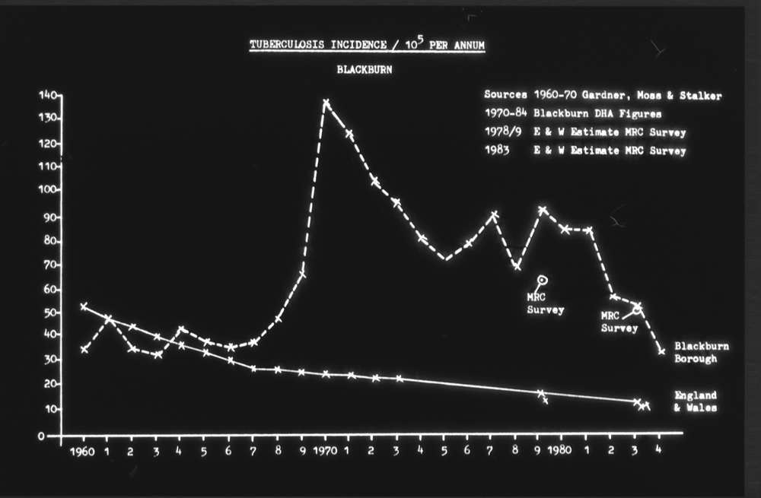

Slide 5
01.01.1981
Short Course chemotherapy
2RHZS/4RH under 50; 2RHZE/4RH over 50
For respiratory disease
Contact Tracing
New entrant screening
LTBI for children
(4 FT TB Nurses + 2 clerks)

Slide 6
LTBI in Children 1981-86
Year ISC Child (N) % ISC Adult (N) %
1978* 14 17 68 83
1979* 29 22.5 99 77.5
1980* 29 24 94 76
37 37 63 63
20 27 53 73
7 11 57 89
4 10.5 34 88.5
6 14.5 35 85.5
2 4 48 96
Ormerod LP Arch Dis Child 1987: 62: 1005-8
Chi2 1978-81 vs 1982-6 10.41 P<0.01:
Chi2 1978-81 vs 1984-6 14.42 P<0.001

Slide 7
Drug Resistance
Senior Bacteriol MLSO had data from 1960!
1500 patients
974 white
538 non-white
Thorax 1986; 41: 946-950
INH resistance 7-11% non-white throughout
White 9.7% 1960-4 to ZERO 1980-4
Cross-infection between communities UNLIKELY

Slide 8
RHZE/S in Clinical Practice
BTS Trial only reported 1984
5 years pulmonary and pleural disease Br J Dis Chest 1987; 81: 268-271
With Newham colleagues Pulm TB Resp Med 1991;85:291-294 and pleural/culture negative TB ; Tubercle and Lung Dis 1995; 76: 25-27
2RHZE/10HR vs 2RHE/10RH for mediastinal glands Br J Dis Chest 1988; 82: 274-281

Slide 9
Contact tracing 1982-90
First JTC (BTS) advice 1983
Respir Med 1993; 87: 127-131
7000 contacts
50 cases detected; 372 children LTBI treatment
All white cases Smear-positive contacts
Only 38% South Asian cases S+ contacts

Slide 10
New entrant screening 1982-8
Resp Med 1990; 84: 269-271
2000 mainly South Asian
Only 11 active cases detected
12.9% children LTBI
30% under 30 Tuberculin negative BCG’d
Half found through POA system
Half found through GP registration
Later 1990-94 data J Infection 1998; 37: 39-40

Slide 11
Compliance (Adherence)
Respir Med 1991; 85: 239-42
1007 cases 1978-87
Compliance strongly associated with relapse
1% in 761 with good compliance
6% in 118 with moderate compliance
50% in 24 with poor compliance
Sex, site of disease, ethnicity NSD
Best over 60 years, worst 15-29

Slide 12
National BTS Lymph node Trial
50% of non-pulmonary disease cervical glands
Trial of short course Rx BTS 1987-90
E2H9R9; Z2H9R9; Z2H6R6
National Trial coordinator
Results during Rx BTS Research Committee Respir Med 1992; 86: 16-19
FU results Campbell IA et al, Respir Med 1993; 87: 621-23

Slide 13
Clinical Series
Gastrointestinal
QJM 1985; 221: 569-78 (n=109)
QJM 2008; 101: 189-95 (n=86)
Bone and Joint
J.Roy Coll.Surg.Edin 1990; 35: 259-62 (n=70)
J Bone Joint Surg 2007; 89-B: 1379-81 (n=79)
Skin – Br J Dermatol 1997; 137: 483-489 (n=47)
Miliary – Respir Med 1995; 89: 555-57 (n=39)

Slide 14
Drug Reactions
1317 Consecutive patients 1978-92.
Tubercle and Lung Disease 1996; 77: 37-42
2.3% under 20 rising to 8% over 60
Females > Males
White > South Asian (mainly age)
2070 consecutive patients 1981-2010
Int J Tuberc Lung Dis 2016; 20(12); 1621-24
Hepatitis approx 3% constant over 30 years
Z (57%) >R (32%) >H (11%)

Slide 15
Outcome Monitoring 1988-2000
Int J Tuberc Lung Dis 2002; 6(8); 662-665
729 cases
205 sputum culture +ve ; 88% cure/completion; 12% death rate. Relapse 1/182 SAT (0.5%); 1/23 DOT (4.3%)
Programme overall 94.3% cure/completion rate;
5.2% death rate; 0.4% Transfer out; 0.6% relapse rate

Slide 16
Joint TB Committee BTS
Joined 1987
Chair 1995-2000; 2011-2015
Involved in production of Guidelines
UK Treatment 1990; 1998
TB/HIV 1992
Control and prevention 1994; 2000
Liver toxicity 2006
Pre TNF 2005
Renal TB 2010

Slide 17
What Could be done to improve Control?
Blackburn rate stuck at 50-60/100000 despite
Consistent 90-95% cure/completion rate
All cases – adult AND children treated by TB team
Contact tracing
NI screening
2.5-3 TB nurses + Clerical Staff BUT
90% South Asian often born abroad
NO active LTBI Rx 16-35 (In line with then guidance)

Slide 18
What is the new entrant active TB rate without intervention?
Choudhury IW, West CR, Ormerod LP
The outcome of a cohort of tuberculin-positive predominantly South Asian new entrants aged 16-34 to the UK: Blackburn 1989-2001. J Public Health 2013;
479 identified; 402 (84%) stayed locally
crude active TB incidence 1297/100000 person years
effectively 1.3% pa
At 10 years 13.5% had developed active TB
At 15 years 16.3% had developed active TB

Slide 20
Intervention with LTBI IGRA screening
Small local cohort 2007/8 showed 25% 16-35 year olds IGRA –positive (QFT)
Health improvement money BwD PCT
2009 onwards (Now Pilot Site for NHSE)
25% approx IGRA positive
90%+ LTBI complete Rx
Approx 2% have early active disease when assessed
Paper with ERJ (Provisionally accepted) 2009-13 cohort matched to Enhanced Surveillance. 83% protective efficacy of 3RH prophylaxis

Slide 21
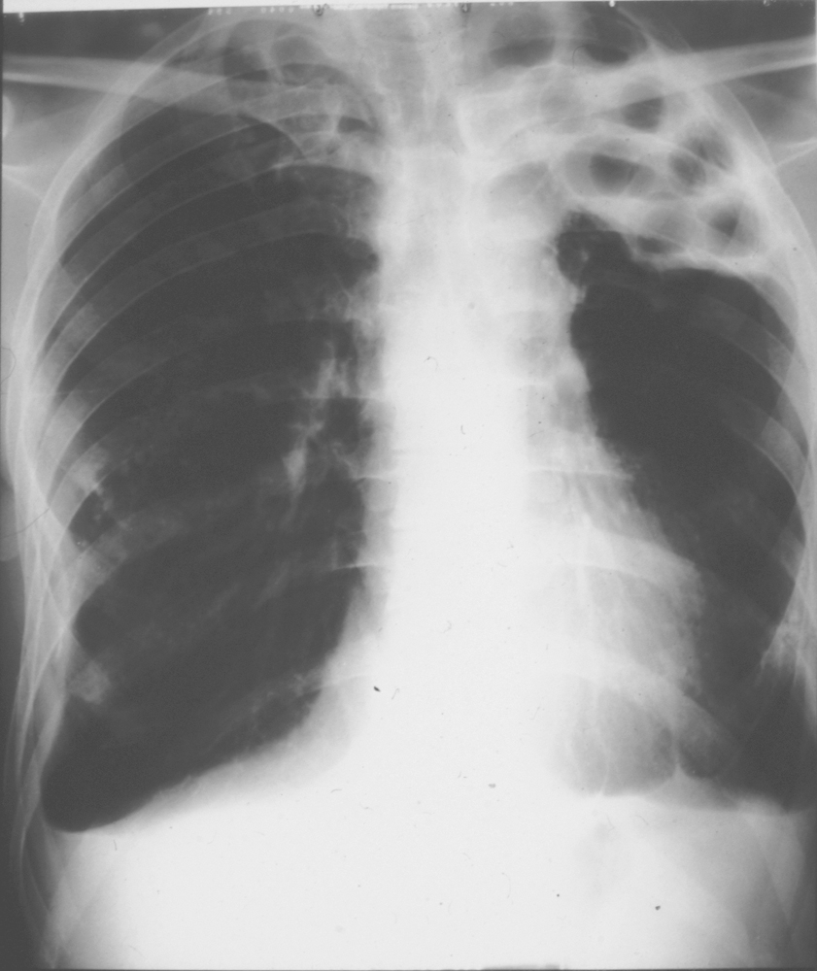

Slide 22
Thoughts on the Future
Third Age of treatment and Second/Third Age of Diagnosis
TREATMENT
First Age SHPAS
Second Age RHZE
Third Age RHZE plus new Drugs

Slide 23
Thoughts (2)
DIAGNOSIS
First Age TST and LJ Slope
Second Age IGRA and Liquid Culture
Third Age – molecular tools
PCR – over-rated need interpretation and knowledge doesn’t replace clinical and epidemiological suspicion (If it looks like TBM TREAT whatever the PCR says)
RFLP ----- MIRU-VNTR ----- WGS

Slide 24
Thoughts (3)
Although TB declining by 10% pa only since 2014
70%+ in those born in high-incidence countries.
Evidence will accumulate on the efficacy of LTBI treatment, and its cost-effectiveness.
NICE has extended age for LTBI treatment to up to 65
Increasing numbers of actual clinical cases have more complex needs (ECM3)
Doctor and Nurse expertise needs to be maintained
As incidence declines temptation may be to reduce funding/staffing (New York 1990 Disaster)

