Slide 1









Feeding LBW & preterm newborns: risks, morbidity & the gut microbiome
Critical issues in LBW infants
Ibadan, March 5th-6th 2018
MRC Confidence in Global Nutrition and Health Research
Improving the survival, growth and development of low birth weight newborns through better nutrition: the Neonatal Nutrition Network project

Slide 2




Biography - Dr Nicholas Embleton
BSc (1984): Environmental Studies & Computer Science
MBBS (1990): Newcastle University
MD (2002): Protein requirements in preterm infants
Consultant Neonatal Paediatrician, Newcastle, UK (2003-)
Chair N3: UK Neonatal Nutrition Network (2014-)
Committee of Nutrition ESPGHAN (2014- )
Newcastle upon Tyne: industrial city developed with ship-building and coal mining in north of England

Slide 3





Research interests: preterm nutrition
ESPGHAN nutrition guidelines – intake recommendations
Large collaborative RCTs (preterm infants)
  Speed of Increases in Feed Trial (SIFT): n=2804
  Enteral lactoferrin in Neonates (ELFIN): n=2204
Mechanistic studies
  MAGPIE: Mechanisms Affecting the Gut in Preterm Infants: n=480
  RCT of Exclusive Human Breast Milk diet (INDIGO): n=18/100
  Gut microbiome and Necrotising Enterocolitis (NEC)
    Stool microbiome, metabolome: biobank
    Immunohistochemistry of gut tissue (NEC)
    Probiotics, supplements, breast milk fortification

Slide 4

Neonatal Intensive Care Unit
Population region: ~3million
3 NICUs, 8 SCBUs
35,000 total births/year
Newcastle NICU – largest
  7,500 inborn (plus 300 transfers)
  Surgery (NEC), congenital etc.
  175 infants <1.5kg / year
  60 infants <1kg / year
Newcastle
London

Slide 5
Nutrition in preterm infants – structure of the talk
Importance of brain growth in early life
Defining ‘growth’ – IUGR, SGA etc.
Typical “nutritional journey” in UK NICU
What are the ‘big’ uncertainties?
Nutritional assessment – how do we do it?
Gut microbiome and relevance to newborn health & disease

Slide 6
Increasing survival of preterm infants
29
28
27
26
25
% survival
24
23 weeks
Year of birth
Newcastle Neonatal Unit – liveborn & admitted

Slide 7
Better nutrition: key to improved survival
Better nutrition
Improved survival
Improved survival: nutritional needs become more important & complex

Slide 8


Brain development is rapid
Brain growth in early life is rapid
Increase in brain size
40 weeks
24 weeks
90% volume
2years

Slide 9


Nutrient requirements are very high
Tour de France
7000Kcal/day
100kcal/kg/day
↑ 20 - 30%
NICU
120-130kcal/kg/day
More than half of all energy expenditure is the brain

Slide 10
Effects of malnutrition on the brain depends on timing, severity and duration
Neuronal development proceeds in sequence
MYELINATION
SYNAPTOGENESIS
APOPTOSIS
NEURONAL MIGRATION
1
2
3
Increase in brain size
24w
2y
Similar principles for other organ systems?

Slide 11


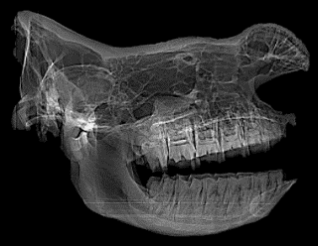

Human evolution has resulted in very large brain

Slide 12




Human brain: 10-20x as large as other mammals
100
Log brain weight
10
Average for mammals
10
100
1000
10000
10⁵
10⁶
Log body weight

Slide 13
Preterm nutritional journeys
Extreme <28 weeks 500-750g
Very 28-32 weeks 1-1.25kg
Moderate 32-36 weeks 1.5-2.5kg
Definitions: different conditions
  SGA <5th centile (?) – can be ‘normal’
  IUGR: evidence of poor fetal growth
  Low birthweight, LBW <2.5kg (some are term born)
  Preterm <37 weeks (most are LBW)

Slide 14
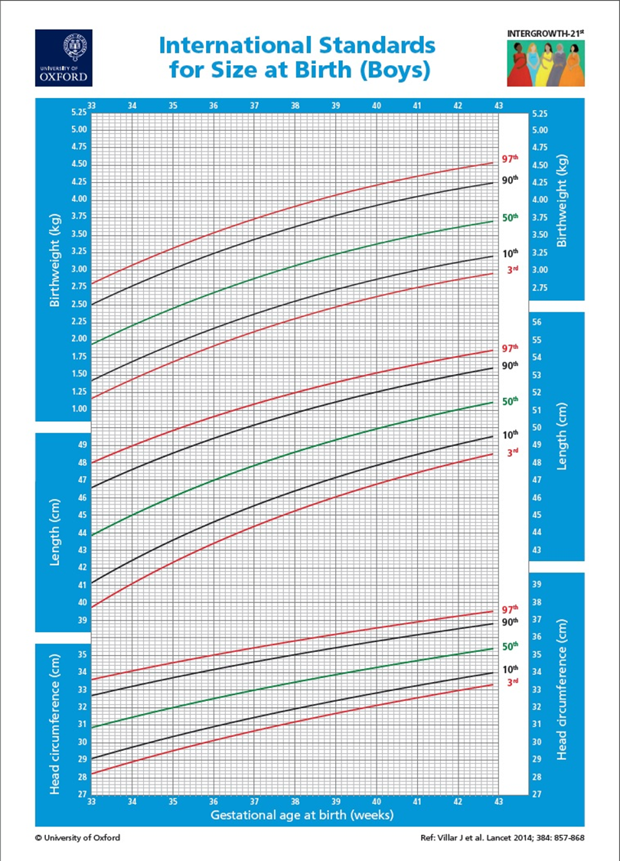
Size is not growth
Weight
Baby weighs 2kg at 36w
Is this normal growth?
We don’t know
3^{c}
Length
Head

Slide 15
Definitions
IUGR – poor fetal growth; usually placental insufficiency; often but not always LBW
SGA – will include IUGR and non-IUGR
AGA – will include IUGR and non-IUGR
LBW – will include IUGR and non-IUGR
3
LBW <2.5kg
2
SGA <10^{c}?
SGA <5^{c}?
1
24
28
32
36
40

Slide 16
Definitions
IUGR is difficult to diagnose without antenatal ultrasound
Most babies have weight << length or head
3
LBW <2.5kg
Baby 1: IUGR 2kg at 36w
2
SGA <10^{c}?
SGA <5^{c}?
1
24
28
32
36
40

Slide 17
Definitions
SGA - Some normally grown small babies
3
LBW <2.5kg
Baby 1: IUGR 2kg at 36w
2
Baby 2: not IUGR 2kg at 36w
1
24
28
32
36
40

Slide 18
Definitions
Preterm: often lose weight over first 10-14 days
May exhibit ‘catch up’
All 3 babies weigh 2kg but all have different nutritional needs
3
LBW <2.5kg
Baby 1: IUGR 2kg at 36w
2
Baby 2: not IUGR 2kg at 36w
Baby 3: preterm 2kg at 36w
AGA at birth
SGA at discharge
1
24
28
32
36
40

Slide 19
Definitions – do they matter?
Nutrient needs reflect developmental stage
But actual amount based on weight that day
IUGR infants
  ↑ long-term metabolic risk if rapid catch up
Preterm infants may need more nutrients /kg
SGA infants may be normal
However, breastmilk always best regardless of whether IUGR, SGA or preterm.

Slide 20


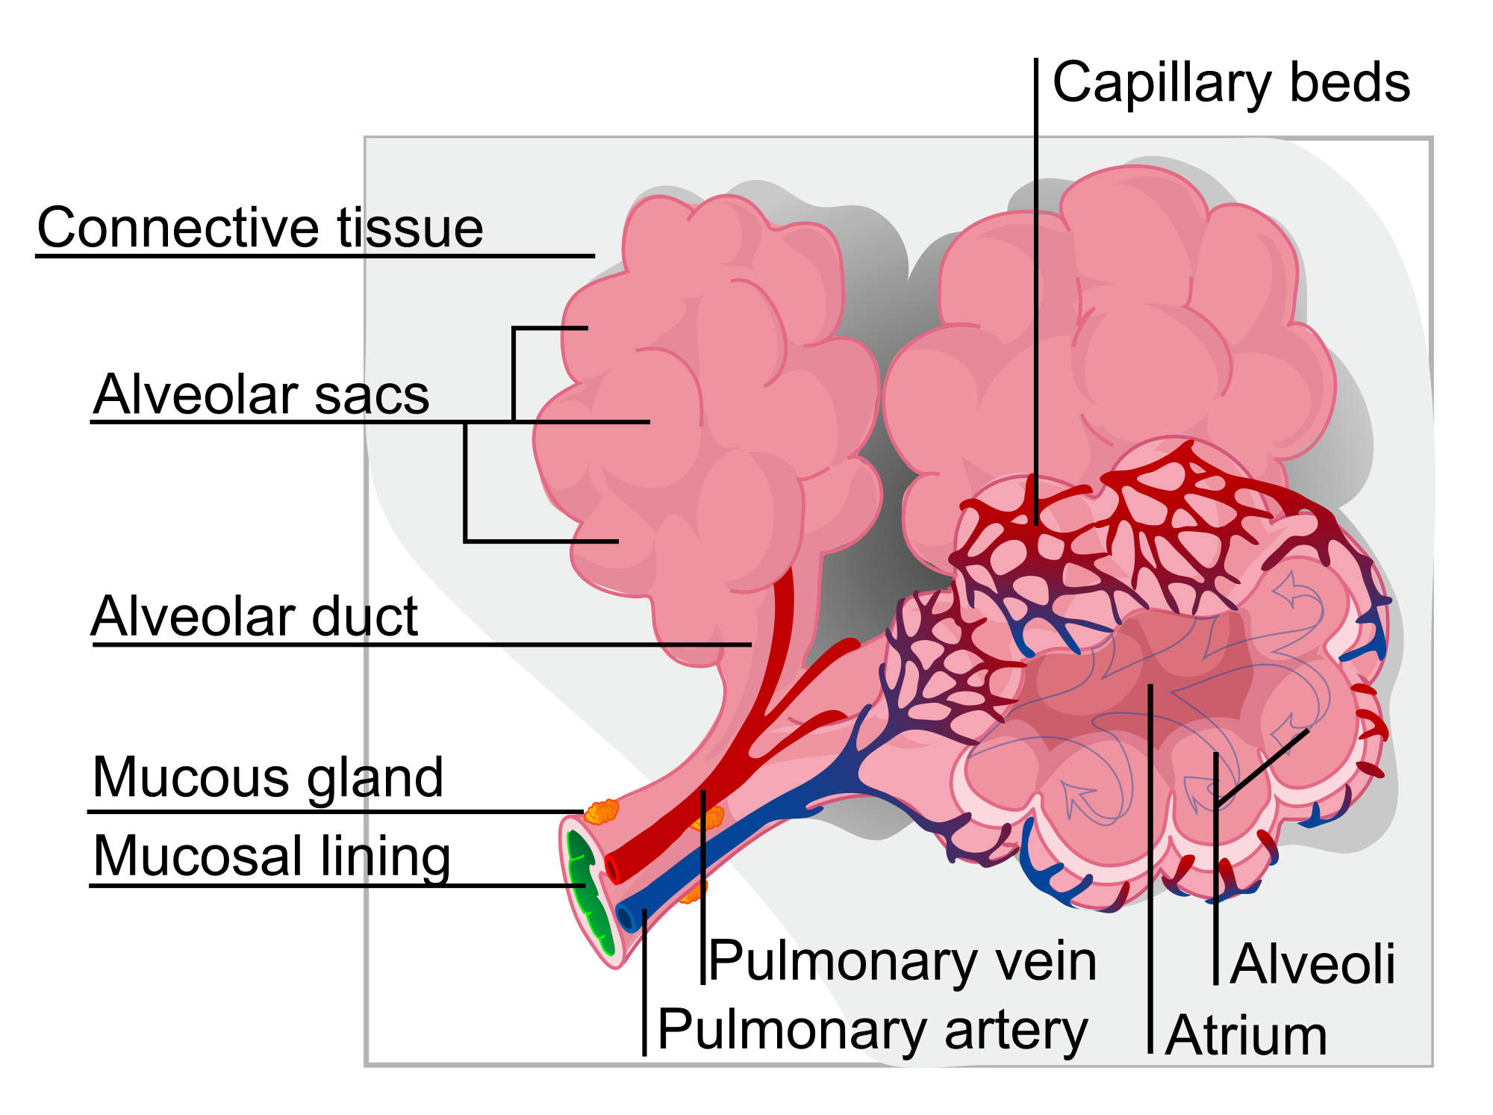
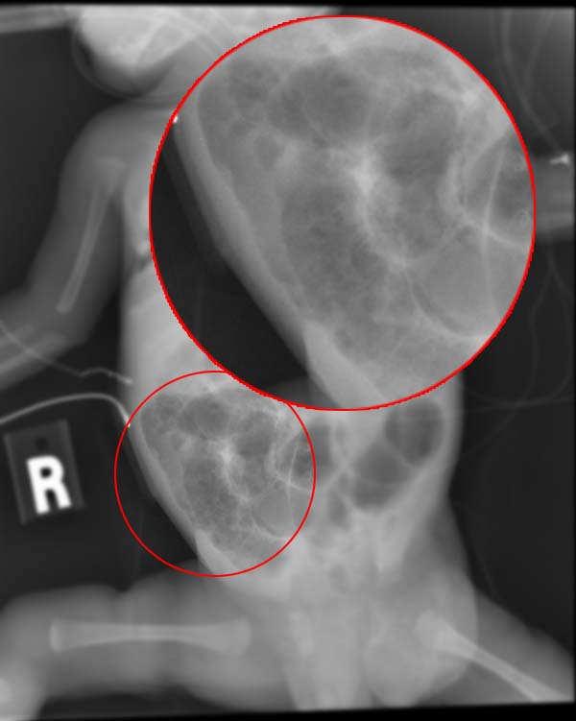
Nutrition - what are we trying to achieve?
Metabolic
Optimise short and long term health
Brain and metabolic outcomes
Minimise risk of
  Late onset sepsis (LOS)
  Necrotising enterocolitis (NEC)
Growth is a marker of health
Weight is a marker of growth
...but weight is not a functional outcome
Brain
Lung

Slide 21
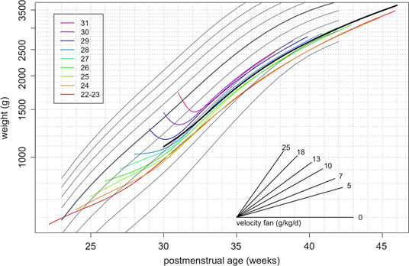
Weight gain is not growth: but it is still important
~50^{c}
Most are born close to 50^{c}
3-10^{c}
Recent UK data: weight loss over first weeks followed by growth at ~16g/kg/day

Slide 22
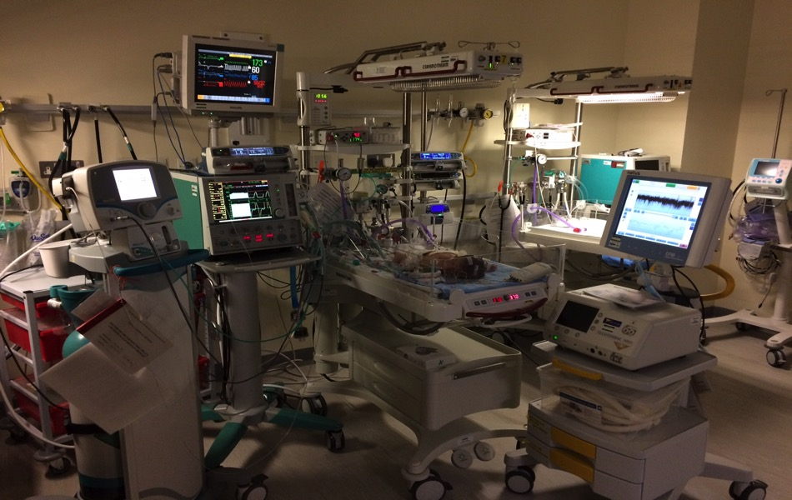
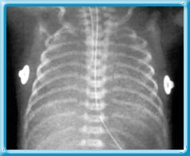
NICU care - focus on what we can see and measure: but malnutrition is “invisible”
There is no “nutrition” monitor

Slide 23
What do we know?
Mother’s own milk (MOM) is the most effective intervention for every outcome!
  Brain, metabolic, sepsis, NEC etc.
Babies with better early growth have better outcomes (may be reverse causation)
Early PN: safe and effective but limited evidence of long-term benefit
NEC & sepsis are very bad for the brain

Slide 24
Examples of nutritional journies
Examples from Newcastle practice
Not recommendations!
  Average Average
Extreme <28 weeks 500-750g
Very 28-32 weeks 1-1.25kg
Moderate 32-36 weeks 1.5-2.5kg

Slide 25
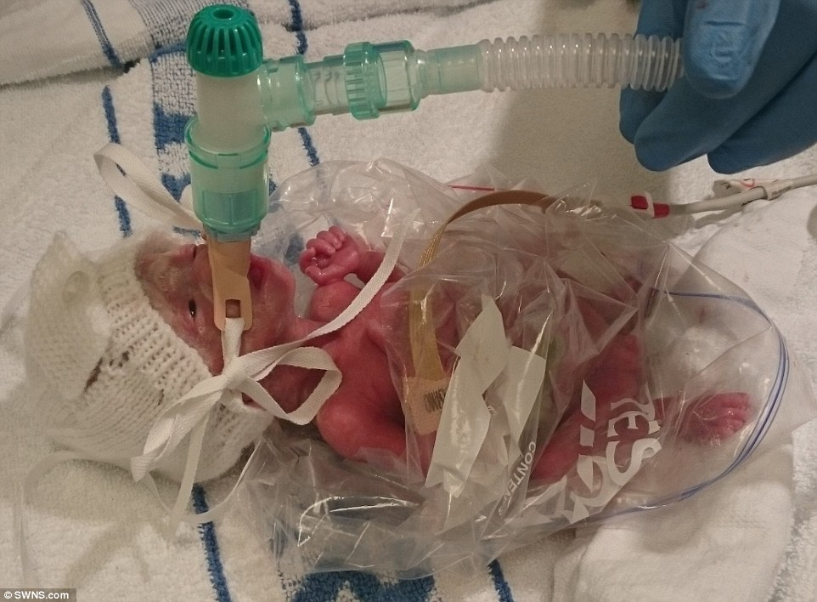
Extreme preterm: typical scenario
50% ‘spontaneous’ / 50% pregnancy issue
  Pre-eclampsia, IUGR, maternal complications
“Golden hour”
  Intubated + surfactant (occasionally CPAP <750g)
  UAC/UVC (usually)
  Keep warm (plastic wrap); Update parents
  …stop fiddling!

Slide 26
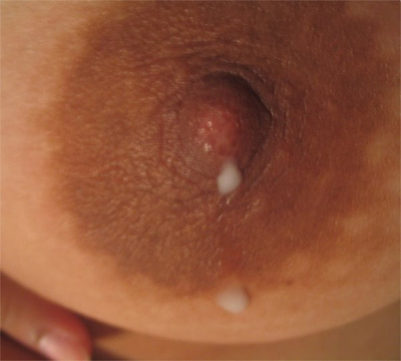
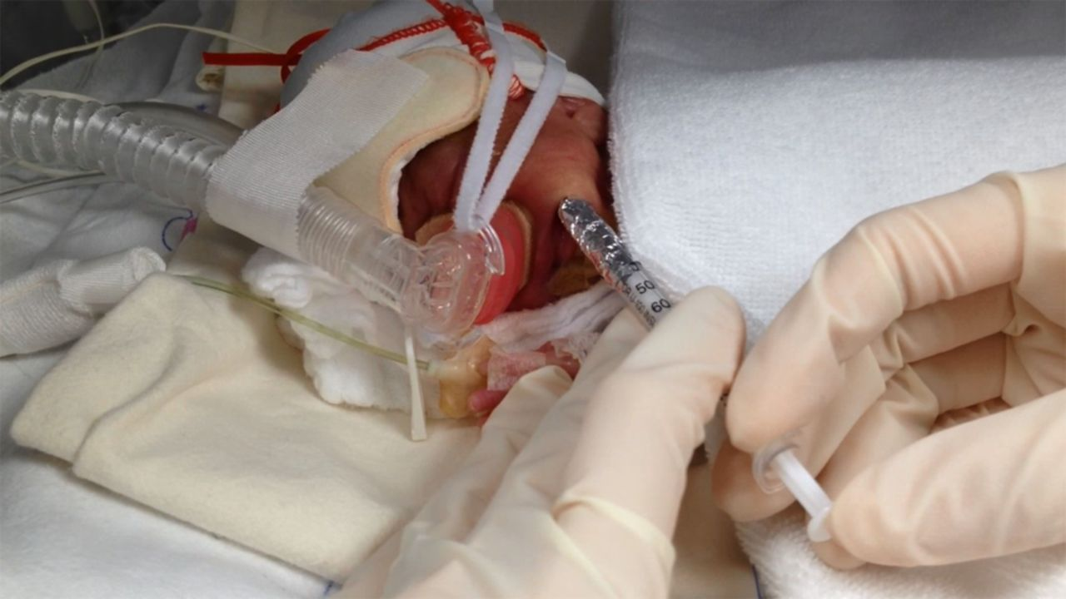
Extreme preterm: nutrition day 0
Immediate parenteral nutrition (PN) 100ml/kg
Amino acids ~2g/kg/day (protein equivalent)
Intravenous lipid ~1g/kg/day
[Glucose] 6-8hrly; [Na] at 24 hours age
Buccal colostrum
  All babies immediately
  As soon as available (nurses & mothers)
  Even if inotropes, 100% oxygen etc

Slide 27
Extreme preterm: days 1-3
Increase fluid 100-125-150 (if stable)
Daily electrolytes
Increase PN to 3-3.5g/kg protein; 3g/kg lipid
Buccal colostrum
Mother’s milk (MOM) via OG tube if >0.5mL
Day 2-3 before enough MOM to increase
Increase milk 24ml/kg/day (continuous NG)

Slide 28
Extreme preterm: days 4-10
Start probiotics when milk ‘tolerated’
Wean PN intakes as increase milk (ml for ml)
Increase milk: 175ml/kg/day MOM (‘full feeds’)
  breastmilk fortifier (BMF)
  vitamins (extra 400iU Vit D)
  iron (2mg/kg/day) at 3-4 weeks (if no recent Tx)
  Preterm formula if MOM shortfall

Slide 29
Very preterm 28-32 weeks
<30% are ventilated and get UAC
Half get UVC, replaced with PICC*
All get PN - same fluids/amounts as extreme
We use peripheral PN (i.e. no PICC)
Same for buccal colostrum
Feed increases faster ~30ml/kg/day
BMF, iron, vitamins: same
*PICC – peripheral inserted central catheter

Slide 30
Late & Moderate preterm (LMPT)
32-33w: i.v. dextrose (no PN) on SCBU
34-36w: transitional or postnatal care
NG tube feeding; rarely BMF
Often forget iron and vitamins!
Breastfeeding rates <50% at discharge
Do not receive any hospital follow up
Important group who are often ‘forgotten’

Slide 31
What are the ‘big’ questions?
Should we use probiotics? If so which ones?
  Cochrane MA is persuasive
Donor milk? Does it really reduce NEC?
  Expensive; trials too small
Will ‘supplements’ e.g. lactoferrin reduce sepsis
  ELFIN trial (N=2200) available in May 2018!
  Other supplements (DHA, choline, iodine etc.)
What is the optimal speed of weight gain?
  Rapid catch up, Barker hypothesis etc.

Slide 32
Nutrition is more than nutrients
Infection control is really important
Minimal ‘handling’ but encourage kangaroo
Developmental care – positioning etc.
SOUND & LIGHT
EMPOWER parents and nurses
Complex functional outcomes

Slide 33
Assessing growth
Growth is not the most important outcome
But it is a useful marker of nutritional status
Need to use a growth chart
  Multiple charts: national, WHO, INTERGROWTH21
  Need to use correct technique (length, head, weight)
  Need to plot correctly
  Need to repeat over time

Slide 34


https://intergrowth21.tghn.org/
Standardised measurements – watch training videos
Carvalho M, et al., for the International Fetal and Newborn Growth Consortium for the 21st Century (INTERGROWTH-21st). Implementation of the INTERGROWTH-21st Project in Kenya. BJOG 2013; 120 (Suppl. 2): 105–110.

Slide 35


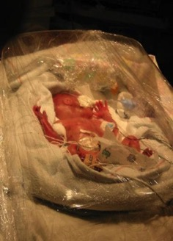

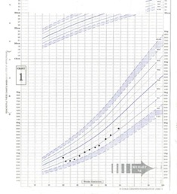
No easy method to determine “nutritional status” in a baby: composite measure
Smith
Baby Boy
301193
Nutritional status
Please
Preterm
26 weeks

Slide 36
Nutritional assessment: Auxology, Bloods, Clinical, Diet, Evaluation (ABCDE)
Auxology – weight, head, length + growth chart
Body composition - weight & length in proportion
Biochemistry/Bloods - Na⁺, Hb, PO⁴⁻ etc.
Clinical – NEC, stoma, energy demands etc.
Diet – actual intakes over 24 hours, supplements etc.
Evaluation
  What is happening and why?
  Are intakes optimised?
  Holistic approach: are you supporting MOM?
  Etc.

Slide 37
Breastmilk and microbes

Slide 38
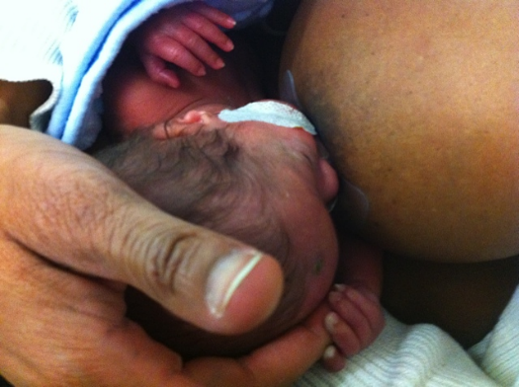
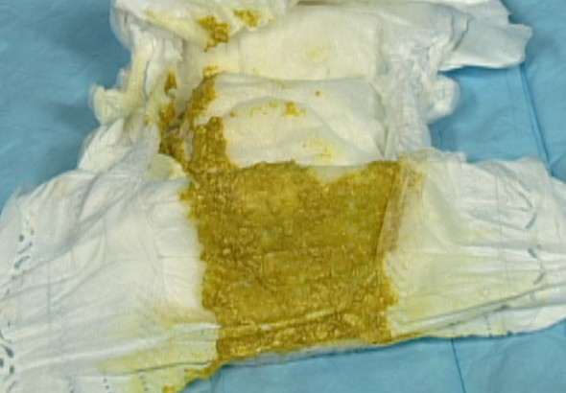
Is breast milk just ‘food’? Drink → absorb nutrients → make stool?
Fluid
Nutrients
Food
Waste
“traditional view”

Slide 39
Breast milk is more than food
Fluid
Nutrients
Metabolites
Immune
Hormones
Microbes
Mechanisms and outcomes differ between breast and formula fed

Slide 40
Gut microbiome
Rapidly expanding area of research
New & complex technologies (DNA sequencing)
Thousands of publications!
Of major relevance to:
  Interventions: probiotics, milks, supplements
  Diseases: NEC & sepsis
  Long-term health: breast feeding, obesity etc.

Slide 41

Gastro-intestinal tract full of microbes
80% antibody producing cells located in the gut
Gut = most important part of the immune system
More microbial than human cells (1.5x)
Many more microbial genes than human genes (100x)
Human development impossible without these microbes and genes

Slide 42
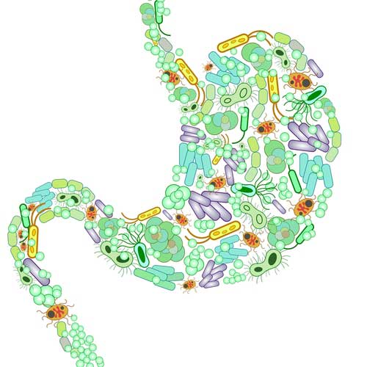

Gut microbiome
Trillions & trillions of bacteria
Thousands of different species
Species are grouped into ‘taxa’
  Firmicutes, Bacteroidetes etc.
Patterns change over life-course
Early life – Bifidobacteria dominate
Consider as a “community”
Health or disease relate to “patterns” and not presence/absence of a single species

Slide 43
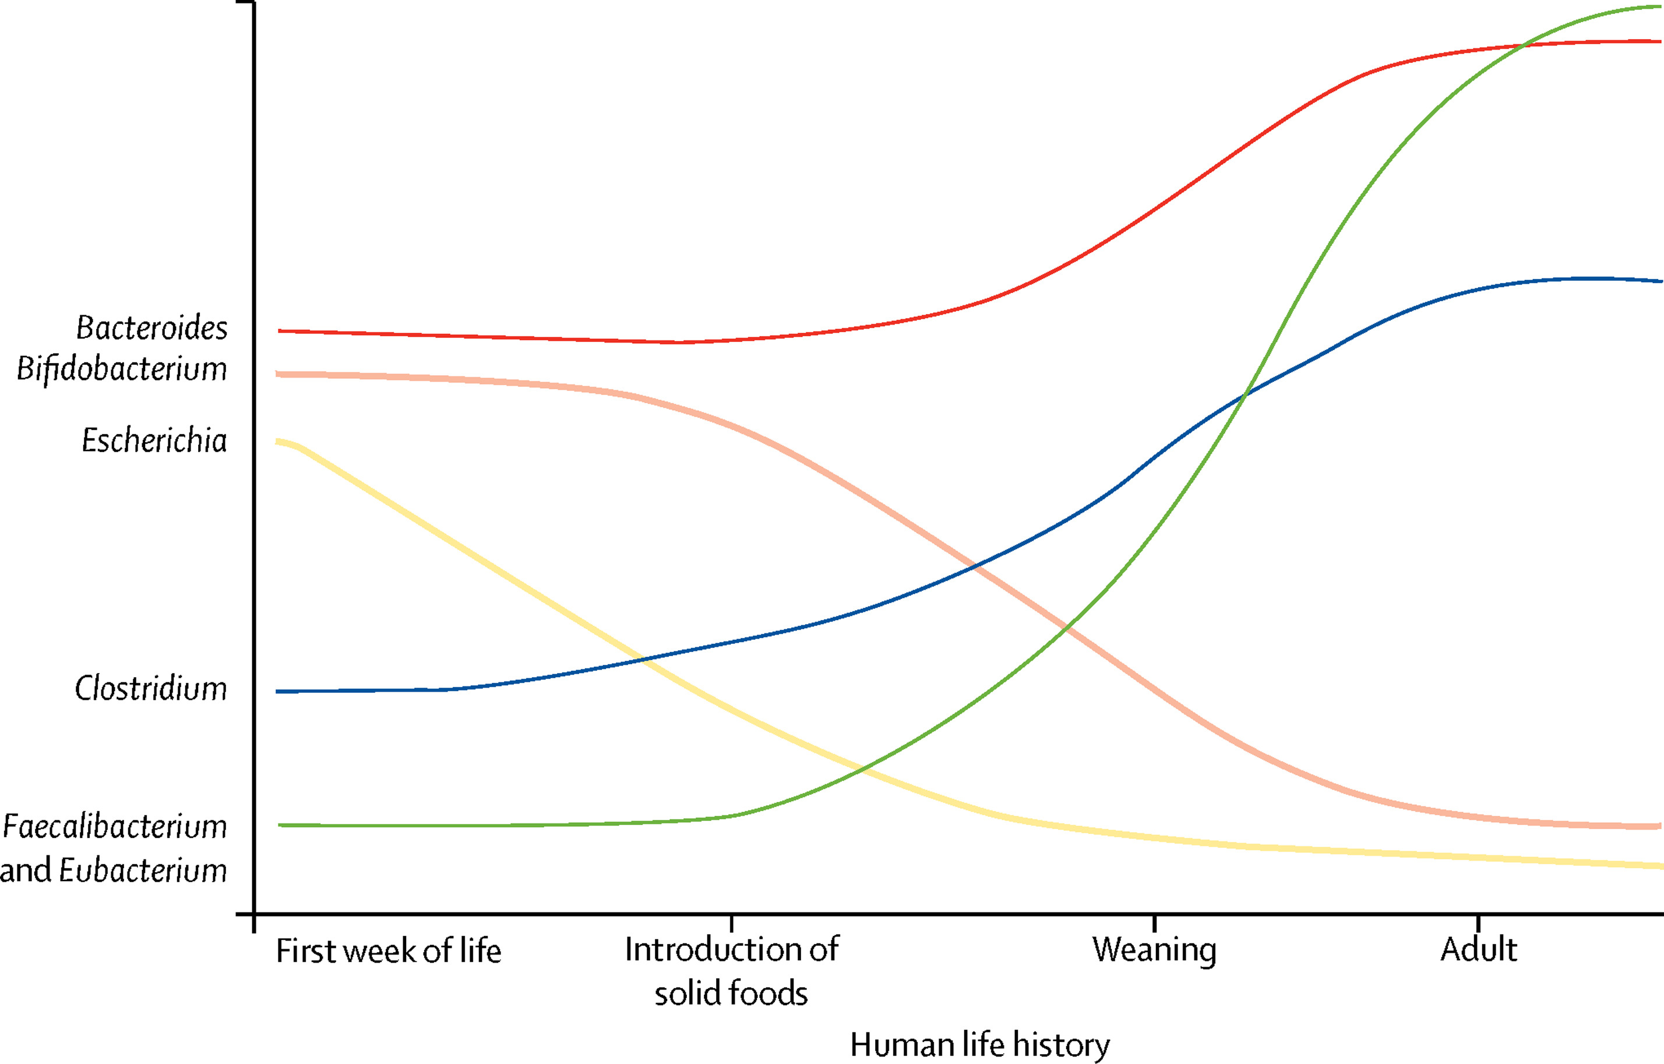
Human life-course: baby to adult
Bacteroides
Faecalibacterium & Eubacterium
Clostridia
Bifidobacteria
E coli
Rook et al. 2017
Week 1
Solid food
Weaning
Adult

Slide 44
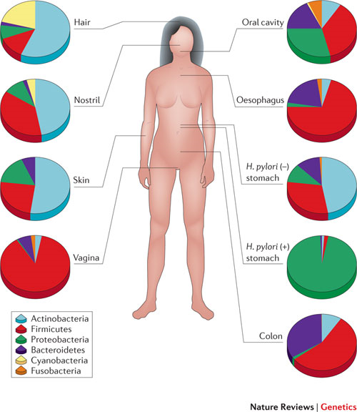
Body site: different microbiota
Hair
Oral
Firmicutes
Staphylococcus
Lactobacilli
Clostridia
Nose
Oesophagus
Skin
Actinobacteria
Bifidobacteria
Stomach
Proteobacteria
E coli
Vagina
Bacteroidetes
Bacteroides
Prevotella
Colon

Slide 45

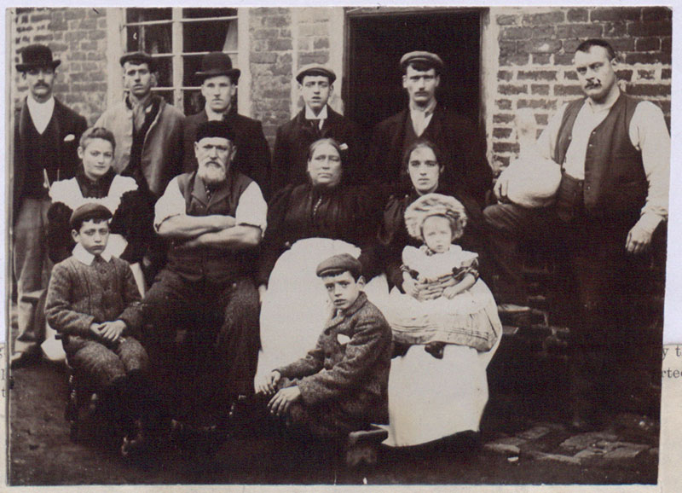
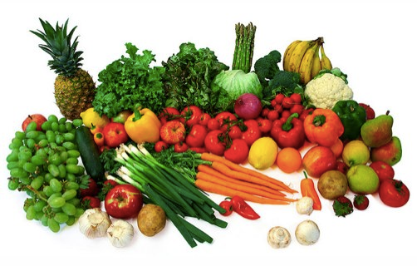
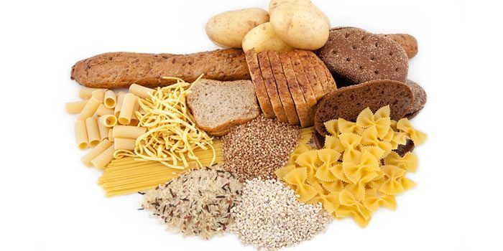


Microbiota – vary with geography, history, diet, age …..

Slide 46
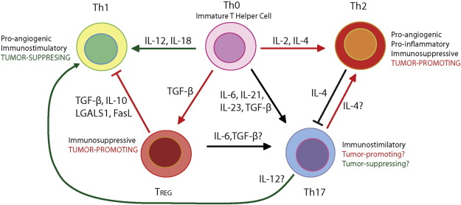
Anti-infective & immune aspects: what happens in the gut?
Intestinal lumen
Dendritic cells
Gut mucosa & epithelium
Lamina propria
Gut immune system
T cells
Systemic immune system

Slide 47
What is going on in the gut lumen?
Gut microbial communities
Nutrients

Slide 48
Microbes produce a range of important nutrients
Short chain fatty acids
e.g. butyrate
Amino acids
Gut microbial metabolism
Bile acids
Phenols
Vitamin B, K
Choline

Slide 49
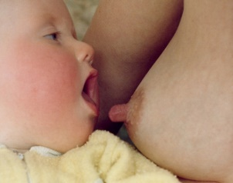

Nutrients promote certain patterns of microbes
Amino acids
Urea
Lactoferrin
Gut microbial ecology
HMOs
Human milk oligosacharides
Fatty acids
Carbohydrates

Slide 50
Disease patterns
Community patterns change
  A few days before NEC onset
  Some cases of sepsis
  Following antibiotics, probiotics, iron, milks etc.
Community patters are different
  C-section v vaginal until at least 12 months of age
  Obese v lean individuals
Suggest that gut microbiome is very important aspect of nutrition in early life

Slide 51
Summary
Good nutrition: vital for all LBW and preterm We can all improve if we pay closer attention
Nutrition has short- & long-term impacts
Nutritional assessment – ABCDE
Gut microbiome modulation of major interest
Mother’s own Milk (MOM) is most important intervention

Slide 52
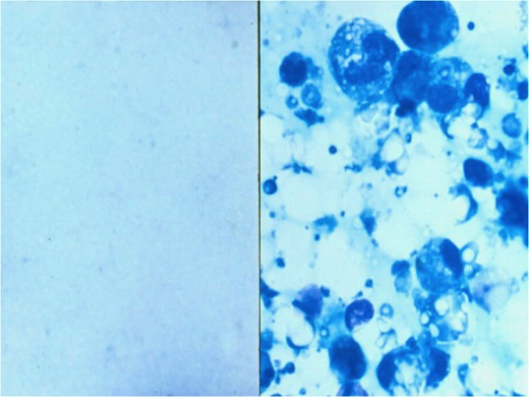
Nutritional Quality v Nutrient Quantity
Amino acids
Formula milk
Breast milk
1 gram of ‘protein’

Slide 53
Nutritional Quality v Nutrient Quantity
Amino acids
Formula milk
Breast milk
Level of functional proteins, peptides, growth factors

Slide 54
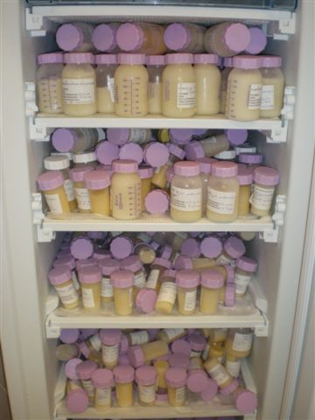

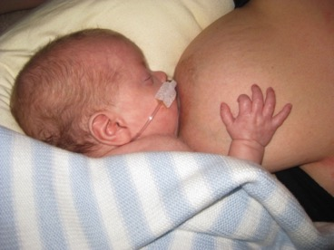
Breast milk – most important & cost-effective intervention in neonatal nutrition
Thank you!

