Slide 1







Critical issues in LBW infants
Ibadan, March 5th-6th 2018
MRC Confidence in Global Nutrition and Health Research
Improving the survival, growth and development of low birth weight newborns through better nutrition: the Neonatal Nutrition Network project

Slide 2

Overview
Aims of the MRC Confidence in Global Nutrition and Health Research award
What are the key issues in global neonatal health?
  Survival
  Survival without disability
  Prevention of long-term adverse effects
Aims of the workshop
Neonatal Nutrition Network project – what’s the plan?

Slide 3

Global Challenges Research Fund (GCRF)
Confidence in Global Nutrition and Health Research
Institutional "pump-priming" awards to develop new opportunities in Global Nutrition and Health Research
2018
The purpose of this call is to provide institutional “pump-priming” funds to lay the grounds for future large scale, multidisciplinary, cross-country global nutrition and health research bids addressing issues of primary relevance to LMICs.
https://www.mrc.ac.uk/funding/browse/confidence-in-global-nutrition-and-health-research/confidence-in-global-nutrition-and-health-research-institutional-pump-priming-awards/

Slide 4
Proposals must focus on issues primarily relevant to LMICs and aim to achieve one or more of the following goals:
Develop new research strategies to tackle nutrition and health challenges that are relevant to LMICs in the short, medium and long-term;
Develop new UK-LMIC research partnerships or capitalise on existing ones;
Identify opportunities and assess feasibility of large-scale global nutrition and health research projects in partnership with LMICs;
Extend scope of existing research to LMIC settings;
Apply novel / potentially high-risk approaches to nutrition research, with opportunities for multidisciplinary approaches;
Produce preliminary data and develop concepts for future grant applications;
Create pathways to impact in LMICs.

Slide 5

http://www.un.org/sustainabledevelopment/sustainable-development-goals/

Slide 6


SDGs specific to child health
Goal 3: Ensure healthy lives and promote well-being for all at all ages
By 2030, end preventable deaths of newborns and children under 5 years of age, with all countries aiming to reduce
  neonatal mortality to at least as low as 12 per 1,000 live births
  under-5 mortality to at least as low as 25 per 1,000 live births
Goal 2: End hunger, achieve food security and improved nutrition and promote sustainable agriculture
By 2030, end all forms of malnutrition, including achieving, by 2025, the internationally agreed targets on stunting* and wasting** in children under 5 years of age:
*Reduce the number of stunted under 5s by 40% by 2025
**Reduce and maintain childhood wasting to less than 5%
Notes:
UK rates 2014: deaths per 1000 live births
Neonatal 3
Infant 4
Under 5 14

Slide 7
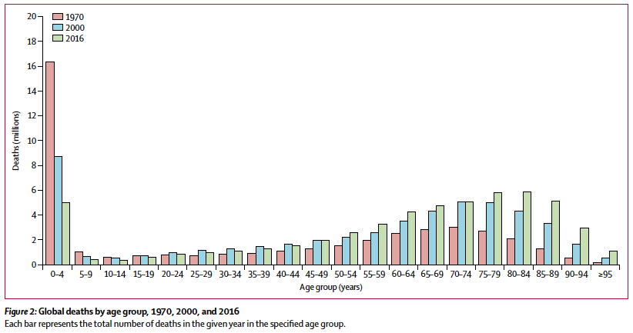
Global, regional, and national under-5 mortality, adult mortality, age-specific mortality, and life expectancy, 1970–2016: a systematic analysis for the Global Burden of Disease Study 2016. Lancet 2017; 390: 1084–1150.

Slide 8
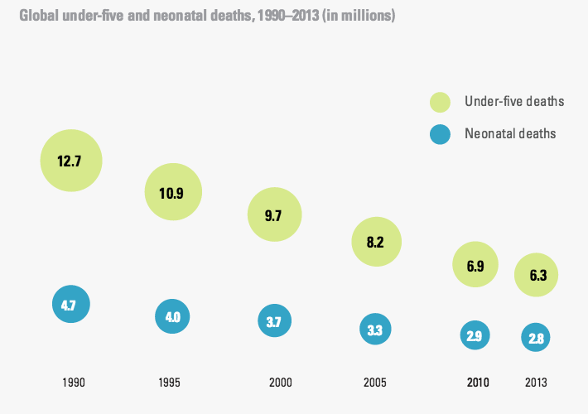
population
Source: UNICEF: Committing to Child Survival: A Promise Renewed; Progress Report 2014

Slide 9
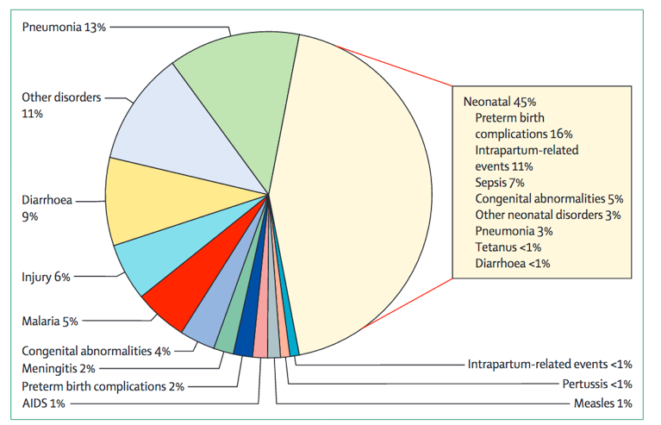
Global causes of under 5 deaths in 2015
Black et al. Reproductive, maternal, newborn, and child health: key messages from
Disease Control Priorities 3rd Edition. Lancet 2016; 388: 2811–24
Notes:
These are specific causes of death – only one way of looking at the data.
Also useful to consider what the risk factors for these diseases are – better insights into what interventions would prevent these deaths – e.g. malnutrition

Slide 10
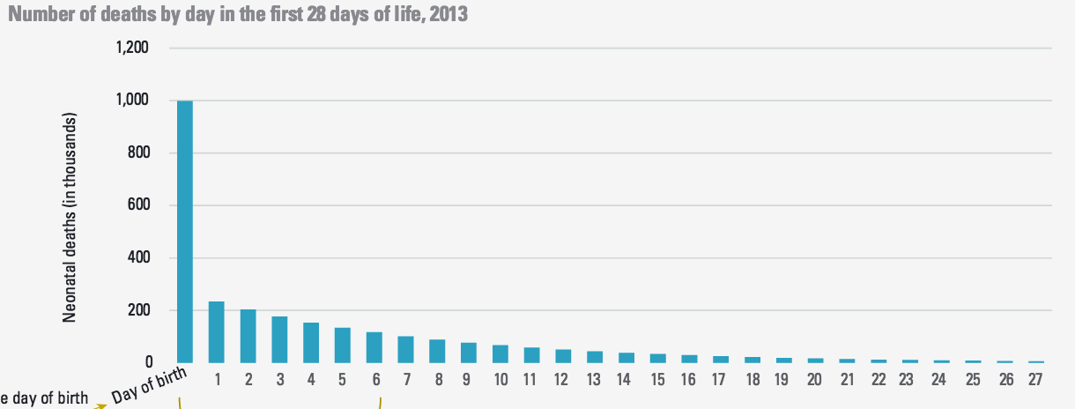
36% newborn deaths occur on the first day of life
First day of life: 1m deaths; 16% under 5 deaths
First week of life: 73% neonatal deaths; 32% under 5 deaths
Source: UNICEF: Committing to Child Survival: A Promise Renewed; Progress Report 2014

Slide 11
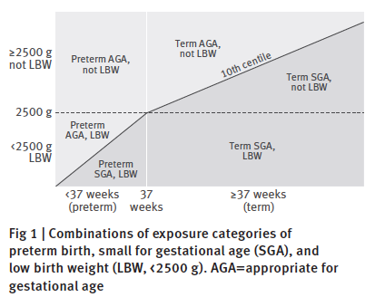
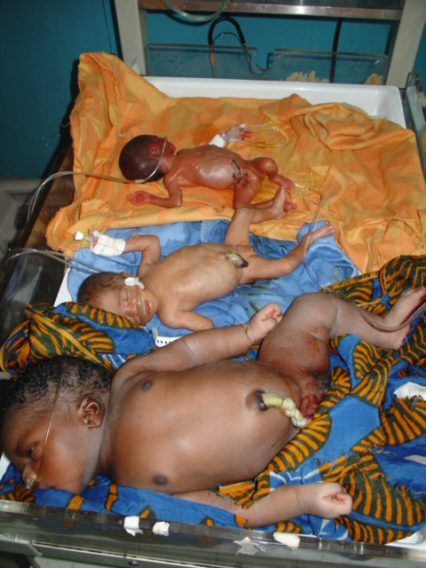
Lee et al 2017. Estimates of burden and consequences of infants born small for gestational age in low and middle income countries with INTERGROWTH- 21st standard: analysis of CHERG datasets. BMJ 2017;358:j3677
Notes:
We know that 80% deaths occur in LBW infants

Slide 12
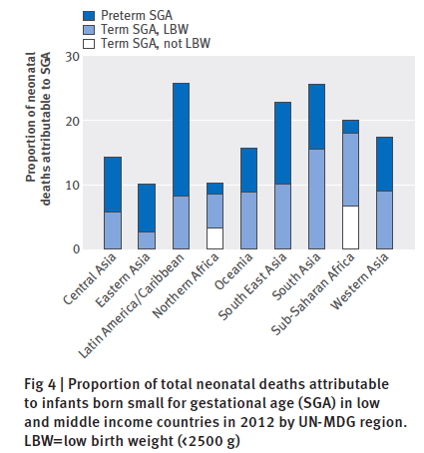
Lee et al 2017. Estimates of burden and consequences of infants born small for gestational age in low and middle income countries with INTERGROWTH- 21st standard: analysis of CHERG datasets. BMJ 2017;358:j3677

Slide 13
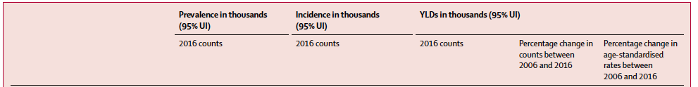
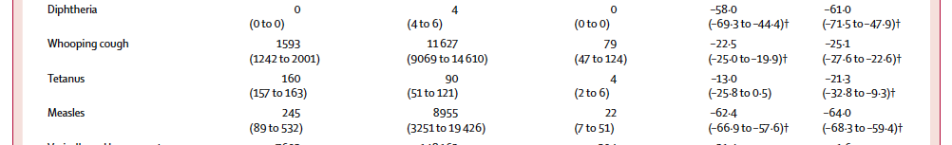
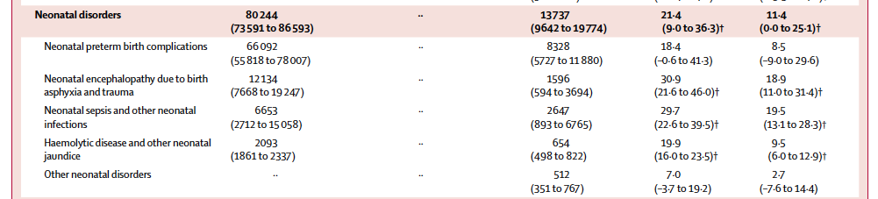
Years Life Lost due to Disability (YLD)
Preterm birth complications had the largest increase in age-standardised YLD rates: 8·5%.
Notes:
The mean percentage change in the number of YLDs reflects the combined effects of population growth, population ageing, and epidemiological change.
The mean percent change in age-standardised YLD rates reflects epidemiological change that is not due to ageing or population growth.
Overall, death rates for specific causes decreased but absolute number of YLDs from non-communicable diseases increased rapidly and across all SDI (Sociodemographic index) quintiles, partly because of population growth, but also the ageing of populations (max age range affected 40-69 years).
I.E much greater success in reducing fatal conditions than non-fatal, chronic conditions.
Effects of the epidemiological transition increases importance of non-fatal health outcomes requiring chronic care as populations age.

Slide 14
Years Life Lost due to Disability (YLD)
All positive
Preterm birth complications had the largest increase in age-standardised YLD rates: 8·5%.
Notes:
The mean percentage change in the number of YLDs reflects the combined effects of population growth, population ageing, and epidemiological change.
The mean percent change in age-standardised YLD rates reflects epidemiological change that is not due to ageing or population growth.
Overall, death rates for specific causes decreased but absolute number of YLDs from non-communicable diseases increased rapidly and across all SDI (Sociodemographic index) quintiles, partly because of population growth, but also the ageing of populations (max age range affected 40-69 years).
I.E much greater success in reducing fatal conditions than non-fatal, chronic conditions.
Effects of the epidemiological transition increases importance of non-fatal health outcomes requiring chronic care as populations age.

Slide 15
Increased survival = increased morbidity
YLD rates from preterm birth complications and neonatal encephalopathy increased, while YLL rates dropped by almost a quarter.
“Improved survival through neonatal intensive care interventions predisposes survivors to the risk of long term disabling outcomes.”
”As countries progress through the epidemiological transition, more attention should be paid to assessing the burden of non fatal health outcomes…”

Slide 16
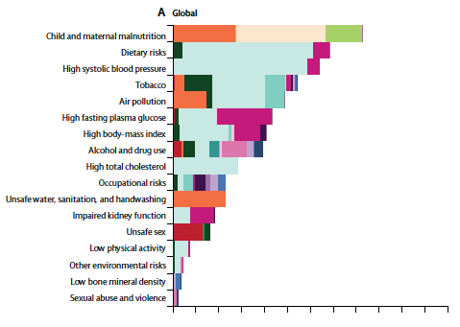
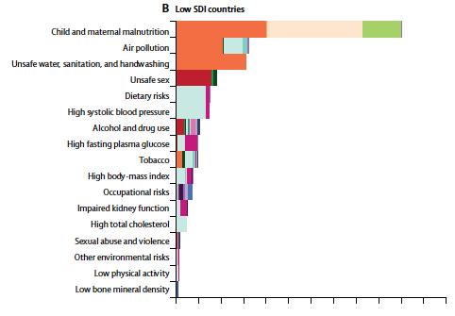


Disability Adjusted Life Years (DALYS)

Slide 17
Developmental origins of health and disease (DoHAD)
Critical importance of “phenotypic plasticity” in early life: single genotype can produce more than one
morphology
physiology
behaviour
as a result of environmental influences
Mechanisms…?
Premature telomere shortening
Poor organ growth/development
Programming of hormone levels
Appetite regulation and other CNS effects
Number/size/function of fat cells
In-utero malnutrition +/- rapid catch-up growth results in metabolic syndrome, epithelial dysfunction, non-communicable diseases (NCDs), mental health problems
Notes:
Restricted diet in weanling rats increased lifespan
Dutch famine (WWII)
Siege of Leningrad (WWII)
China famine (“Great Leap Forward” 1959-61)
Biafra famine (Nigerian civil war; 1967-70)
In-utero malnutrition +/- rapid catch-up growth results in metabolic syndrome, epithelial dysfunction, NCDs, mental health problems

Slide 18
In summary
Neonatal mortality “in the spotlight”
Focus on LBW: distinguishing preterm / IUGR / both remains a problem
Great potential for novel nutritional interventions to improve short and long-term outcomes

Slide 19
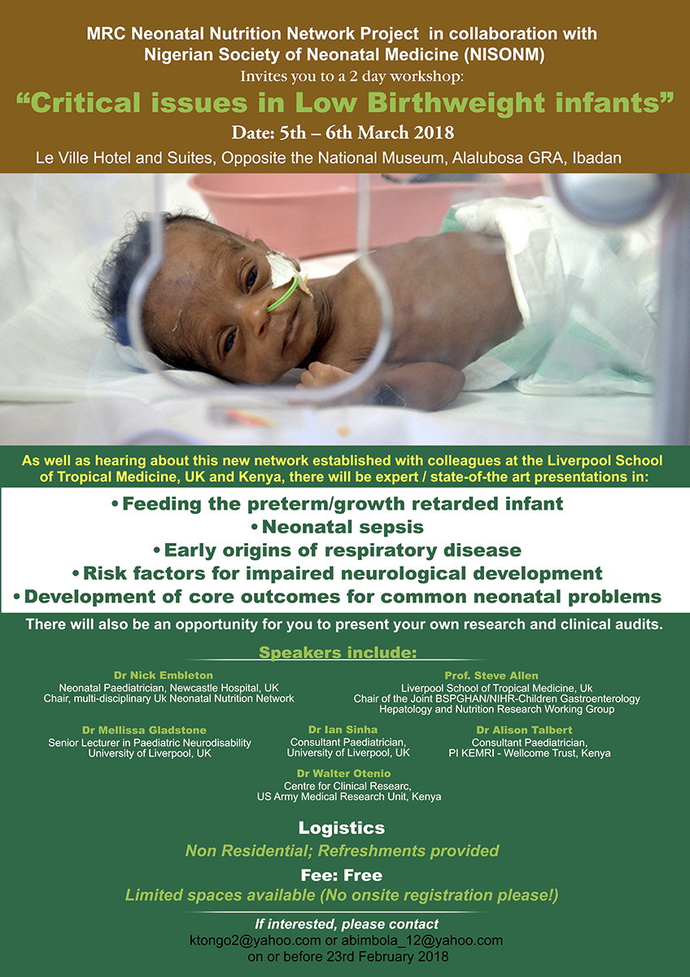

Slide 20
Neonatal Nutrition Network project
Where are we heading?
Pragmatic, large-scale studies of affordable, feasible and safe nutritional interventions (e.g. probiotics)
Effects of nutritional interventions on longer term outcomes
Cluster-randomised trial; n=12 clusters
Probiotics in preterm infants in LMICs
23 RCTs (n=4783) from 4 continents and 10 LMICs
Risk ratio of
NEC ≥stage II = 0.46 (95% CI 0.34 to 0.61) P<0.00001; NNT 25 (20 to 50)
Late-onset sepsis = 0.80 (0.71 to 0.91) P=0.0009; NNT 25 (17 to 100)
All-cause mortality = 0.73 (0.59 to 0.90) P=0.003; NNT 50 (25 to 100)
No significant adverse effects
Deshpande et al. Benefits of probiotics in preterm neonates in low-income and medium income countries: a systematic review of randomised controlled trials. BMJ Open 2017;7:e017638

Slide 21
Potential differences between LBW infants in NNUs in LMICs versus HICs
Maternal factors
diseases: e.g. malaria
nutrition: Vit A/D/iron/folate + seasonal effects
prevalence of GBS
Genetics and epigenetics
Pregnancy
intra-uterine infection
placental malaria, gestational diabetes, eclampsia
prevalence of PROM
Delivery
Place of delivery
CS rate
Vaginal/faecal microbiome
Infant resuscitation
Ante-natal and post-natal care
accuracy of dating of gestation
monitoring of foetal growth
early intervention; e.g. early delivery for poor foetal growth
management of common diseases e.g. hypertension, diabetes
use of ante-natal steroids
human resources / staff time
hand washing / infection control
material resources and hospital environment (KMC; incubators; long lines)
feeding practices inc. parenteral nutrition
Infant factors
proportion preterm vs. IUGR vs. prem + IUGR
exposure to infection
feeding practices; breastmilk, formula, donor milk, oral colostrum
investigations (inc. AXR for diagnosis of NEC)
drugs (inc. antibiotics, surfactant
interventions (e.g. PN, umbilical artery catheters)

Slide 22

Neonatal Nutrition Network project
Nigeria (4 NNUs) Kenya (2 NNUs)

Slide 23
Neonatal Nutrition Network project overview
Systematic review of feeding practices for LBW infants in LMICs
Core outcomes for research
NNN shared, anonymised clinical database
Micronutrients, inflammation in small blood samples
Feeding survey
Standardised diagnostic criteria for major illnesses
Microbiome:
AMR infant gut
Maternal vaginal

Slide 24
Project timeline
Activities |  | 2018 |  |  |  |  |  |  |  |  |  | 2019
 | Preparation | M | A | M | J | J | A | S | O | N | D | J | F
Prepare workshop materials
Systematic review
Workshops Nigeria / Kenya
Ethical approvals
Adapt standard criteria
Develop and test database
Populate database
Mother/infant recruitment/samples
DNA extraction and shipping
Sample analysis
Research visits; report writing
Research proposal development

Slide 25
All welcome; all hands to the pump!
Many thanks to all of the people and institutions involved
Enjoy the workshop!

