Slide 1

Pharmacodynamics of novel Mycobacteria tuberculosis DNA gyrase inhibitors
EMMANUEL MOYO

Slide 2
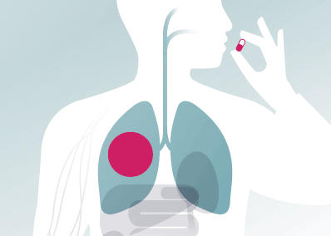
Treatment is lengthy and complex
Treatment for drug susceptible TB is 6 month course
- Isoniazid, Rifampicin, Ethambutol and Pyrazinamide
Treatment is undermined by increased multi-drug resistant TB
Novel drugs are required to
- improve efficacy against MDR-TB
- shorten treatment lengths

Slide 3
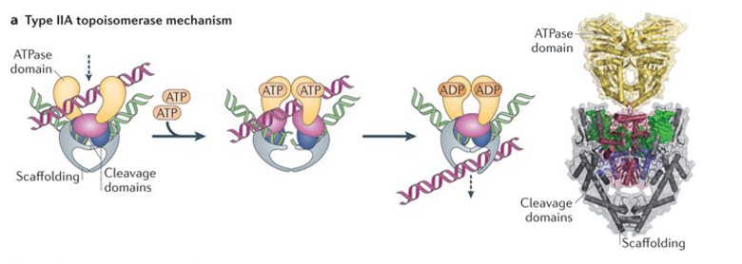
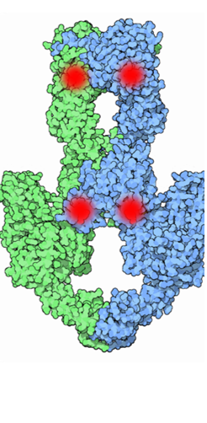
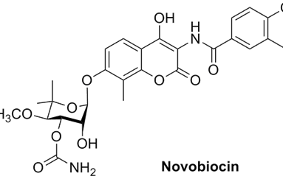
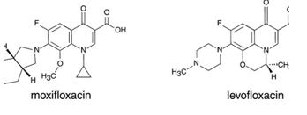
DNA gyrase is an opportune drug target
DNA Gyrase maintain topological homeostasis of DNA.
DNA gyrase is an opportune drug targets
- Prokaryotic topoisomerases are
structurally unique
- Essential for cellular survival
- Mechanism of action allows for
bactericidal killing
- M. tuberculosis has a singular DNA
Gyrase
DNA gyrase is a clinically validated target
- aminocoumarins
- Fluoroquinolones

Slide 4
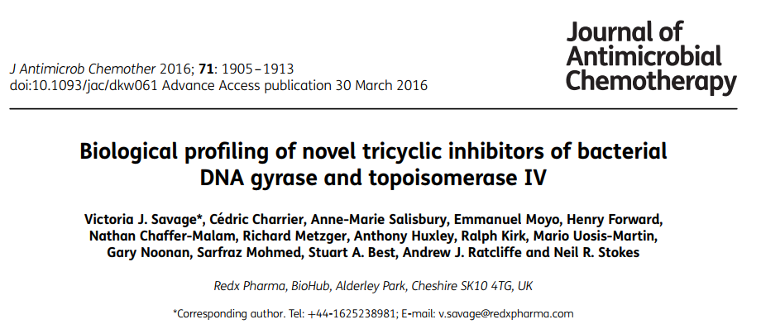
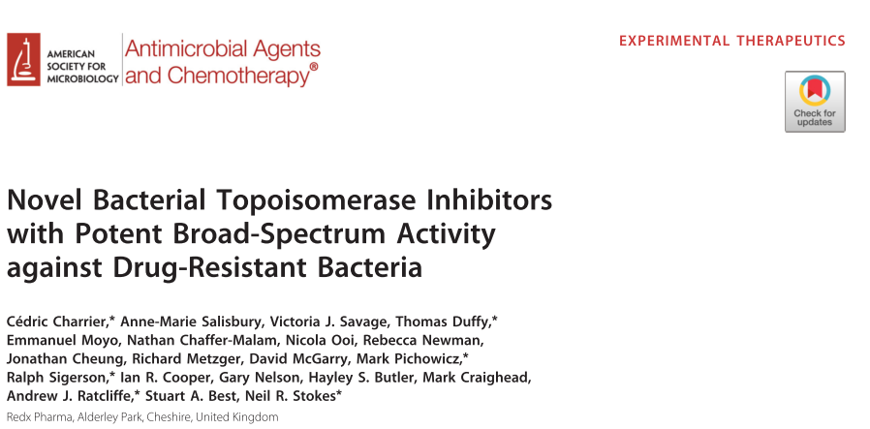
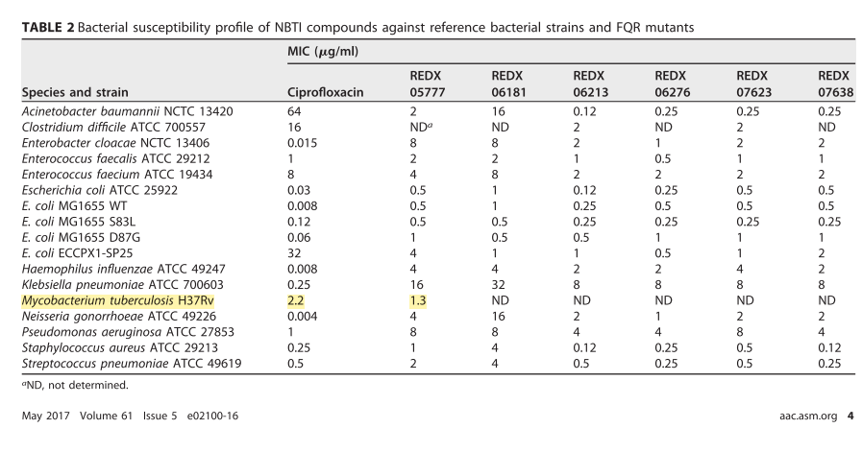
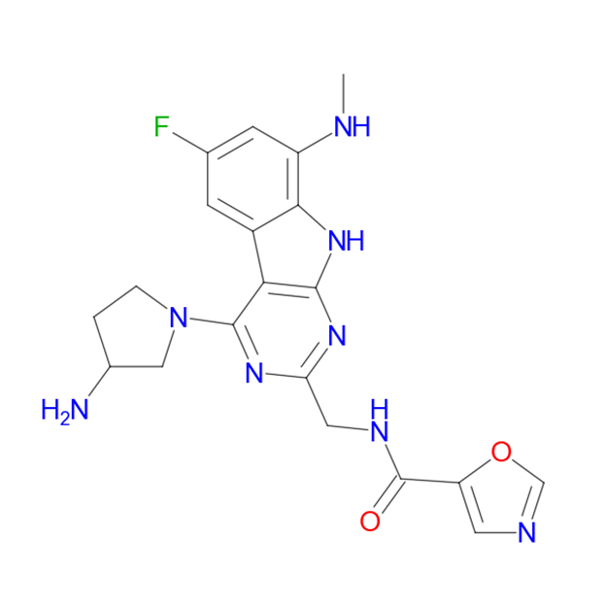
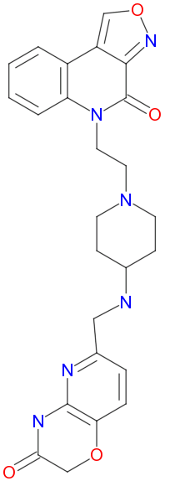
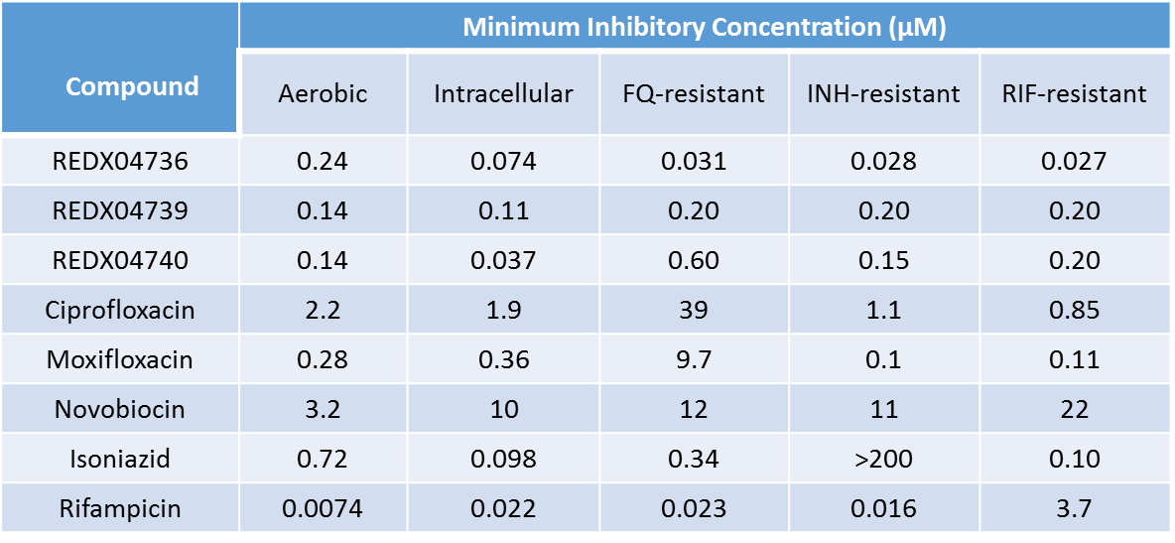
REDX Pharma has developed Novel DNA gyrase inhibitor series
Tricyclic Amides
- putatively target GyrB
Novel bacterial topoisomerase inhibitors (NBTI)
- target GyrA
REDX compounds are potent inhibitors of DNA Supercoiling
- more potent than to clinically validated antibacterial
REDX compounds are promising anti-tubercular drugs
Tricyclic Amides
Straight-chain NBTI

Slide 5
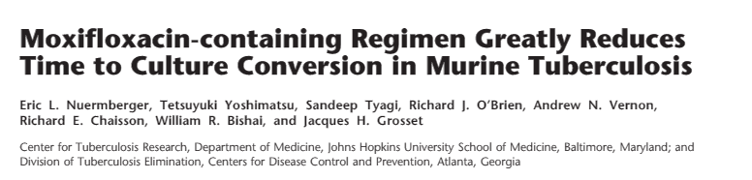
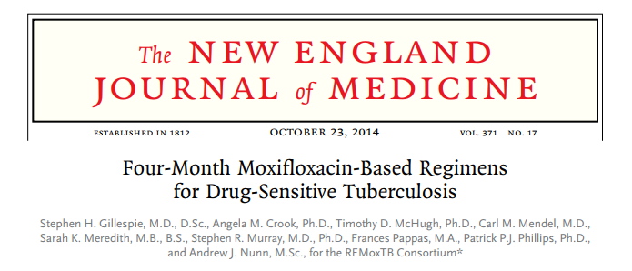
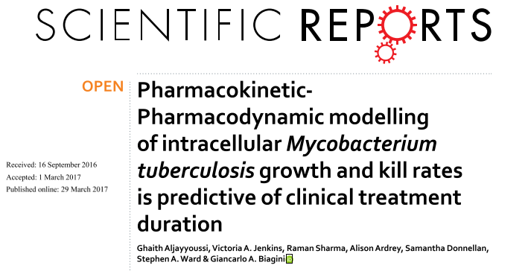
Developing novel predictive in-vitro tools and PK-PD models for TB chemotherapy
TB drug development lacks predictive in-vitro tools.
- Moxifloxacin failed to reduce dose length as predicted
Giancarlo’s group has used in-vitro data and PK/PD modelling to predict clinical outcomes.
Time kill kinetics produced from intracellular and extracellular assay were more predictive.
Cell imaging and analysis used for intracellular assays
- Operetta® High-Content Imaging System
- Harmony® High-Content Image Analysis Software

Slide 6
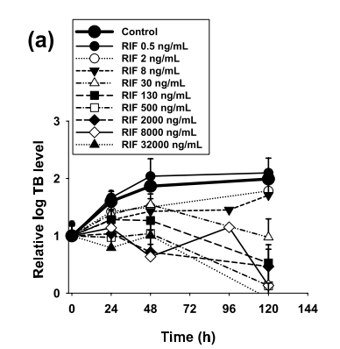
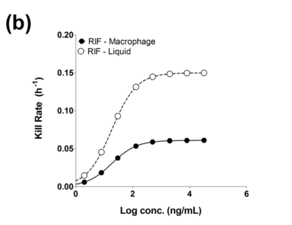
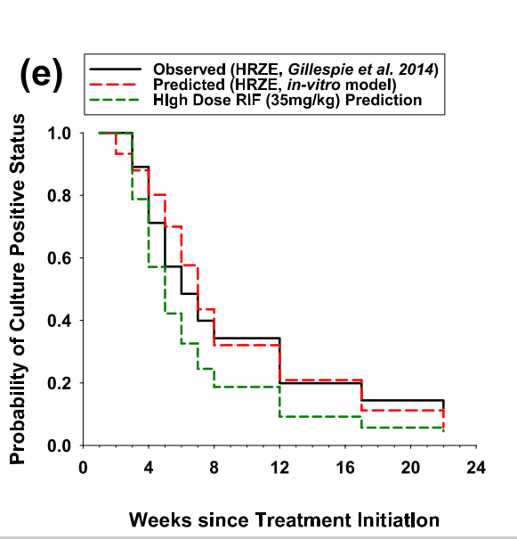
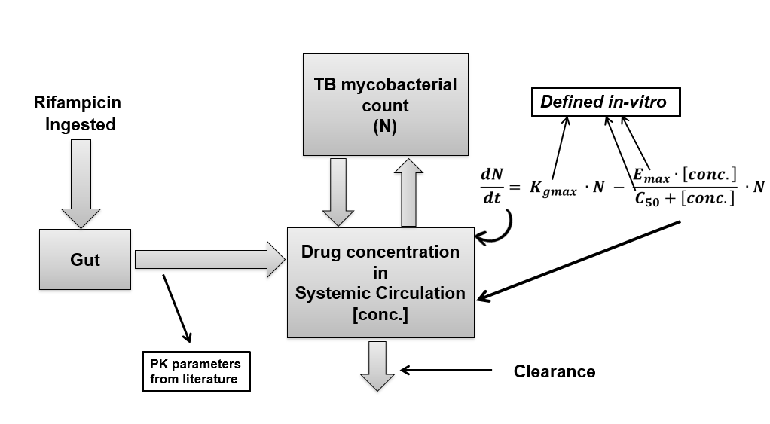
In-vitro data can be used predict the overall activity of drugs when administered clinically.
In-vitro time-kill curves used to define relationship between kill-rate and concentration.
- Maximum rate of killing (Emax)
- IC₅₀
Parameters are used in a PK/PD model to predict clinical outcomes.
Using this novel model able to produce data comparable clinical data seen in literature.
Profile Pharmacodynamics of REDX compounds
Further develop predictive in-vitro tools

Slide 7
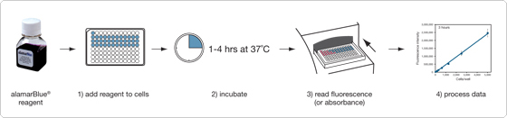
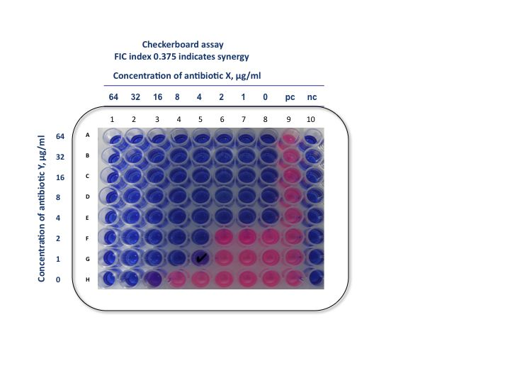
Screening for activity
Library of compounds were screened for activity using Microplate Alamar Blue assay.
Plates containing test drugs are incubated with M. tuberculosis H37Rv.
Alamar blue solution is added after incubation and fluorescence read.
Live bacteria reduce resazurin to resorufin.
- red coloured compound
- highly fluorescent
Visual MIC observed
IC₉₀ measured using fluorescence

Slide 8
Primary screening data
Compound group | Compound number | Visual MIC (µg/mL) | IC₅₀ (µg/ml) | IC₉₀ (µg/ml)
Reference anti-tubercular drugs | Isoniazid | 0.69 | 0.18 | 0.27
 | Moxifloxacin | 0.06 | 0.029 | 0.045
Tricyclic Amides | REDX04739-02 | 0.25 | 0.198 | 0.27
 | REDX07774-01 | 0.03 | 0.02 | 0.037
 | REDX07942-01 | 0.12 | 0.092 | 0.15
 | REDX07966-01 | 0.03 | 0.025 | 0.037
 | REDX08027-01 | 0.06 | 0.042 | 0.067
 | REDX08049-01 | 0.06 | 0.038 | 0.062
 | REDX08191-01 | 0.03 | 0.018 | 0.03
 | REDX08230-01 | 0.015 | 0.008 | 0.017
 | REDX08271-01 | 0.015 | 0.01 | 0.018
 | REDX09133-01 | 0.03 | 0.015 | 0.025
 | REDX09147-01 | 0.25 | 0.11 | 0.15
Straight-chain NBTIs | REDX05851-01 | 0.5 | 0.20 | 0.29
 | REDX06003-01 | 1 | 0.27 | 0.50
 | REDX06145-01 | >8 | >8 | >8
 | REDX06181-01 | 4 | 1.38 | 2.24
 | REDX06213-01 | 0.03 | 0.02 | 0.038
 | REDX06662-03 | 0.12 | 0.098 | 0.20
Macrocycle NBTIs | REDX06858-01 | 1 | 0.23 | 0.55
 | REDX07452-01 | 4 | 1 | 1.97
 | REDX07468-01 | 0.25 | 0.23 | 0.50
 | REDX07666-01 | 0.12 | 0.07 | 0.12
Series 4 NBTIs | REDX07207-02 | 0.004 | 0.002 | 0.004
 | REDX07027-01 | 0.03 | 0.015 | 0.03
 | REDX07208-02 | 0.001 | 0.0007 | 0.0012
 | REDX07425-01 | 0.004 | 0.0017 | 0.0038
 | REDX7499-01 | 0.008 | 0.0058 | 0.009
 | REDX07502-01 | 0.004 | 0.0033 | 0.0057
 | REDX07605-02 | 4 | 1.50 | 2.9
 | REDX07609-03 | 0.015 | 0.011 | 0.017
 | REDX07627-01 | 0.25 | 0.096 | 0.18
 | REDX07662-01 | 0.008 | 0.0032 | 0.0057
 | REDX07691-01 | 0.12 | 0.063 | 0.13

Slide 9
Extracellular Time-Kill assay
M.tb grown in broth and presence of compounds.
- M.tb plated on agar
Time-kill graphs allow calculation of kill rate
Colony forming units in process of being obtained.
Experiment is lengthy, laborious and resource consuming.
- fluorescence M.tb strain possible replacement
Notes:
M.tb H37Rv grown in media containing compound/antibiotic at multiples of its MIC
M.tb H37Rv plated on 7H11 agar media after every 2-3 days.
Drop in CFU is plotted over time to obtain time-kill curves.
Slope of time kill-curves can be used to calculate Kill rate of compounds.

Slide 10
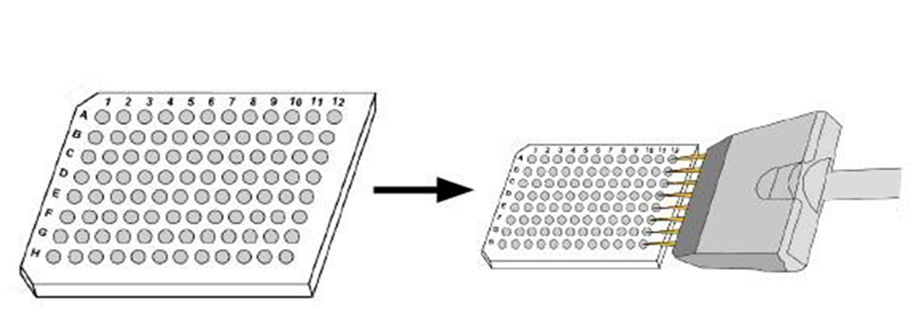
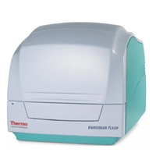
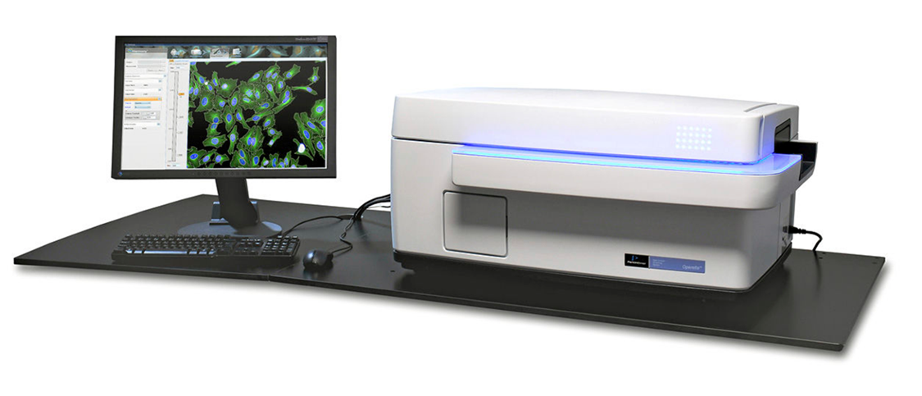
Intracellular Time-Kill assay
Differentiate THP-1 monocytes into macrophages using PMA for 72hrs .
inoculate macrophages with M.tb H37Rv-mCherry (MOI:5-1) for 24hrs.
Drug treatment for 144hrs
M.tb H37Rv-mCherry fixed by PFA
Fluorescence measured
Macrophages nucleus stained by Hoestche
Image acquisition : Operetta
Image analysis and data analysis : Harmony

Slide 11
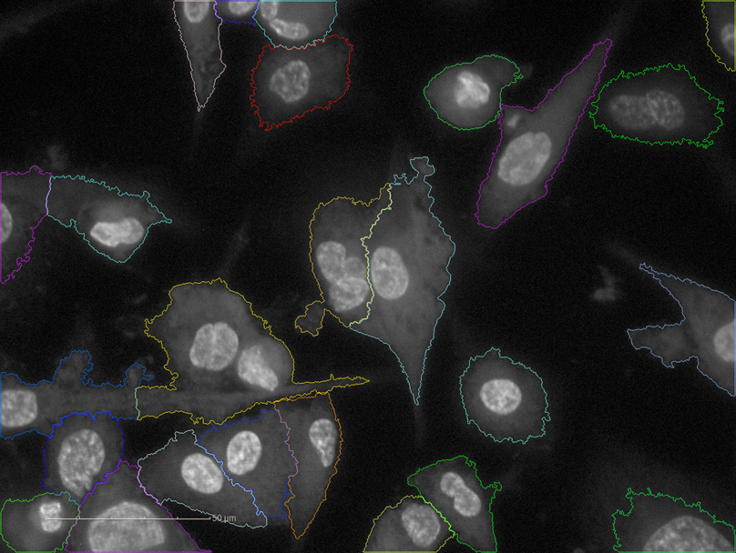
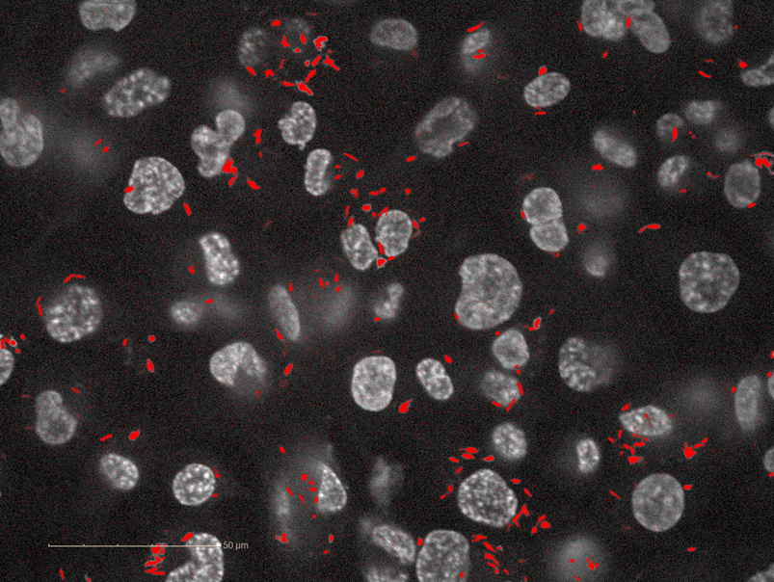
Operetta® High-Content Image acquisition and Harmony® Image and Statistical Analysis
Image of each well taken
- 10 different areas
- 6 different planes of well
Use stained nucleus and area around to define macrophage.
- spots of certain size defined as M. tb
- spots within cytoplasm are defined as intracellular
Applied to the entire 96 well plate.
Statistical output
- Nuclei - Cell Area [µm²] - Sum per Well
- Intracellular TB Area [µm²] - Sum per Well
- Intracellular - Ratio

Slide 12
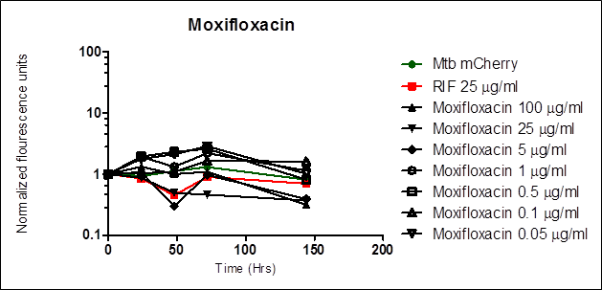
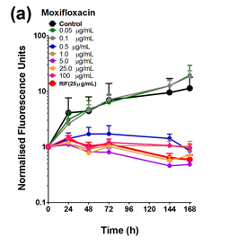
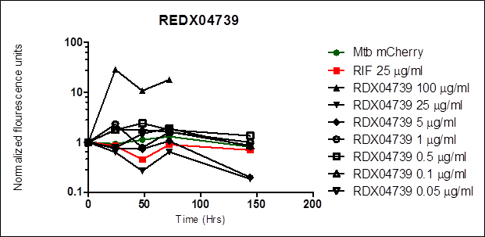
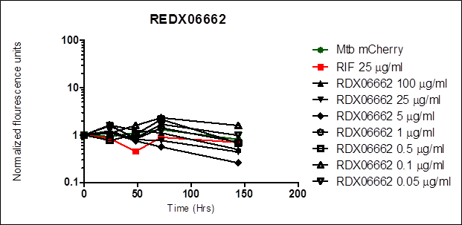
Intracellular Time-Kill assay: fluorescence data from Varioskan
Moxifloxacin, REDX04739 and REDX06662 tested.
THP-1 infected at MOI of 5:1.
Very low growth of control M. tb m-Cherry (in green).
Ten fold growth of control from 0hr to 144hrs is required for usable data.
Previously obtained data
Notes:
Macrophage like THP-1 cells are infected with M. tb expressing m-Cherry fluorescence gene.
Compound is introduced at different concentrations.
Relative fluorescence is obtained by a fluorimeter (Varioskan) at time points over 144hrs.
Drop in fluorescence overtime used to obtain time-kill curves.
Time-kill curves can be eventually used to produce kill-rate of compounds.

Slide 13
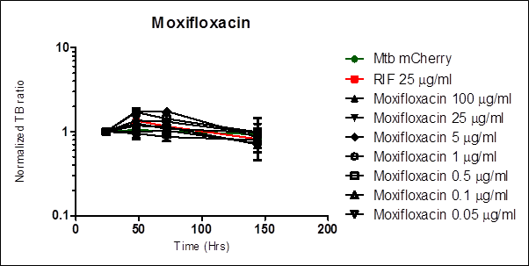
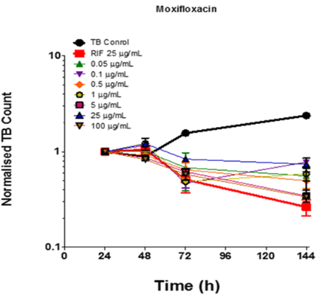
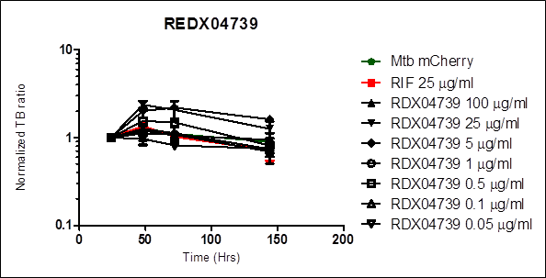
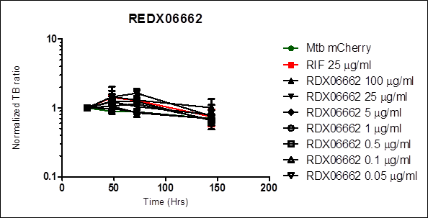
Intracellular Time-Kill assay: Imaging data from Operetta
Similar experiment with data obtained by cell imaging.
No. of objects defined as intracellular M. tb counted.
Again control was too low for data to be usable.
Previously obtained data
Notes:
Macrophage like THP-1 cells are infected with M. tb expressing m-Cherry fluorescence gene.
Compound is introduced at different concentrations.
Counts of objects defined as Intracellular Tb obtained by a Cell imaging (Operetta) at time points over 144hrs.
Drop in No. of intracellular objects overtime used to obtain time-kill curves.
Time-kill curves can be eventually used to produce kill-rate of compounds.

Slide 14
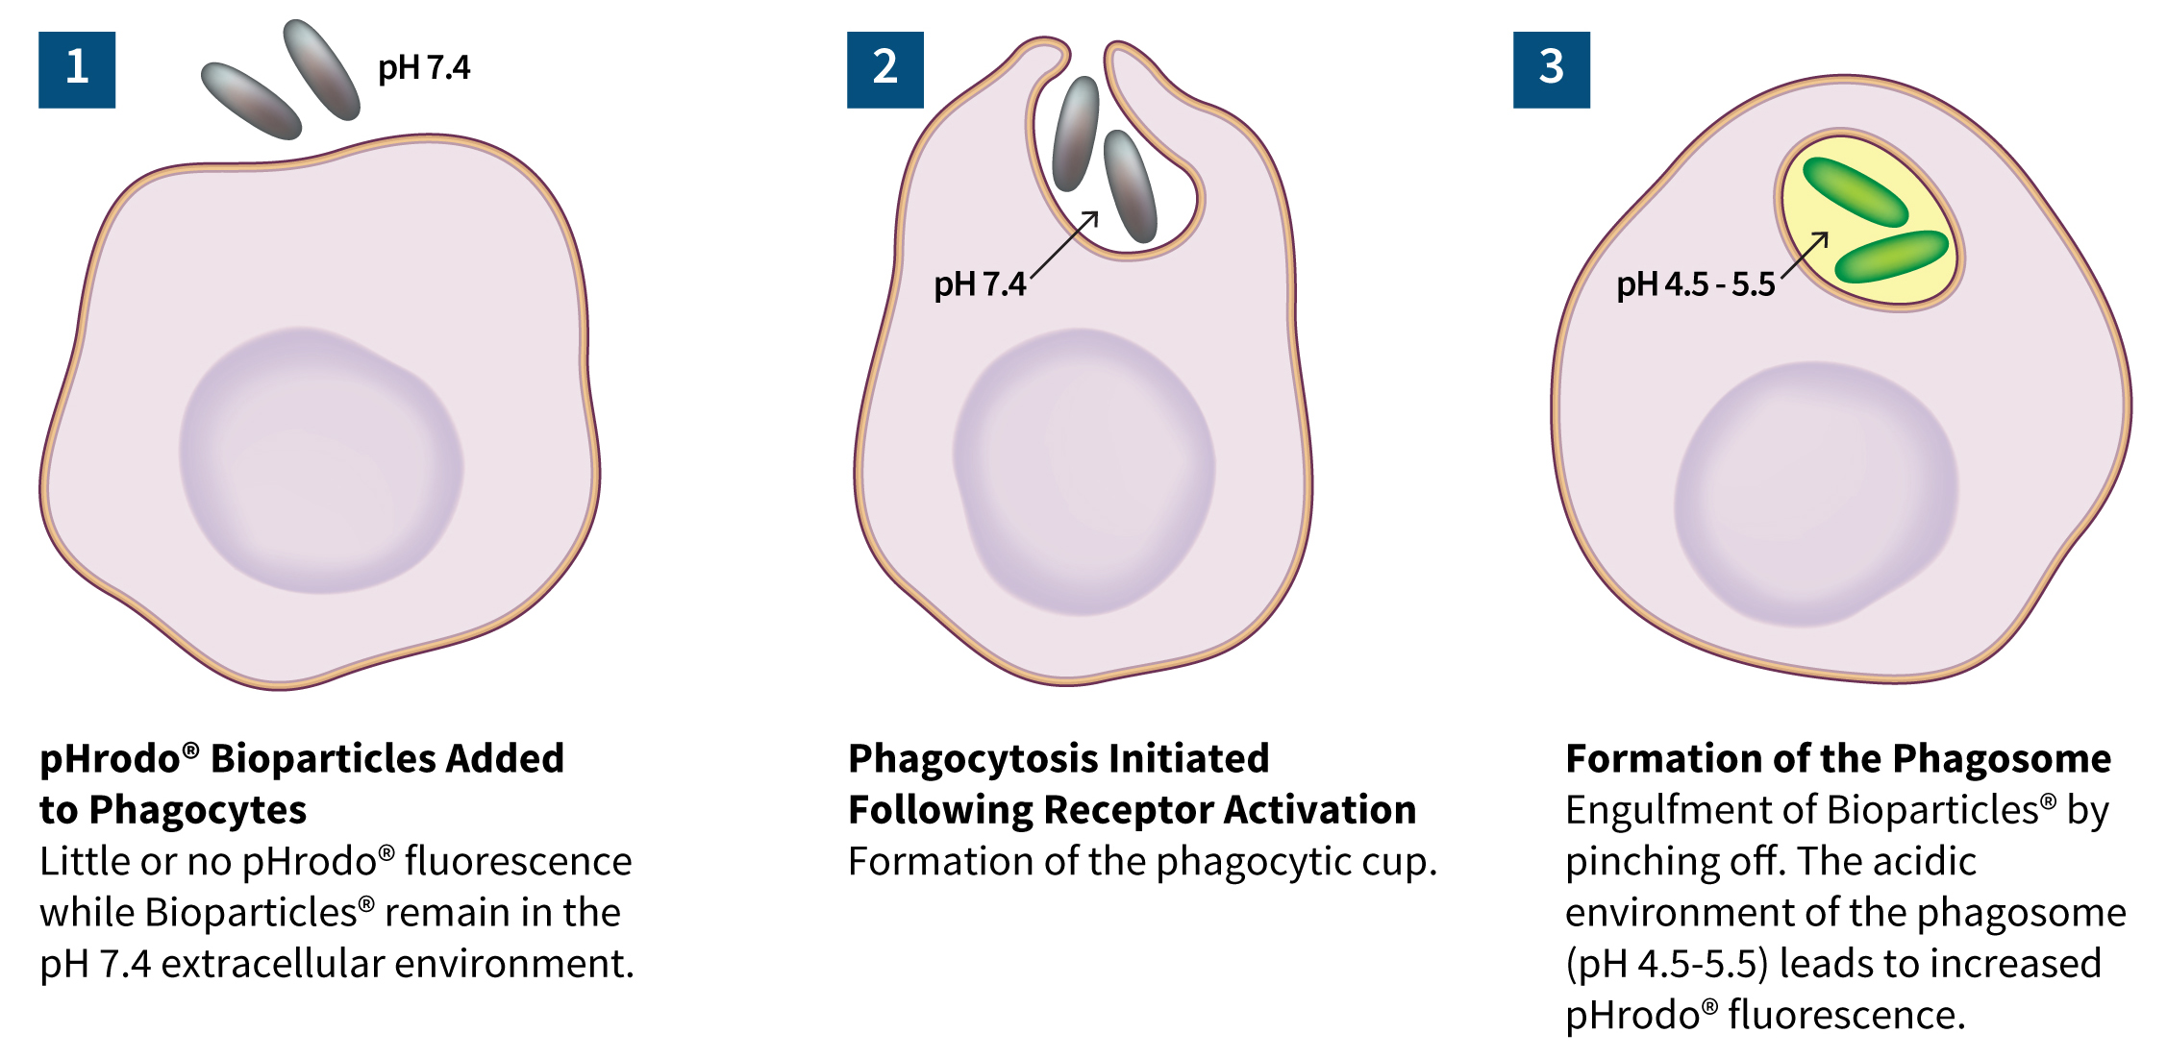
Assay development: Bio-particle production
Interest in further development in-vitro tools
- co-infection with HIV
- screen compounds effecting macrophage function
M. tuberculosis H37Rv fixed with 5% PFA.
Fixed cells coated with pH-dependent (pHrodo) luminescing dye.

Slide 15
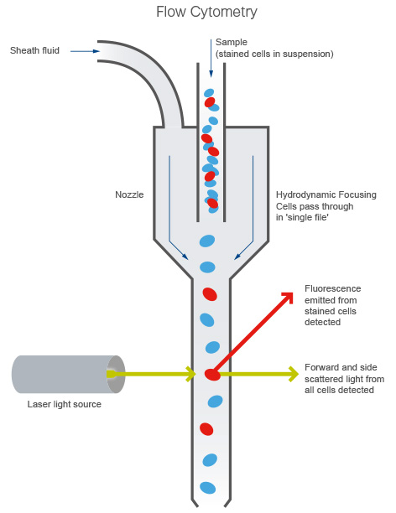
Bio-particle formation assay
Bio-particles incubated in acid-base pH range.
- fluorescence detected at low pH.
Bio-particles incubated with macrophage like THP-1 cells for 72hrs and washed off.
- MOI:5, 10, 15 and 20 used
- increased fluorescence with increase of MOI
Further analysis done by Flow cytometry

Slide 16
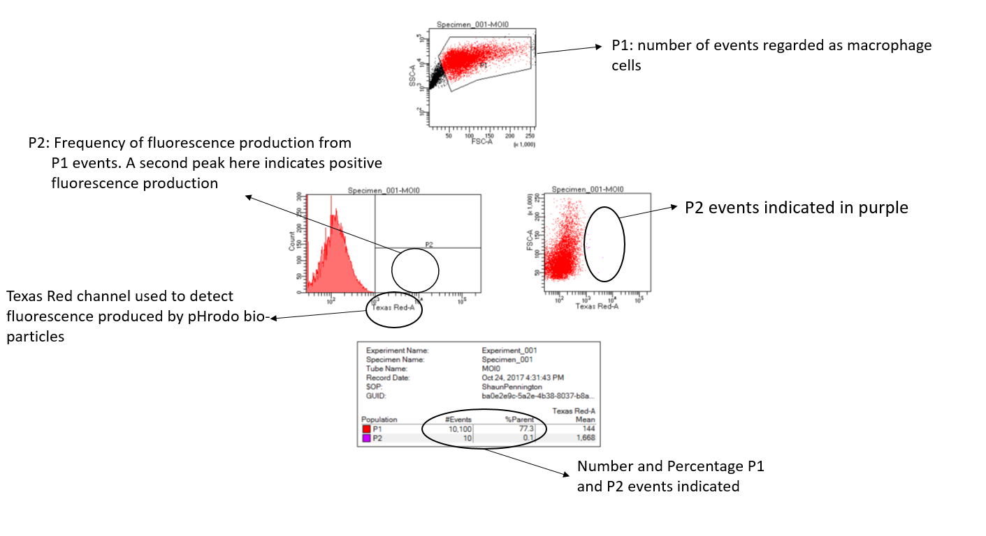

Slide 17
MOI:0 (No bio-particles present)

Slide 18
MOI:5
MOI:10

Slide 19
MOI:15
MOI:20

Slide 20
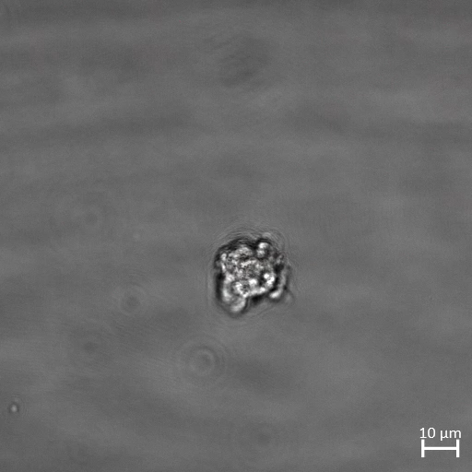
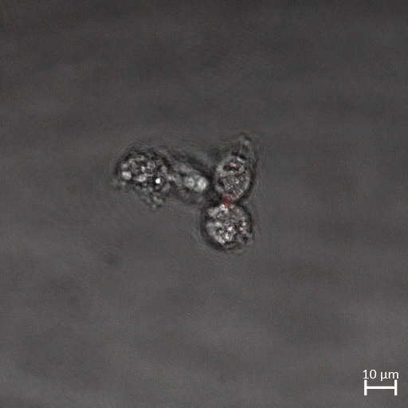
MOI:20 P1 population
MOI:20 P2 population

Slide 21
