Slide 1






Neonatal sepsis in Kilifi
Alison Talbert
Kisumu, June 5th 2018
MRC Confidence in Global Nutrition and Health Research
Improving the survival, growth and development of low birth weight newborns through better nutrition: the Neonatal Nutrition Network project

Slide 2
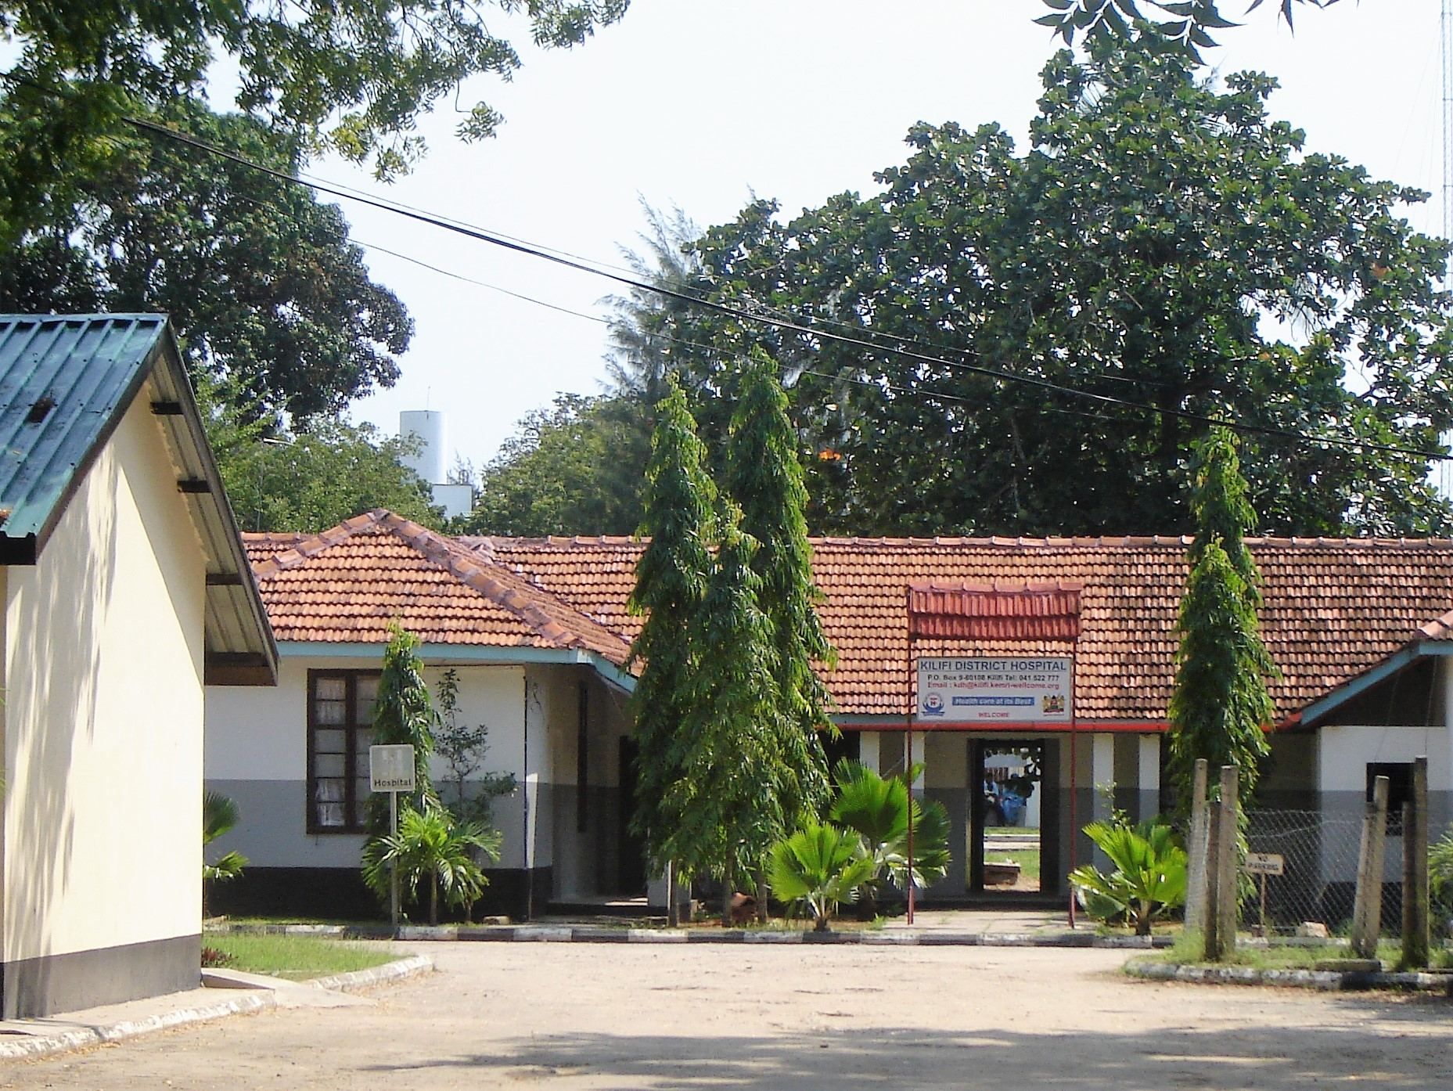
Kilifi County Hospital
Kilifi County Hospital situated in Kilifi town, 60 km north of Mombasa, is a referral hospital serving a population of 1.5 million.
Neonatal admissions approx. 1,200 per year
Newborn Unit -18 cots and Paediatric HDU - 9 cots
Staff: 2 paediatric consultants, 6 clinical officers. There are 3-4 neonatal nurses per shift
Laboratory facilities provided by KEMRI/Wellcome Trust Research Programme and Kilifi County

Slide 3
Neonatal sepsis in 2016
Neonates made up 32% of all paediatric admissions: 1215/3809
The most common discharge diagnoses were:
1.Sepsis 684 (56%)
2.Preterm 263 (22%)
3. Birth asphyxia 250 (21%)
4. Neonatal jaundice 164 (13%)
5. Respiratory distress syndrome 88 (7%)

Slide 4
Antibiotic use in neonates in KCH
V. common – 93% of babies admitted in 2013-2014 received antibiotics
Kenya guidelines
1st line Penicillin or Ampicillin [50mg/kg] twice daily and gentamicin [3mg/kg for babies <2kg or 5mg/kg for babies >2kg] once daily for 7 days
2nd line 3rd generation cephalosporins usually ceftriaxone 50mg/kg once daily (cefotaxime safer in jaundice in 1st week of life)

Slide 5
Bacterial isolates from blood cultures
Blood cultures taken on 1,156 (95%) neonates in 2016
Contaminants: 95 (8%)
Pathogens: 59 (5%)
Isolates | Frequency
E. coli, K.pneumoniae, Serratia marcescens | 9
Group B Streptococcus | 8
S. aureus | 7
Pseudomonas spp, Acinetobacter spp. | 4
Enterobacter cloacae, Aeromonas hydrophila | 2
Group A Streptococcus, Group D Streptococcus, H. influenzae, Salmonella spp | 1

Slide 6
Community acquired infections in KCH
“Invasive bacterial infections in neonates and young infants born outside hospital admitted to a rural hospital in Kenya.”
Talbert et al.
Pediatr Infect Dis J. 2010 Oct;29(10):945-9. doi: 10.1097
Infants <60 days admitted 2001 to 2009 - included 4,467 outborns
Commonest bacterial isolates in outborn neonates were
Klebsiella pneumoniae 46
S. aureus 44
Acinetobacter spp 38
E. coli 36
Enterobacter spp 31
Group A Streptococcus 30
Group B Streptococcus 29

Slide 7
Hospital acquired infections Kilifi
“Risk and causes of paediatric hospital-acquired bacteraemia in Kilifi District Hospital, Kenya: a prospective cohort study”
Aiken A et al
Lancet. 2011 Dec 10; 378(9808): 2021–2027.
33,188 paediatric admissions 2002 to 2009
Incidence 1 (95%CI 0.87- 1.14) per 1,000 days in hospital
Mortality 53%
Most common organisms were Gram negative (74%) with E.coli (21%) and K.pneumoniae (20%)

Slide 8
Antimicrobial resistance in Kilifi
“Molecular epidemiology of Klebsiella pneumoniae invasive infections over a decade at Kilifi County Hospital in Kenya”
Henson S et al
International Journal of Medical Microbiology
Volume 307, Issue 7, October 2017, Pages 422-429
174 invasive isolates from children and 24 from adults collected between 2001 and 2011
Gentamicin resistance increased from 43% in 2001 to 83% in 2011
Gentamicin resistance in 88% of HAI and 37% in CAI isolates
ESBL-producing strains in 79% of HAI and 23% in CAI isolates

Slide 9
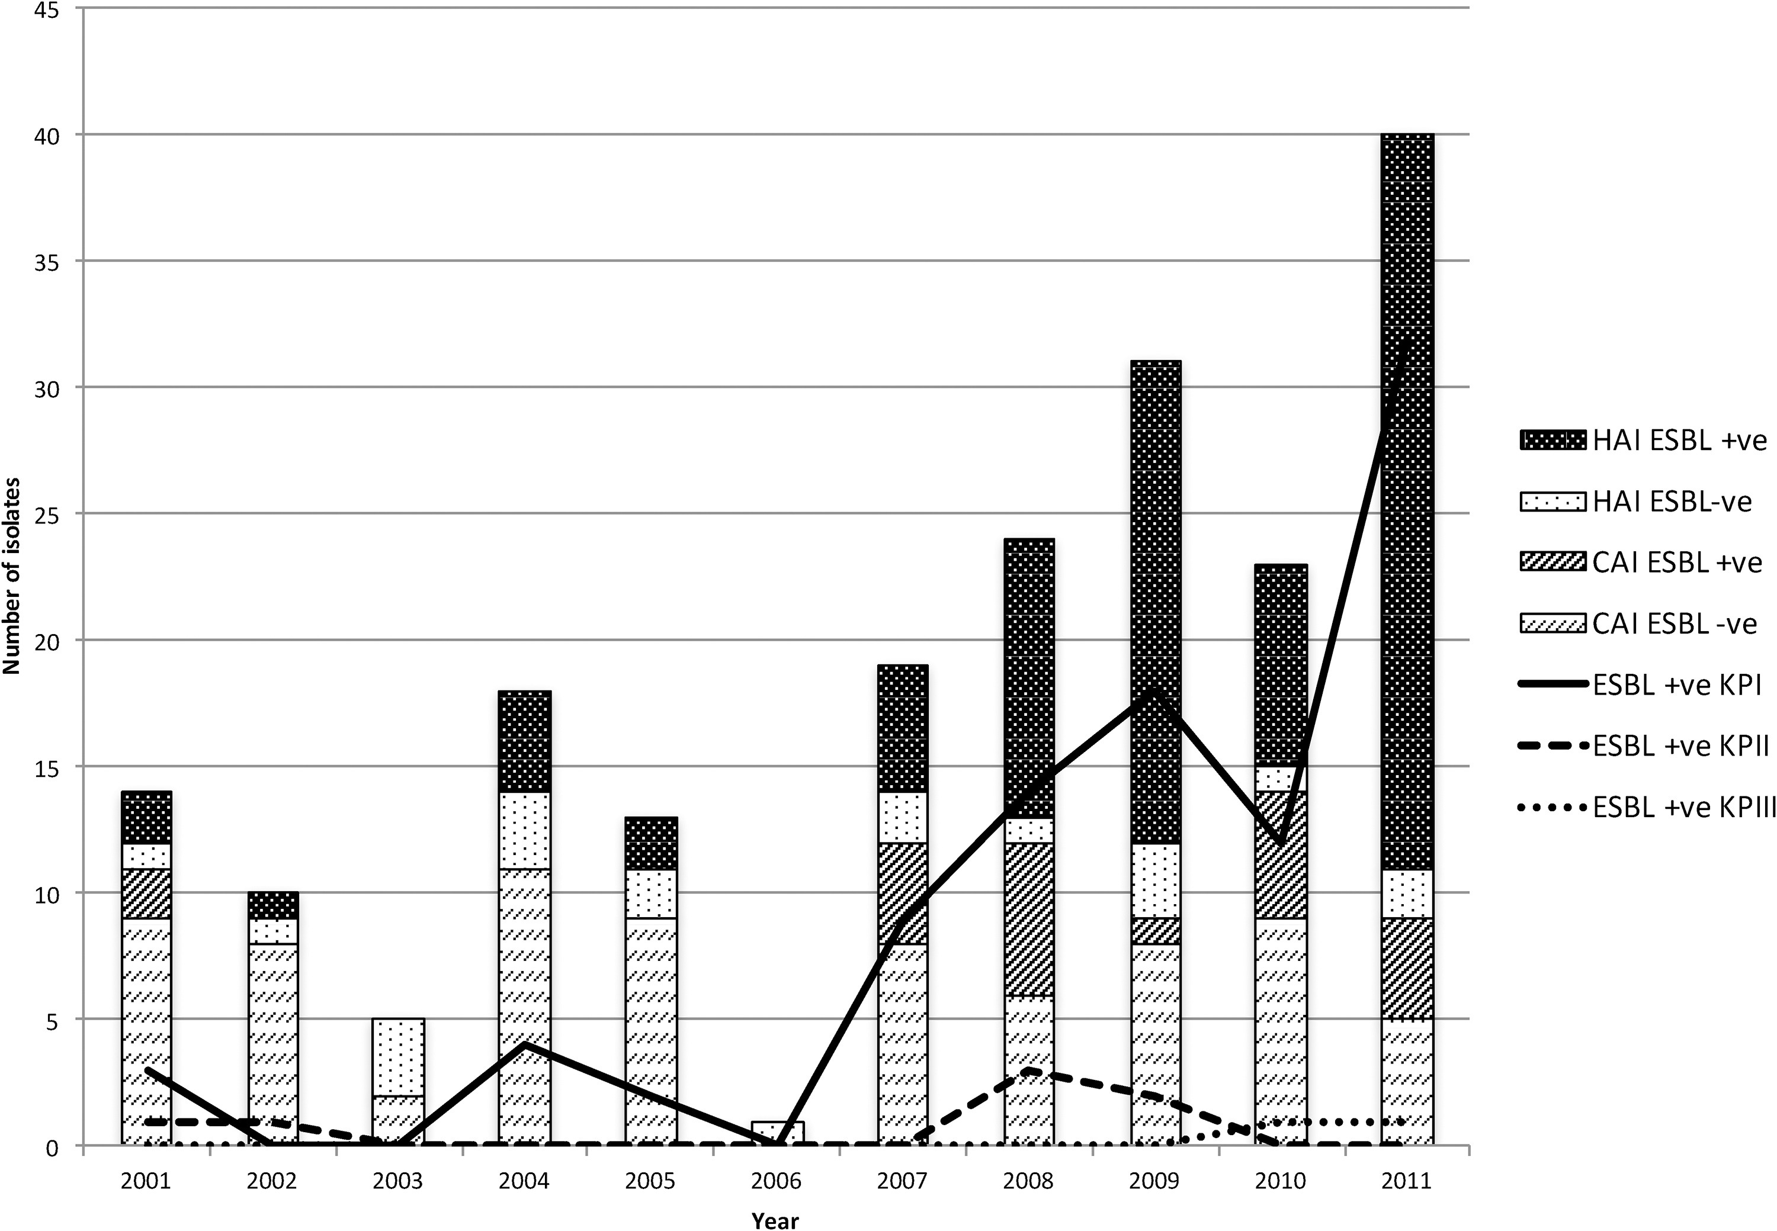
Increase in ESBL-producing isolates over time

Slide 10
Paediatric infection control team –role and responsibilities
Producing and maintaining up to date hospital infection control policies.
Surveillance and reporting of (hospital-borne) infections and monitoring methods of control.
Rapid detection and investigation of hospital based outbreaks or potentially hazardous procedures.
Liaison with the main Hospital Infection Prevention and Control Committee.
Giving advice on management of patients with infection (in collaboration with Infectious Diseases Consultant) and need for isolation or barrier nursing as required.
Advising the Programme on initiatives to combat healthcare associated infections.
Produce guidelines for cleaning, disinfection and decontamination and work to ensure adherence to those guidelines.
Providing a staff training program in infection control and auditing compliance
Preparing quarterly infection control reports.
Producing an annual infection control program report and recommendations for the Programme.

Slide 11
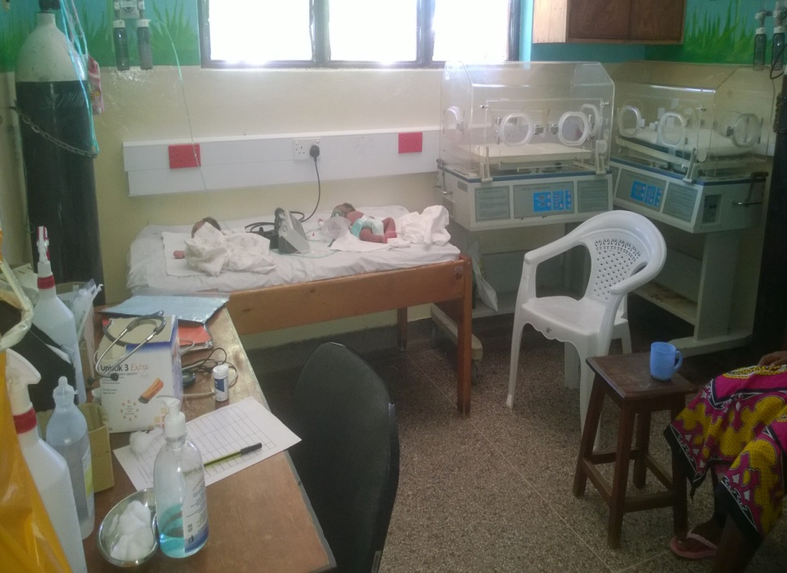
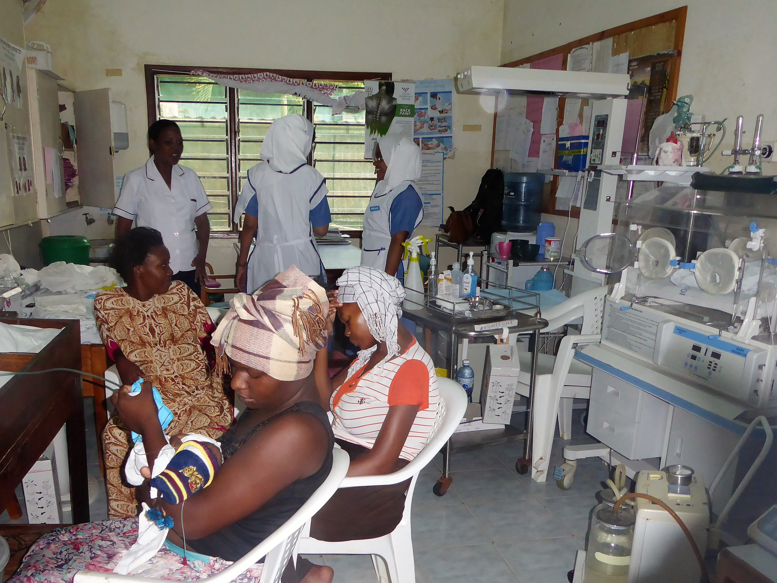
Space constraints in paediatric HDU and NBU

