Slide 1
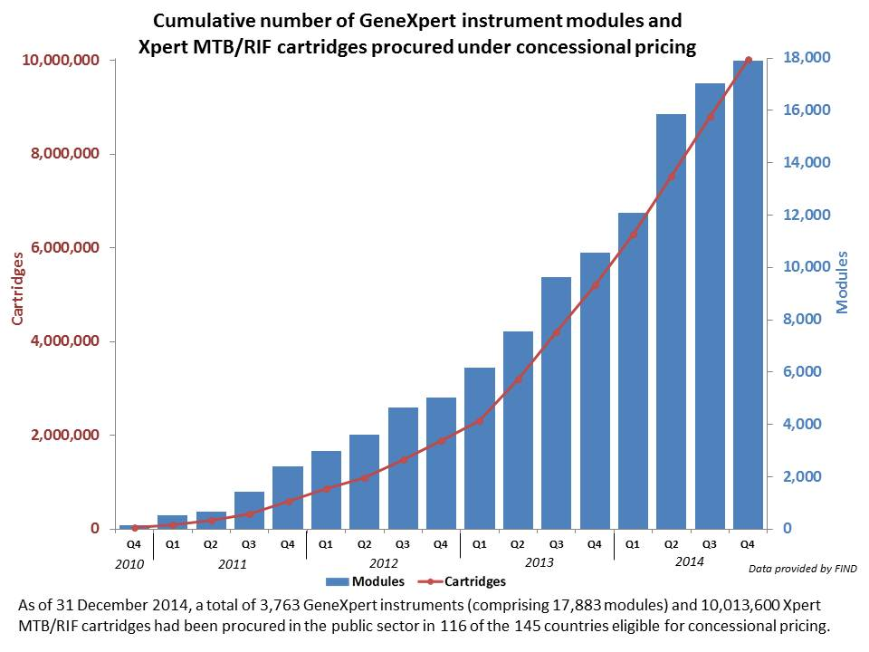
Xpert MTB/RIF - a game changer?
First molecular TB test to be endorsed by WHO (2010)
Semi-automated
Detects TB and RIF resistance in 2 hours
Sensitivity 85%, Specificity 98%
Significant donor and country investment → rapid scale-up in high burden countries
Notes:
I’ll start with a bit of context for my talk.
The World Health Organization estimates that at least 1/3rd of TB patients worldwide are not being diagnosed or treated, the so called missing 3 million.
Better diagnostics are clearly critical to improving case finding. We have been doing smear microscopy for over 100 years – it’s insensitive, missing at least half of all TB cases and it requires patients to make multiple visits to health centers, resulting in high rates of loss to follow up.
So not surprisingly there has been considerable donor and country investment in novel diagnostics, in particular Xpert MTB/RIF which the WHO has now endorsed as the first line test for TB wherever feasible. I think most of you are familiar with Xpert MTB/RIF – it’s a semi-automated PCR-based test that is much more sensitive than microscopy and provides a result within two hours, including identifying rifampin resistance.
The graph here shows how rapidly Xpert testing capacity has been scaled-up in high burden countries, with 18000 modules and 10 million cartridges procured by the end of 2014. The number of modules and cartridges has continued to increase exponentially over the past two years.

Slide 2
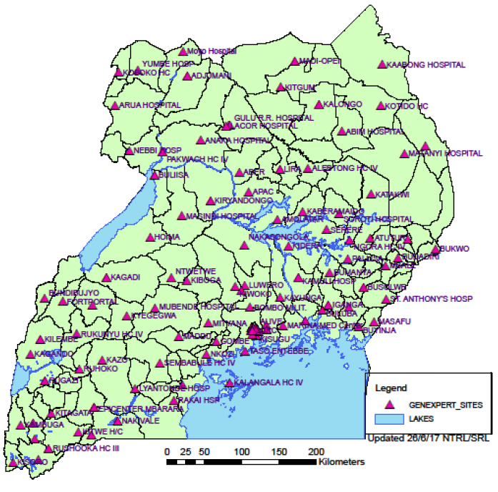
Uganda Context – Key successes
Rapid scale-up of Xpert testing coverage
>200 GeneXpert devices (hub-and-spoke model)
>400,000 Xpert MTB/RIF cartridges
Nearly 4-fold increase in confirmed MDR TB patients (2009 → 2015)
? increase in total TB cases notified annually
40-42000 → 44-45000 cases (pre-2010 → 2015)
? increase in proportion of bacteriologically-confirmed TB cases
60-65% → >70% (pre-2010 → 2015)
Notes:
Let’s move to the Uganda context.
Uganda has been a leader in Xpert scale-up on a per capita basis. The NTLP and NTRL have established a hub-and-spoke model. The red dots on the map indicate health facilities that now have Xpert devices. These testing hubs, which are now in virtually all districts of the country, are each linked with 3-5 microscopy units. Sputum samples collected at the microscopy units are transported to the testing hubs and results are returned to the microscopy centers after testing is completed. The NTRL is also in the process of installing software at all of the testing hubs which enables central monitoring of test results and device performance.
There are no formal studies I am aware of the impact of this massive scale-up of Xpert testing capacity. But the nearly 4-fold increase in confirmed MDR TB patients from 2009 to 2015 is certainly due in large part to increased Xpert testing.
There has also been in increase in TB cases notified, from about 40-42 thousand cases pre-2010 to 44-45 thousand cases in the last two years.
And the proportion of bacteriologically-confirmed cases has increased from 60-65% to >70% in the same period.
At least some of these increases are likely attributable to Xpert scale-up, though more formal trend analysis is needed to further support this.

Slide 3
Unresolved questions
How well are Xpert referral networks (i.e., hub-and-spoke model) functioning?
What is the quality of TB diagnostic care within Xpert referral networks?
What policy changes and co-interventions can further enhance implementation of Xpert (and future molecular tests)?
Notes:
There are also several unresolved questions that are important to understanding the effectiveness of Xpert scale-up and the potential for further improvements in case finding. Some of these question include:

Slide 4
Xpert Performance Evaluation to facilitate Linkage to TB care (XPEL TB)
AIMS
To quantify gaps in TB diagnosis at health centers linked to Xpert testing sites
To identify modifiable barriers to high-quality TB diagnostic services
Provider-level
Patient-level
Health system-level
To develop and evaluate a theory-driven intervention to improve the quality of TB diagnostic services
Notes:
Over the past 3-4 years, our group has tried to address some of these question in a collaborative partnership with the Uganda NTLP and NTRL.
The name for these studies has evolved over time, but they are now captured under the XPEL TB study, which stands for:
The aims of the study are:
Quantify gaps in TB diagnosis at health centers linked to Xpert testing sites. In particular, we focused on whether or not patients presenting to these peripheral health centers were being evaluated in accordance with international guidelines, which say to 1) refer all…..
The second aim was to identify modifibale barriers to high quality TB diagnosis
And the third aim was to….
In the rest of the talk, I will review our progress on each of these aims, highlighting a series of completed and ongoing studies.

Slide 5
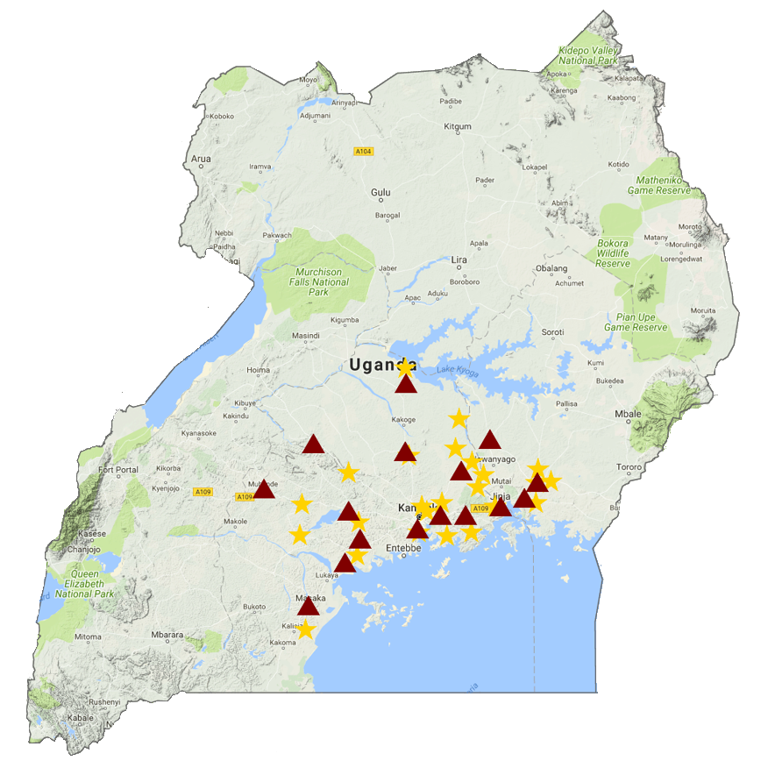
Study setting
24 health centers (spokes) linked to 16 Xpert testing sites (hubs)
Selected based on 2015 Uganda TB case notification data and proximity to Kampala (within 6 hours)
Notes:
To define the quality gap and assess compliance with these standards, we focused on 24 health centers linked to 16 Xpert testing sites. The health centers are shown in yellow on the map and the Xpert sites in red. The 24 health centers were selected based on pre-defined criteria assessed using NTLP case notification data. The criteria ensured that health centers performed a minimum amount of TB testing and treatment so that we would have adequate power to test our hypotheses. We reviewed the list of health centers meeting these criteria with the NTLP and together selected sites. We focused on health centers that were outside Kampala but in reasonable proximity to reduce travel time and costs.
Our goal was to include all adults undergoing TB evaluation at these health centers and to capture the outcomes of their Tb evaluation, so whether they underwent sputum-based testing, what testing, whether they started TB treatment and when they started treatment.

Slide 6
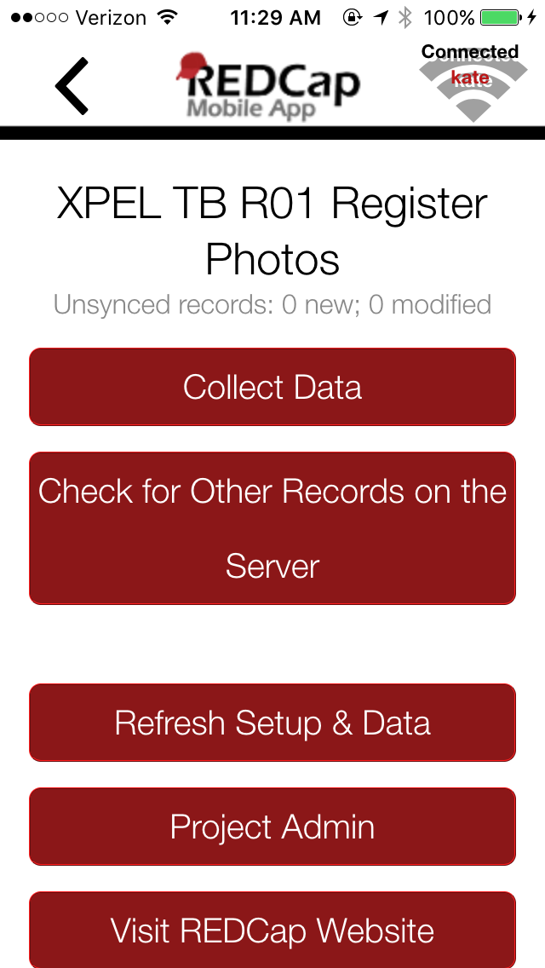
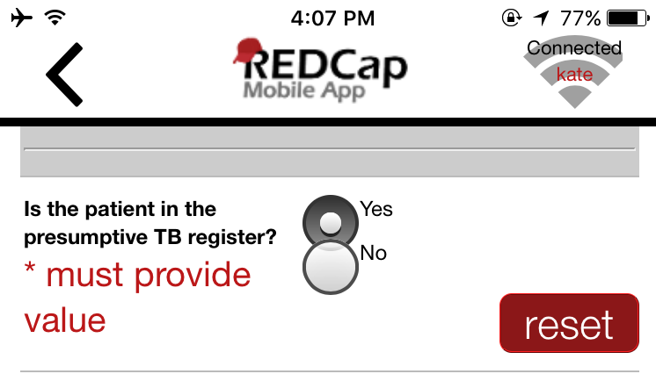
Pragmatic collection of TB evaluation outcome data
Data collection from routine data sources
Data sources: Presumptive TB register, TB laboratory register, Xpert requisition forms, TB treatment register
GxAlert server and machine data used to ensure complete capture of Xpert results
1. Take & upload photos
2. Extract patient-level data
3. Resolve queries
Health Center Staff
(every 2 weeks)
Study Staff
Study Staff/Health Center Staff
Notes:
To do this, we set up what I think is an innovative data collection system to reflect routine care.
The data collection utilized routine data sources already available at the health centers. These included the presumptive TB register, TB laboratory register, Xpert requisition forms, and TB treatment register. We trained two health center staff not involved in TB evaluation to take photos of these data sources every two weeks using a camera-enabled smart phone and to upload the photos to a secure REDCap server.
Study staff first verified that each batch of photos was complete and that the photos were clear, and then extracted patient-level data from the photos using a standardized REDCap data entry form. The patient-level data included age and gender, HIV and ART status, TB test dates and results and TB treatment dates and results. After the initial extraction, study staff resolved queries including key missing data and any patients they had difficulty matching across data sources by calling health center staff. This process repeated itself every two weeks, enabling near real-time surveillance and monitoring of TB evaluation.
In addition to the primary data sources, study staff extracted Xpert testing data from the GxAlert server at NTLP to ensure complete capture of Xpert test results.

Slide 7
Aim 1: Quality of TB diagnostic evaluation
6744 adults undergoing pulmonary TB evaluation (Jan – Dec 2017) | % | Range
Indicator 1: Proportion referred for sputum-based TB testing | 79% | 59 – 92%
Indicator 2: Proportion completing recommended TB testing (if referred) | 56% | 21 – 81%
Indicator 3: Proportion treated within 14 days (if smear- or Xpert-positive) | 75% | 14 – 100%
Indicator 4: Proportion receiving ISTC-recommended care | 42% | 16 – 64%
Davis JL, Katamba A et al. AJRCCM. 2011
Farr K, Nalugwa T et al. JC TUBE 2019
Notes:
Here’s what we found among the 2594 adults evaluated for pulmonary TB across the 24 heath centers over a 6 month period.
81% were referred for sputum-based TB testing, 55% completed TB testing if referred, and 73% were treated within 14 days if smear or Xpert results were positive.
What this means is that if you were a smear or Xpert positive patient presenting to these health centers, you had on average just a 33% chance of being diagnosed and treated.

Slide 8
Utilization of Xpert testing
20% (1316/6744) of patients referred for Xpert testing
33% (1075/3229) of HIV-positive adults
7% (241/3515) of HIV-negative adults
6% (81/1316) of patients referred for Xpert as first-line test
52% (63/119) of Xpert-positive patients initiated treatment within 14 days
High coverage of Xpert testing services ≠ High quality care
Farr K, Nalugwa T et al. JC TUBE 2019
Notes:
Since our primary focus is on Xpert scale-up, I include here additional data on Xpert utilization.
Only 17% of patients were referred for Xpert testing, including only one-third of patients who were HIV-positive and just 7% of those who were HIV negative.
<5% of patients were referred for Xpert as the first-line test, meaning Xpert testing was most often done after sputum smear microscopy. I’ll note again that Uganda guidelines recommend Xpert as a first-line test for HIV-infected patients.
Of the 48 patients with positive Xpert results, less than half were inititiated on treatment within 14 days.

Slide 9
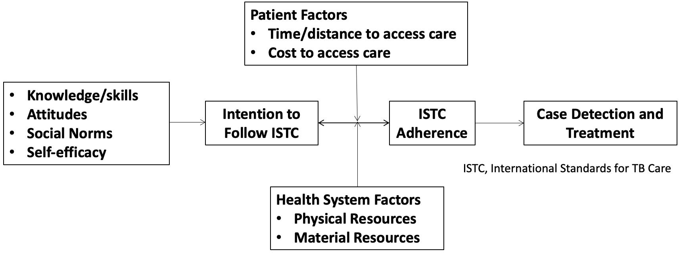
Aim 2: “Understand quality gap”
Conceptual Model: Theory of Planned Behavior
Notes:
Moving on to Aim 2, to understand the reasons for the quality gap, we conducted a mixed methods study. We used the theory of planned behavior as our conceptual model. This is a well known behavioral theory…..

Slide 10
Methods
Data collection
Key informant interviews (N=22 staff at 6 health centers)
Field observation
Surveys (N=64 presumed TB patients at 6 health centers)
Analysis
Qualitative data
Transcribe interviews and field notes
Apply standard coding scheme to identify recurring themes/sub-themes
Quantitative data: descriptive statistics

Slide 11
Aim 2 Summary: Barriers to high-quality TB evaluation
PRECEDE framework | Recurring themes
Predisposing factors (Knowledge, attitudes, beliefs, intention) | Time and resource constraints (i.e., high workload) → low self-efficacy Belief that TB evaluation is not urgent
Enabling Factors (Factors that if addressed make it easier to initiate the desired behavior) | Failure of patients to return after initial visit (due to time and costs) Inconsistent/delayed specimen transport to Xpert testing sites Inability to track and follow-up patients “When they have a cough for more than 2 weeks they are sent to the lab. But the problem is they get the first sample and sometimes, actually most times they don’t bring the second sample.”
Reinforcing Factors (Factors that if addressed make it easier to continue the desired behavior) | Lack of communication and coordination among staff Insufficient oversight from NTP “…Actually at times we have met but we don’t meet [regularly], only when we realize there is a problem that’s when we communicate and say why is this happening, then we try to rectify.”
1. Shete P, Haguma P et al. IJTLD 2015; 2. Nalugwa T, Shete PB et al. BMC Health Serv Res 2020; 3. Cattamanchi A et al. BMC Health Serv Res. 2015
Notes:
I’ve listed on the slide some of the key barriers identified. The barriers are categorized using the PRECEDE framework, which is a well-validated framework for designing behavior change interventions. The framework classifies barriers as predisposing, enabling or reinforcing factors, and interventions that target barries within each of these categories are more likely to result in successful behavior change.

Slide 12
Aim 3: “Improve quality gap”
Intervention design process:
Evidence review
Stakeholder consultation
Feasibility
Prioritize barriers
Select interventions
Specify how interventions delivered

Slide 13
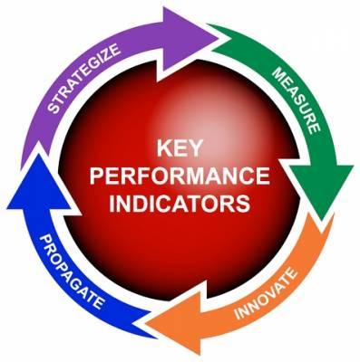
XPEL TB Intervention Strategy
Onsite Xpert testing at health clinic
Reduce workload, increase speed and accuracy of testing
Structured clinic process redesign to facilitate same day testing and treatment of TB
Address lack of urgency and failure of patients to return
Regular feedback of quality metrics to health facility staff
Improve communication, coordination and oversight

Slide 14
XPEL TB trial design and population
Objective: To evaluate the effectiveness, implementation and costs/cost-effectiveness of the XPEL TB strategy at community health centers.
Design: Cluster-randomized, hybrid effectiveness implementation (Type 2) trial at 20 community health centers in Uganda
Population: All adults evaluated for pulmonary TB from Oct 2018 to Mar 2020
Patients with RIF resistance excluded from analysis
Reza T, Nalugwa T et al. Implement Sci 2020
Cattamanchi A et al. NEJM 2021

Slide 15
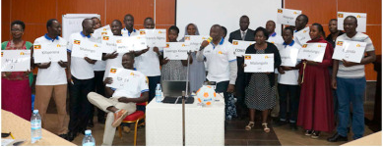
XPEL TB trial procedures
Public randomization ceremony
restricted + stratified randomization using 2017 TB data
“Ultra-pragmatic features”
Waiver of informed consent
No trial-specific changes to usual care (e.g., no CXR, culture, additional patient contact)
Outcomes assessed using routine data sources (i.e., TB registers)
Minimal contact with health centers
initial training visit + quarterly site visits to resolve data queries and conduct nested sub-studies
Reza T, Nalugwa T et al. Implement Sci 2020
Reza T, Nalugwa T et al Contemporary Clinical Trials communication

Slide 16
XPEL TB trial effectiveness outcomes
Secondary outcomes:
Care Cascade | Outcome
Testing | Number completing TB testing per national guidelines
Diagnosis | Number diagnosed with confirmed TB*
Treatment | Number treated for confirmed TB*
Treatment | Number treated for TB*
Primary outcome:
Number of patients treated for microbiologically-confirmed TB within 14 days
*Assessed within 1-day (same-day) and 14 days

Slide 17
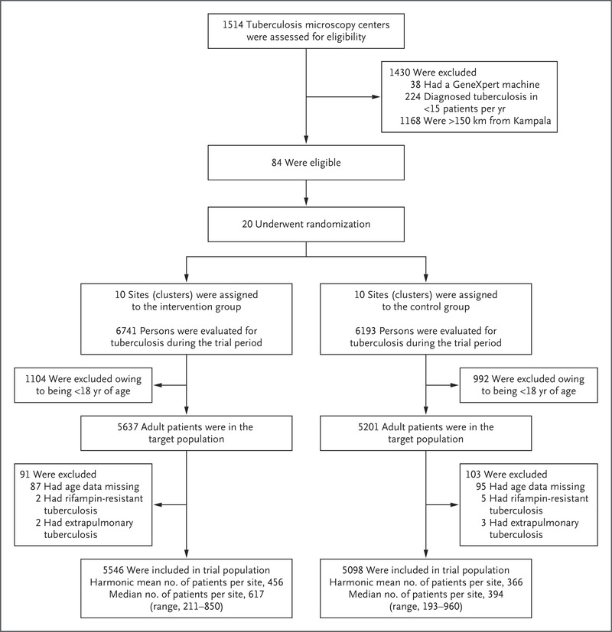
Trial flow chart
20 of 84 eligible health centers selected and randomized
>10,000 in target population (adults evaluated for pulmonary TB)
<2% excluded
Harmonic mean number of patients higher in intervention arm (456 vs. 366)
Cattamanchi A et al. NEJM 2021

Slide 18
Patient-level characteristics
Characteristic | Intervention (n=5,546) | Control (n=5,093)
Female – no. (%) | 3289 (59.3) | 3112 (61.0)
Age in years – median (IQR) | 40 (30-52) | 38 (27-50)-
HIV status* – no. (%)
Positive | 2,285/5273 (43.3) | 1,905/4290 (44.4)
Negative | 2,988/5273 (56.7) | 2,385/4290 (55.6)
Cattamanchi A et al. NEJM 2021

Slide 19
Primary outcome
Cluster-level analysis using negative binomial regression models
Adjusted rate ratio: 1.56 (1.21– 2.01)*
* Adjusted for: Randomization strata, number of patients treated for confirmed TB within 14 days in 12-month pre-trial period
Cattamanchi A et al. NEJM 2021

Slide 20
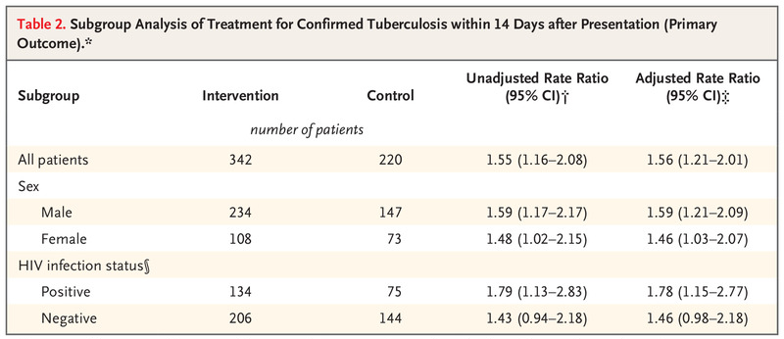
Subgroup analyses of primary outcome
* Adjusted for: Randomization strata, number of patients treated for confirmed TB within 14 days in 12-month pre-trial period
Cattamanchi A et al. NEJM 2021

Slide 21
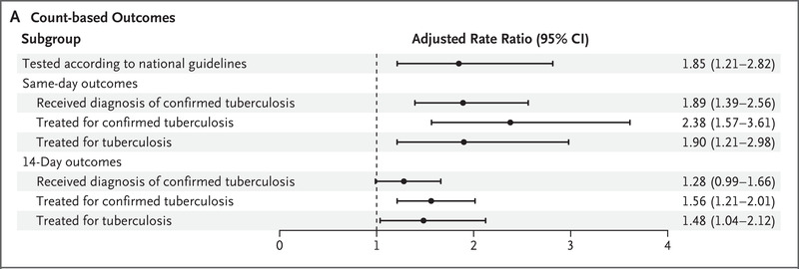
Secondary outcomes
High implementation fidelity and improved quality across the cascade of care
Cattamanchi A et al. NEJM 2021

Slide 22
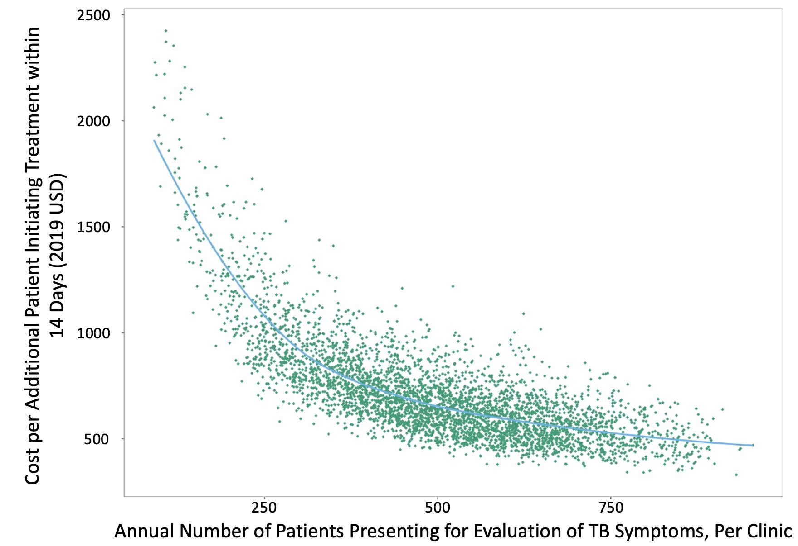
Costs and incremental cost-effectiveness ratio (ICER)
Outcome | Centralized testing | Decentralized testing
Cost per test | $20.61 (18.63 27.20) | $20.46 (17.85, 25.72)
Cost per patient | $9.59 (7.62, 14.34) | $20.28 (17.68, 25.48)
ICER* |  | $687 (501, 1,207)
* Cost per additional treatment within 14 days

Slide 23
Key limitations
Potential imbalance in the underlying prevalence of TB and other factors by trial arm given relatively small number of clusters
Multi-faceted intervention – effect of decentralized molecular testing alone unknown
Generalizability – uptake and impact of intervention strategy in other high burden countries uncertain

Slide 24
Conclusions
Scale-up of novel diagnostics alone is unlikely to significantly increase case detection or improve patient outcomes
The XPEL TB strategy (onsite Xpert testing + implementation supports)
increased 14-day TB diagnosis and treatment by 56%
improved quality metrics at each step along the TB diagnostic evaluation cascade of care
National TB programs should consider decentralized molecular testing to close the case detection gap and improve quality of care
Implementation science-based methods are useful for designing and evaluating health system interventions to improve quality of care

Slide 25
Acknowledgements
Principal Investigator: Adithya Cattamanchi (UCSF)
Co-Investigators: Luke Davis (Yale), David Dowdy (Johns Hopkins), Priya Shete (UCSF), David Moore (LSHTM), Katherine Fielding (LSHTM), Sara Ackerman (UCSF), Margaret Handley (UCSF)
Study Coordinators: Talemwa Nalugwa (U-TIRC), Kate Farr/Tania Reza (UCSF)
Laboratory Technologist: Mariam Nantale (U-TIRC)
Research Assistants: Denis Oyuku, Annet Nakaweesa, Johnson Musinguzi (U-TIRC)
Uganda MoH: Stavia Turyahabwe, Moses Joloba
Funding:
U.S. National Institutes of Health
GeneXpert devices donated by Cepheid via FIND

