Slide 1








Beyond TB: a person-centred and rights-based approach for people affected by TB and their households
Claire Calderwood & Katharina Kranzer
London School of Hygiene & Tropical Medicine, UK
Biomedical Research & Training Institute, Zimbabwe
LIV-TB | September 2023

Slide 2
Outline
Rationale
Social protection for households affected by TB
Preliminary data from IMBA Hutano

Slide 3
TB, Multimorbidity and Syndemics
x
  Life circumstances
x
Community
Household
Social &
financial capital
Health system & policies
Person with TB
Health provider & facility
Social, cultural & political structures
Stigma
Behaviours
Mtb transmission
Biology
Notes:
Person centred care

Slide 4
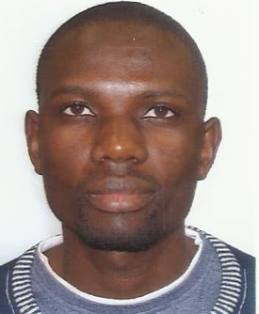
Livelihood and social protection
Socioeconomic effect of TB and social protection
Money-centric vs holistic measures
Household (and its members) as unit of analysis and intervention

Slide 5

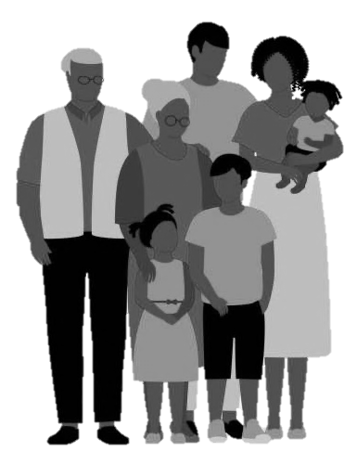
The household

Slide 6
The household
Deprived socioeconomic circumstances
Limited access to health care
Crowding
Malnutrition
Risk factors for TB:
HIV, DM, smoking,
silicosis

Slide 7
The household
Deprived socioeconomic circumstances
Crowding
Malnutrition
Risk factors for TB:
HIV, DM, smoking,
silicosis
Limited access to health care
Aerosol Mtb transmission = secondary TB cases
Catastrophic costs (impoverishment)
Stigma
Clustering of risk factors (HIV, DM)
Undiagnosed disease

Slide 8
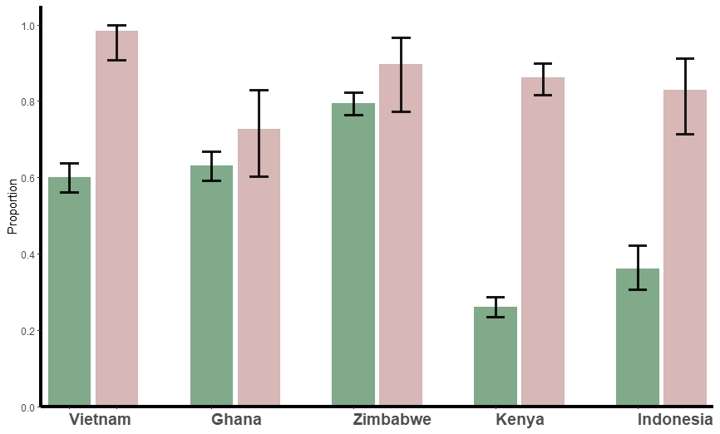


Patient cost survey
Catastrophic costs = total costs (direct and indirect) costs 20% of a household’s annual income
Drug resistant TB
Drug susceptible TB
WHO/CDS/TB/2019.15; https://www.researchsquare.com/article/rs-29280/v1

Slide 9
Effect of social protection
Author (year) | Setting | Population | Outcome | Intervention | Effect estimate
Carter 2019 | Brazil | 13029 DS-TB | Tx success | $55.60/month | 87.2% (i) vs 76.6% (c)
Klein 2018 | Argentina | 941 DS-TB | Tx success | Cash | 83% (i) vs 69% (c); aRR=2.9 (2.0–4.3)
Lutge 2013 | South Africa | 4091 DS-TB | Tx success | Monthly food vouchers ($15) | 76% (i) vs 71% (c)
Torrens 2018 | Brazil | 7255 DS-TB | Tx success | $55.60/month | 82% (i) vs 77% (c), aRR=1.07 (1.04–.11)
Reis-Santos 2019 | Brazil | 25084 DS-TB | Tx success | $55.60/month | 78% (i) vs 68% (c); aRR=1.16 (1.05–1.11)
Wingfield 2016 | Peru | 312 TB affected HH | Catastrophic costs | $230 + psychosocial visits | Prevalence of catastrophic costs: 30% (i) vs 42% (c)
Rogers 2018 | Liberia | 513 DS-TB | Tx success | Cash + social assistance | 82.5% (i) vs 69% (c), LTFU 2.1% (i) vs 9.5% (c)
Wingfield 2017 | Peru | 24 DR-TB 258 DS-TB | Tx success | $230 | 64% (i) vs 53% (c); OR=1.6 (1.00–2.60)
Ngamvith 2013 | Thailand | 759 DS-TB | Tx success | $3-$132 per visit dep. on need + home visits | 69.3% (i) vs 51.6% (c); RR=1.35 (1.20–1.53)
Yin 2018 | China | 218 DR-TB | Tx success | $20/month | 78% (i) vs 52% (c)
Ukwaja 2017 | Nigeria | 294 DS-TB | Tx success | $15/month | 86.0% (i) vs 71.1% (c); aOR=2.3 (1.20–30)
Martins 2009 | Timor-Leste | 270 DS-TB | Tx success | Meals & food | 78% (i) vs. 76% (c); RR=1.15 (0.87–1.52)

Slide 10
Effect of social protection
Author (year) | Setting | Population | Outcome | Intervention | Effect estimate
Carter 2019 | Brazil | 13029 DS-TB | Tx success | $55.60/month | 87.2% (i) vs 76.6% (c)
Klein 2018 | Argentina | 941 DS-TB | Tx success | Cash | 83% (i) vs 69% (c); aRR=2.9 (2.0–4.3)
Lutge 2013 | South Africa | 4091 DS-TB | Tx success | Monthly food vouchers ($15) | 76% (i) vs 71% (c)
Torrens 2018 | Brazil | 7255 DS-TB | Tx success | $55.60/month | 82% (i) vs 77% (c), aRR=1.07 (1.04–1.11)
Reis-Santos 2019 | Brazil | 25084 DS-TB | Tx success | $55.60/month | 78% (i) vs 68% (c); aRR=1.16 (1.05–1.11)
Wingfield 2016 | Peru | 312 TB affected HH | Catastrophic costs | $230 + psychosocial visits | Prevalence of catastrophic costs: 30% (i) vs 42% (c)
Rogers 2018 | Liberia | 513 DS-TB | Tx success | Cash + social assistance | 82.5% (i) vs 69% (c), LTFU 2.1% (i) vs 9.5% (c)
Wingfield 2017 | Peru | 24 DR-TB 258 DS-TB | Tx success | $230 | 64% (i) vs 53% (c); OR=1.6 (95% CI:1.00–2.60)
Ngamvith 2013 | Thailand | 759 DS-TB | Tx success | $3-$132 per visit dep. on need + home visits | 69.3% (i) vs 51.6% (c); RR=1.35 (1.20–1.53)
Yin 2018 | China | 218 DR-TB | Tx success | $20/month | 78% (i) vs 52% (c)
Ukwaja 2017 | Nigeria | 294 DS-TB | Tx success | $15/month | 86.0% (i) vs 71.1% (c); aOR=2.3 (1.20–30)
Martins 2009 | Timor-Leste | 270 DS-TB | Tx success | Meals & food | 78% (i) vs. 76% (c); RR=1.15 (0.87–1.52)

Slide 11
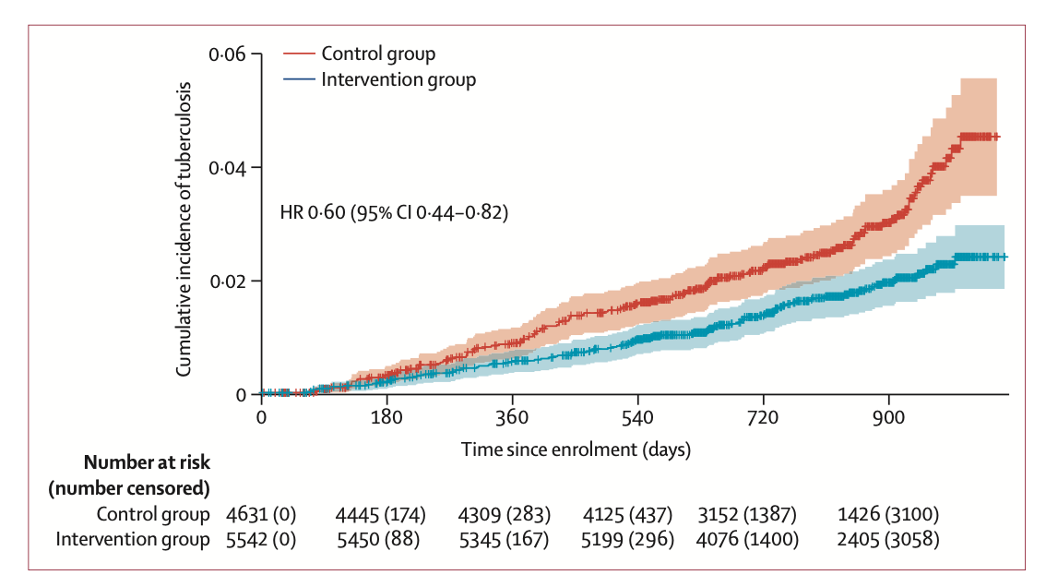
Incident TB among HHC in India
Bhargava et al, Lancet 2023

Slide 12
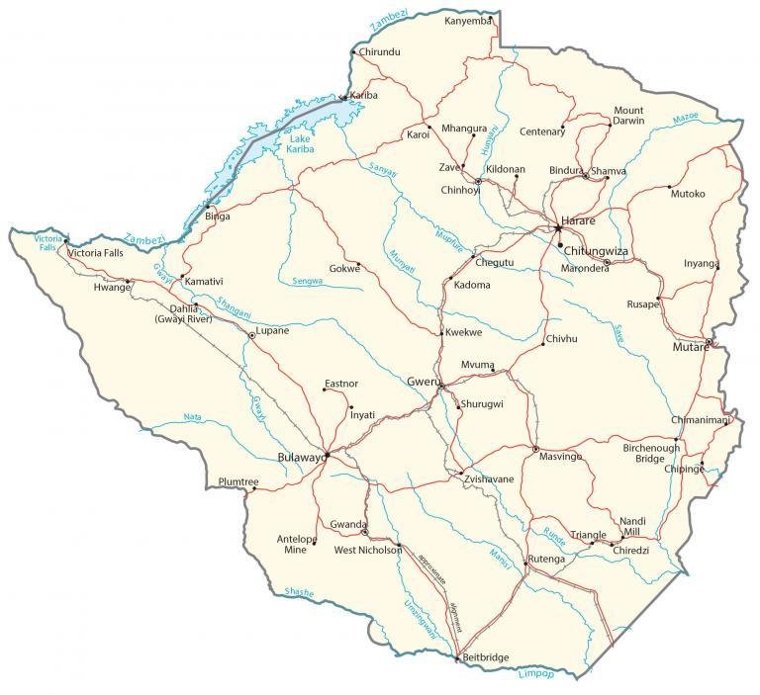
Zimbabwe: Epidemiological context
40% people live in poverty (<USD1.90pp/day)
90% unemployment (+ informal sector)
7% households experienced catastrophic health spending in 2015 (80% of TB households)
1 in 3 households have severe food insecurity: 23% children <5 have stunting, 3% have wasting
12% adults have HIV (89% diagnosed)
10% adults have diabetes (<50% diagnosed)
Up to 37% adults have symptoms of common mental disorders
High rates of alcohol and substance misuse, particularly among young men (no estimates)
HIV is the leading risk factor for TB, followed by undernutrition

Slide 13
Conditional cash transfers in Zimbabwe
Retrospective cohort
People registered for MDR-TB treatment (2014-2021), 35 selected health facilities in four provinces
Information on CCT obtained from national disbursement logs
TB treatment outcomes extracted from DR-TB registers
Qualitative study
16 in depth interviews with people in the continuation phase of DR-TB treatment
Timire et al Plos GPH 2023 https://pubmed.ncbi.nlm.nih.gov/36962815/

Slide 14
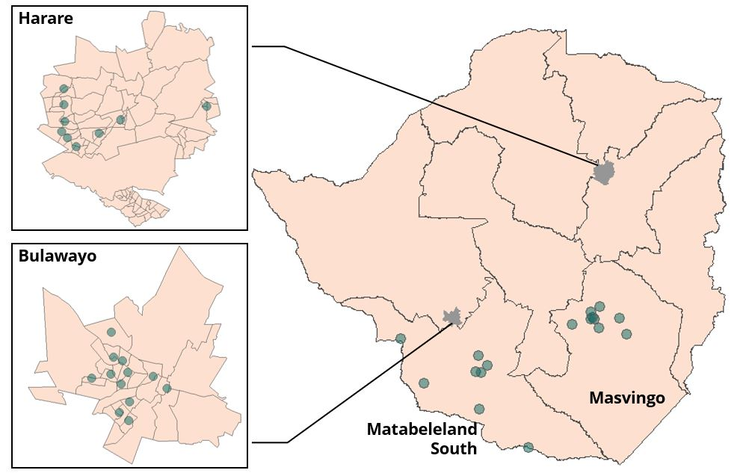
Methods: health care facilities

Slide 15
Unsuccessful outcomes & proportion receiving CCT
481 enrolled, 61% men
53% received CCTs
Receiving CCTs
Death/LFTU: RR=0.27 (0.18–0.41)
Mat South & Harare
Enrolment in 2018–2019
Proportion in DR-TB care
3 months
Months since treatment initiation

Slide 16
Results
119 (25%) died/LTFU in the first 3 months. Of these, only 21 (18%) received CCTs. Overall, 45% had unsuccessful outcomes.
481 registered for DR-TB treatment in 35 clinics with recorded treatment outcomes
91 died within
3 mo of tx initiation
28 LTFU within 3 mo of tx initiation
362 included in the analysis assessing effectiveness of CCTs
100 unsuccessful outcomes
262 successful outcomes
53 did not received CCT
47 received CCT
186 received CCT
76 did not receive CCT

Slide 17
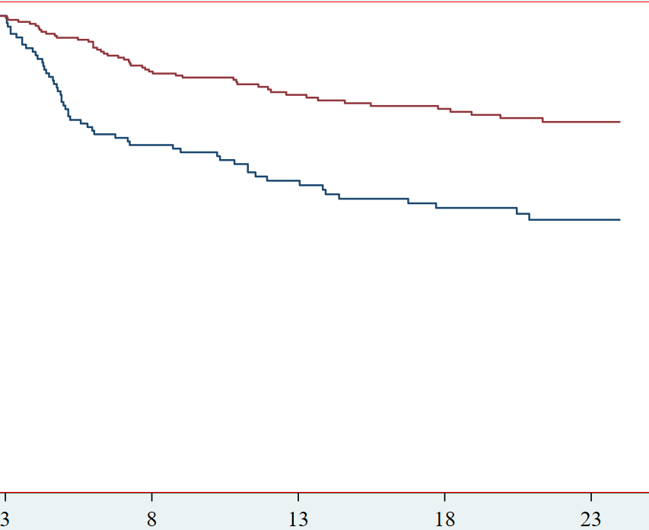
Effect of CCTs on outcomes
Received CCTs
aHR*=0.43 (0.28-0.63) for unsuccessful treatment outcomes (comparing those who received CCT versus those who did not)
Did not receive CCTs
Proportion in DR-TB care & alive
*adjusted for age, sex, province, year of treatment initiation
Months since treatment initiation

Slide 18
Money centric measures to capture the socioeconomic effect of TB?
Income is an unstable metric particularly among people who are informally employed or rely on seasonal jobs
Benchmarking measures against income affects reproducibility and reliability of findings since the resultant estimates vary depending on how income is estimated
Costs and income do not account for coping strategies and social consequences in their estimates
Poor people may not have any money to spend and develop ”other” coping strategies (for example reducing number of meals)

Slide 19
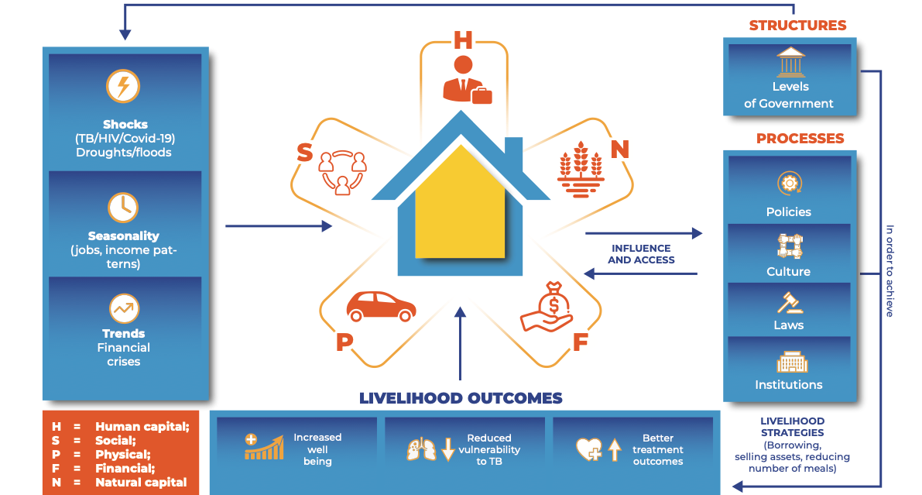
The sustainable livelihood framework
Timire et al, CID 2023 https://pubmed.ncbi.nlm.nih.gov/37132328/

Slide 20
Livelihood in households with / without TB
270 households (prospectively enrolled)
(90 DR-TB, 90 DS-TB, 90 community)
4 provinces
Two interviews – 6 months apart

Slide 21
Changes in circumstance
Variables | Community | DS-TB | DR-TB | P value
Individual
Hospitalisation* | 2% | 20% | 41% | <0.01
Loss of income* | 51% | 82% | 88% | <0.01
Change of residence* | 9% | 32% | 37% | <0.01
Household
History of TB | 31% | 39% | 50% | 0.03
Death of a household member* | 16% | 19% | 22% | 0.64
Household member requiring care* | 22% | 67% | 78% | <0.01
Under the poverty line 12 mo ago | 23% | 45% | 41% | 0.03
Under the poverty line now | 81% | 88% | 94% | 0.02
*past 12 months

Slide 22
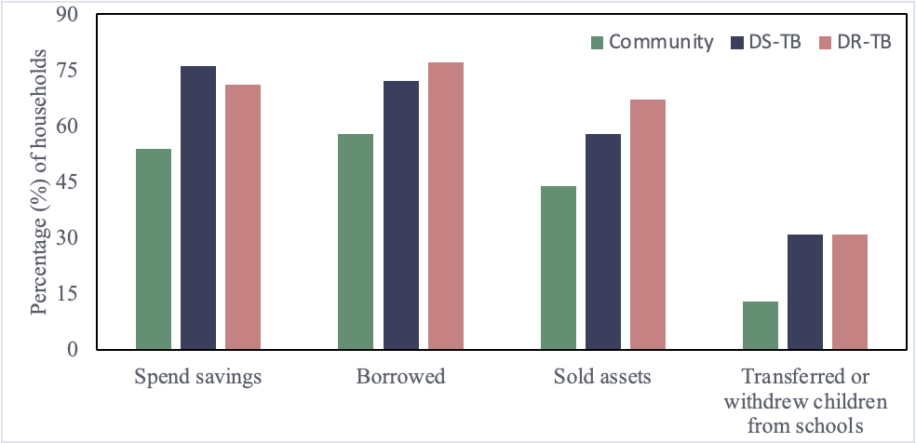
Coping strategies

Slide 23
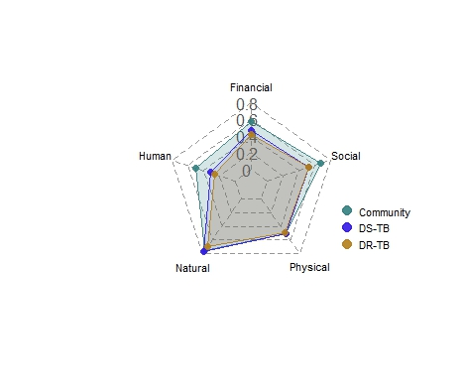
Loss of livelihood
Type of household | aPR (95% CI)
Community | 1
DR-TB | 2.02 (1.35–3.03)
DS-TB | 2.06 (1.38–3.07)

Slide 24
The household
Deprived socioeconomic circumstances
Crowding
Malnutrition
Risk factors for TB:
HIV, DM, smoking,
silicosis
Limited access to health care
Aerosol Mtb transmission = secondary TB cases
Catastrophic costs (impoverishment)
Stigma
Clustering of risk factors (HIV, DM)
Undiagnosed disease

Slide 25
The household
HIV
55%^{b}
Mental health conditions
?
TB
3%
Diabetes
17%^{b}
↓ nutrition 16%-35%^{c}
Alcohol use disorders
?
Chronic lung disease
41%^{c}
References: HIV= Ayles et al, Lancet (2013); CLD= Singla et al, IJTLD (2011); Nutr= Shivakumar et al, IJTLD (2018) + Bhargava et al, Lancet (2023); DM= Restrepo et al, Tuberculosis (2018)

Slide 26
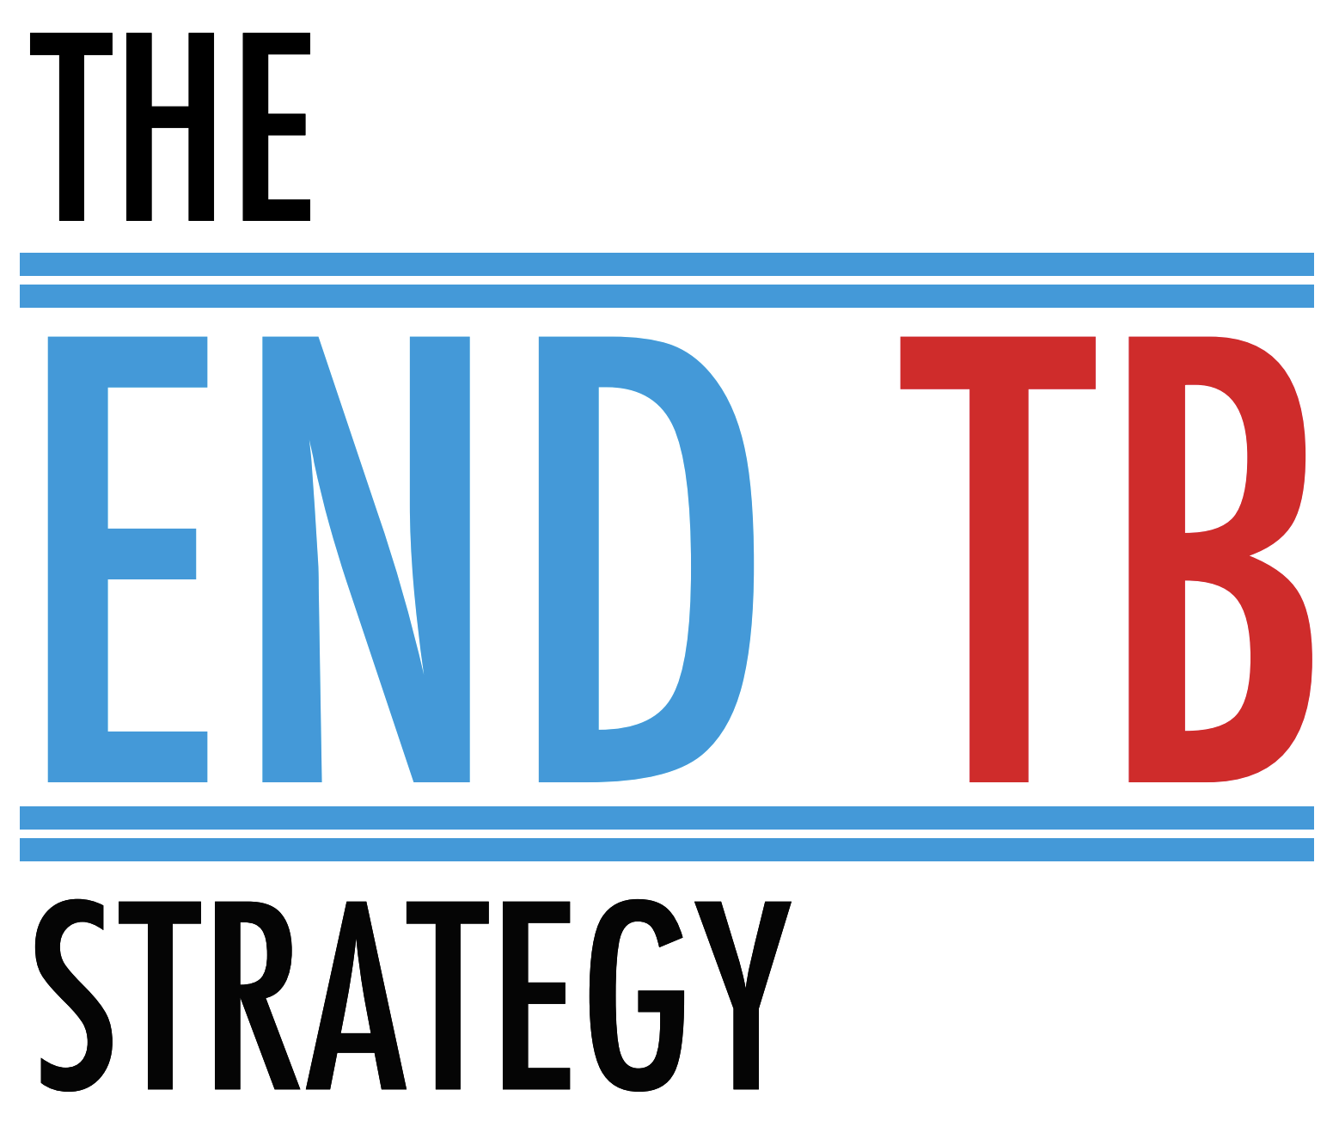
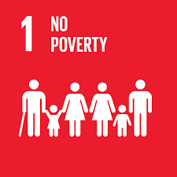

Rationale for IMBA Hutano
TB remains a major public health threat in Africa: innovation and upscaling of TB screening (and TPT) is needed.
These epidemics are reinforced by structural factors: the poorest experience the greatest burden of poor health, and highest barriers in accessing healthcare.
NCDs are an emerging public heath threat in Africa: expansion of access to diagnostic and treatment services (and broader public health interventions) is urgently needed.

Slide 27

Aim
Could integrating TB screening with screening for other diseases improve the health of TB affected households in southern Africa?

Slide 28
Methods: ERASE-TB
Study design:
  Three sites: Mozambique, Tanzania, Zimbabwe
  2100 HHC (≥10 years) of adults with highly infectious pulmonary TB
Main objectives:
  To diagnose TB earlier (reduce transmission)
  To identify individuals with high risk of developing TB (target for TPT)
Secondary objective:
- To estimate the proportion of HHCs with chronic diseases at baseline and explore the relationship between chronic diseases and co- prevalent/incident TB.
Sub-study objectives:
- Explore experiences, understandings, preferences, and the social context of disease screening in user communities, healthcare workers and policy makers.
- Evaluate the feasibility and potential impact of integrated multi-disease screening through a pilot screening package for TB household contacts in Zimbabwe.
Add in substudy obj
Notes:
Add logos

Slide 29
Methods: ERASE-TB
Mozambique
Tanzania
Zimbabwe
Adult TB index case
BMI
Spirometry
HIV
BP
HbA1c
Haemoglobin
AUDIT-C
HHC (age 10+) recruited
WHO symptom screen & CXR → Xpert Ultra
Sample biobanking
TB
No TB
HHC invited for further study visits at 6, 12, 18, 24 months
Notes:
Already happening – me
Highlight which are mine
-

Slide 30
Methods: ERASE-TB
Zimbabwe
Adult TB index case
HHC (age 10+) recruited
NESTED SCREENING COHORT
WHO symptom screen & CXR → Xpert Ultra
Sample biobanking
TB
No TB
HHC invited for further study visits at 6, 12, 18, 24 months
Notes:
Already happening – me
Highlight which are mine
-

Slide 31
Methods: Integrated health check
Health Check
On-site
Referral
TB
Xpert Ultra
TB services
HIV
ART services
Underweight
NGO / social services
Overweight
High BP
Chronic disease clinics
Information, education and counselling
Diabetes
Anaemia
SSQ+
CSU (counselling)
Hazardous alcohol
Reading glasses
Near vision impairment
Vision impairment
Ophthalmology clinic
Notes:
PHC tertiary NGO
ADD DETAIL
What we have learned
- Phone counselling vs face to face

Slide 32
Demographics: HHC
 |  | Total N = 2,108 | Zimbabwe N = 700 | Mozambique N = 710 | Tanzania N = 698
Men |  | 796 (38%) | 264 (38%) | 281 (40%) | 251 (36%)
Age ^{A} | 10-17 | 619 (29%) | 194 (28%) | 223 (31%) | 202 (29%)
 | 18-39 | 912 (43%) | 320 (46%) | 319 (45%) | 273 (39%)
 | >40 | 576 (27%) | 186 (27%) | 168 (24%) | 222 (32%)
Education ^{B} | None/primary | 961 (48%) | 186 (28%) | 266 (40%) | 509 (76%)
 | Secondary | 1,042 (52%) | 474 (72%) | 404 (60%) | 164 (24%)
Food insecurity |  | 572 (27%) | 281 (40%) | 251 (35%) | 40 (5.7%)
^{A} Missing for 1 person; ^{B} Missing for 105 people

Slide 33
Demographics: HHC
Characteristic | Total N = 822 | Zimbabwe N = 268 | Mozambique N = 277 | Tanzania N = 277
N people in household | 5 (1–20) | 4 (2–20) | 6 (2–16) | 4 (1–13)
Crowding ^{A} | 169 (21%) | 79 (29%) | 67 (24%) | 23 (8.3%)
Income/person/day, USD | 0.64 (0.00–49.18) | 0.74 (0.00–49.18) | 0.64 (0.00–8.58) | 0.42 (0.02–4.93)
Breadwinner had TB ^{B} | 342 (42%) | 123 (46%) | 73 (27%) | 146 (53%)
Income <1.9USD/person/day ^{C} | 606 (90%) | 214 (86%) | 213 (90%) | 179 (95%)
^{A} Crowding according to the UN (≥3 people per room). ^{B} Missing for 3 people; ^{C} Missing for 146 people

Slide 34
’Behavioural’ risk factors
 |  | Total N = 2,108 | Zimbabwe N = 700 | Mozambique N = 710 | Tanzania N = 698
Smoking status | Non smoker | 1,949 (93%) | 613 (88%) | 681 (96%) | 655 (94%)
 | Ever smoker | 158 (7.5%) | 86 (12%) | 29 (4.1%) | 43 (6.2%)
Pack years smoking |  | 1.8 (0.5–4.5) | 1.8 (0.5–5.0) | 1.8 (1.3–3.8) | 1.8 (0.5–4.1)
Alcohol intake | No alcohol | 242 (33%) | 86 (39%) | 53 (21%) | 103 (41%)
 | AUDIT-C negative | 215 (29%) | 41 (19%) | 114 (44%) | 60 (24%)
 | AUDIT-C positive | 272 (37%) | 92 (42%) | 91 (35%) | 89 (35%)
History of mine work |  | 59 (2.8%) | 24 (3.4%) | 4 (0.6%) | 31 (4.4%)
History of imprisonment | Imprisonment | 29 (1.4%) | 16 (2.3%) | 6 (0.8%) | 7 (1.0%)

Slide 35
Diagnosed medical conditions
 | Total N = 2,108 | Zimbabwe N = 700 | Mozambique N = 710 | Tanzania N = 698
Known HIV | 292 (14%) | 104 (15%) | 109 (15%) | 79 (11%)
Previous TB | 127 (6.0%) | 38 (5.4%) | 62 (8.7%) | 27 (3.9%)
Known hypertension | 152 (8.1%) | 70 (10%) | 62 (8.7%) | 20 (4.3%)
Known diabetes | 29 (1.6%) | 11 (1.6%) | 12 (1.7%) | 6 (1.3%)
Any lung disease | 134 (7.2%) | 24 (3.6%) | 32 (4.5%) | 78 (16%)

Slide 36
Prevalence of chronic conditions
 |  | Overall N = 2,108
HIV |  | 15.4 (13.6–17.2)
Diabetes |  | 8.4 (6.9–9.9)
Hypertension |  | 23.0 (21.1–24.9)
BMI category ^{A} | Mod/severe underweight | 3.9 (3.0–4.8)
 | Mild underweight | 13.5 (12.0–15.1)
 | Healthy weight | 54.4 (52.2–56.7)
 | Overweight | 17.8 (16.1–19.5)
 | Obese | 10.3 (9.0–11.6)
Stunting ^{B} | None | 56.4 (52.1–60.6)
 | Mild | 27.1 (23.7–30.5)
 | Moderate | 12.9 (10.2–15.7)
 | Severe | 3.6 (2.0–5.1)
^{A} According to WHO criteria; ^{B} Among people under the age of 18 only

Slide 37
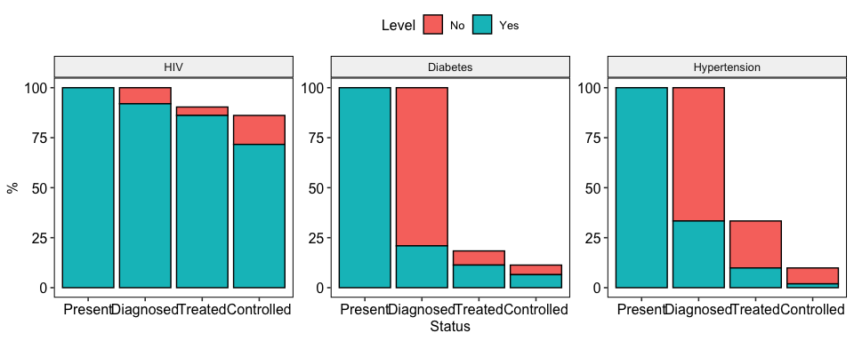
‘Cascade of care’
Status | Present | Diagnosed | Treated | Controlled
HIV | 15.4 (13.6–17.2) | 92.0 (88.7–95.2) | 95.3 (92.9–97.8) | 83.2 (78.1–88.2)
Diabetes | 8.4 (6.9–9.9) | 21.0 (13.4–28.5) | 61.5 (41.4–81.7) | 57.5 (29.1–85.9)
Hypertension | 23.0 (21.1–24.9) | 33.4 (28.7–38.0) | 29.6 (22.4–36.7) | 19.6 (7.6–31.6)

Slide 38
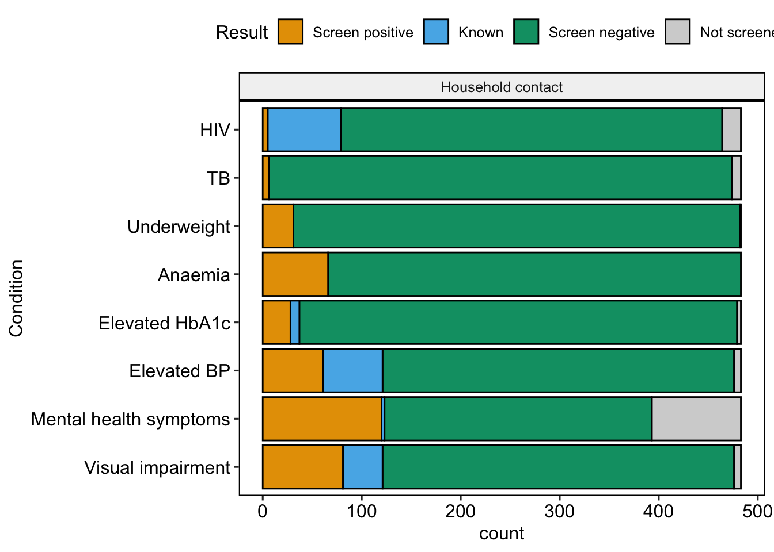
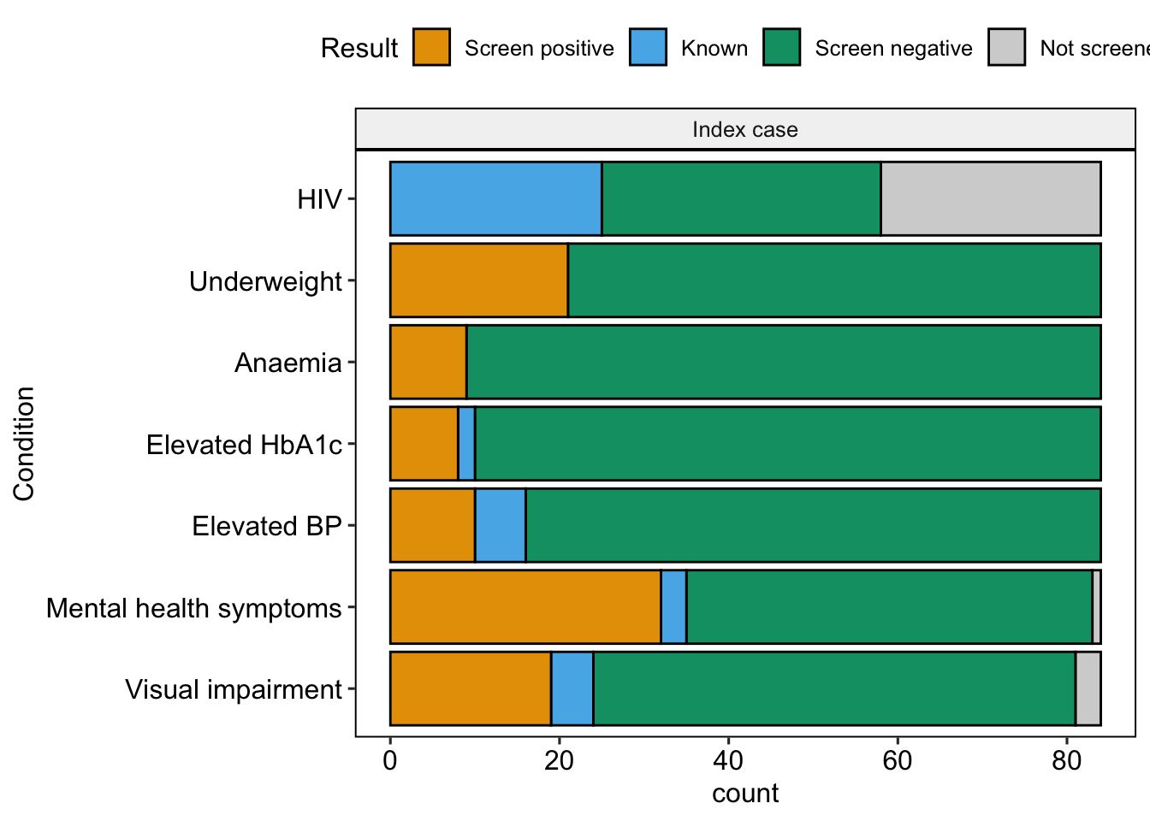
IMBA Hutano: Yield of screening

Slide 39
IMBA Hutano: Linkage to care
 | Overall |  |  | HHC |  |  | Index cases
 | Referred | Linked |  | Referred | Linked |  | Referred | Linked
 |  | N | % |  | N | % |  | N | %
Mental health | 155 | 69 | 45% | 123 | 58 | 47% | 32 | 11 | 34%
Hypertension | 109 | 41 | 38% | 97 | 40 | 41% | 12 | 1 | 8%
Vision | 90 | 46 | 51% | 74 | 40 | 54% | 16 | 6 | 38%
Diabetes | 42 | 12 | 29% | 32 | 10 | 31% | 10 | 2 | 20%
HIV | 7 | 1 | 14% | 7 | 1 | 14% | 0 | 0
Anaemia | 4 | 0 | 0% | 4 | 0 | 0% | 0 | 0
Undernutrition* | 41 | 22 | 54%
* For undernutrition the N refers to a number of households, not number of individuals; linkage to care was defined as receiving the majority food hampers required
Notes:
This is created in the Excel IMBA_allresults_Aug23

Slide 40
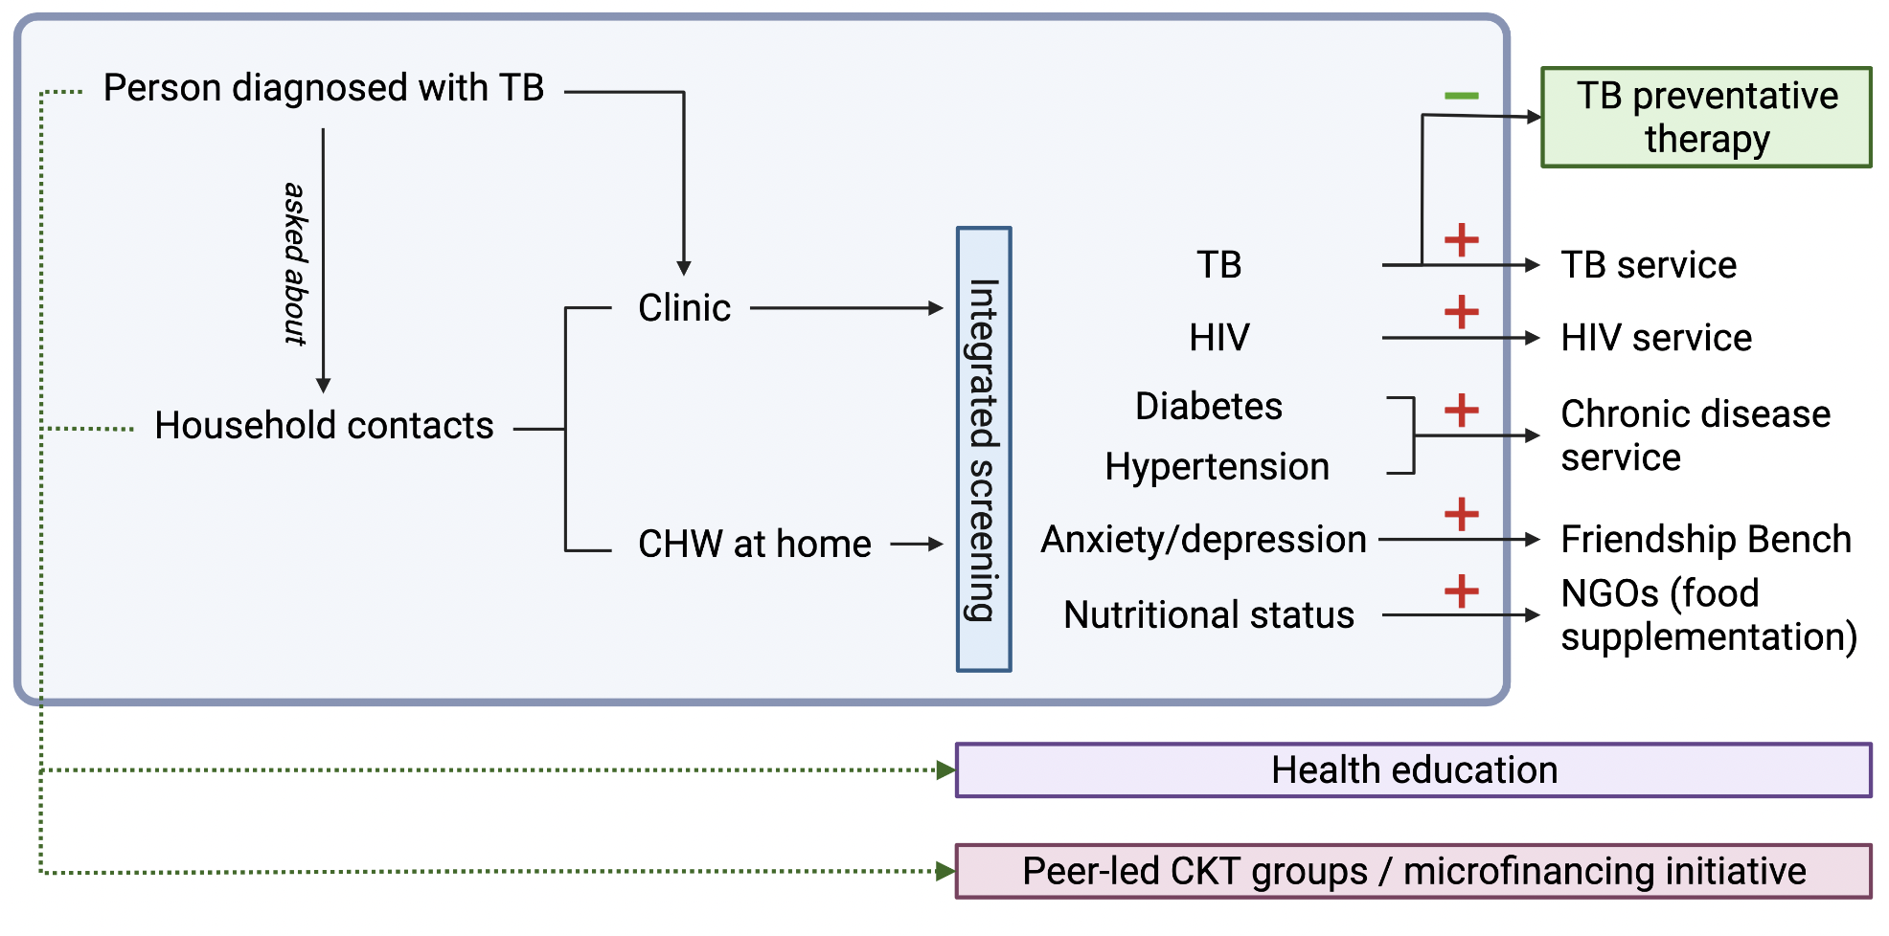
A model of integrated TB screening
What is important from a public health perspective?
What can the local health system manage?
What do local community members need and want?
Counselling
Food supplementation
Nutritional support / social protection
With thanks to: Karlos Madziva, Fungai Kavenga, Mx Ngwenya, Collins Timire, Constancia Mavodza & Katharina Kranzer
Notes:
Important from public health perspective = prevalent and associated with

Slide 41
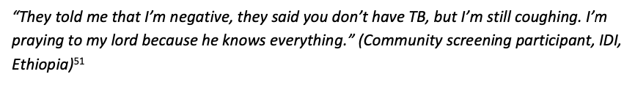
Community perspectives on TB screening
Relatively few studies identified in SR (despite ++ papers on TB screening)
People who are invited to screening also have other (urgent) priorities
Screening is dependent on people’s relationship with the health system
The benefit of screening might be greater for people who are unwell
Benefits of screening include education & support – more than ‘just TB’
Home visits – intrusive or high-quality and efficient?
A negative result might not be reassuring:
Tulloch et al, BMC PH (2015); Mendley et al presentation to WHO GDG
Notes:
Several studies have considered community perspectives on TB screening in order to give insight into these challenges.
Multiple and urgent competing priorities
Whilst a screening programme itself may be new, people have prior (often negative) experiences of health care seeking
These priorities and attitudes interact with how someone feels in themselves
TB policies = long term outcomes + community-level incidence. Communities = opportunity to know your status, better care for the index case. DIABETES.
Home visits - might reflect participating in a research programme, in contrast to their previous experiences accessing care
Of particular importance (10% or fewer of people in TB screening programmes who have symptoms actually have TB)

Slide 42
Delphi survey
Online survey open for responses from 11 July – 31 August 2023
Snowball sampling (N > 613)
  209 people emailed
  404 forwarded emails
  17 mailing lists
  Twitter posts
204 responses received
  189 in English; 12 in Spanish and 2 in Portuguese
  91 women and 109 men (4 identified as other genders)
Continent | N
Africa | 111
Asia | 36
Australia | 1
Europe | 16
N America | 8
S/C America | 18
Multiple | 14

Slide 43
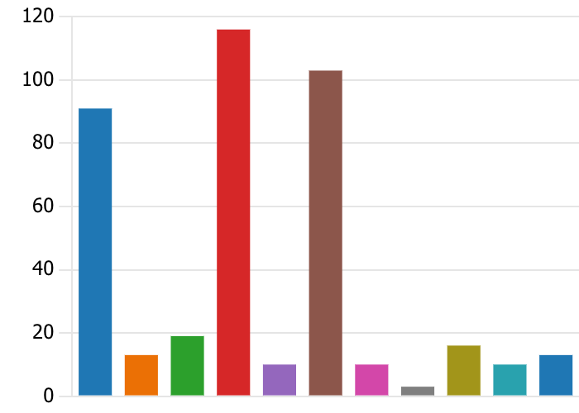
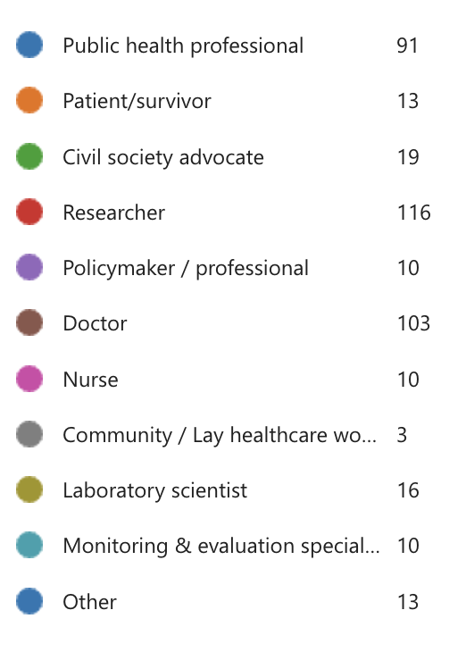
Participants: Professional background

Slide 44
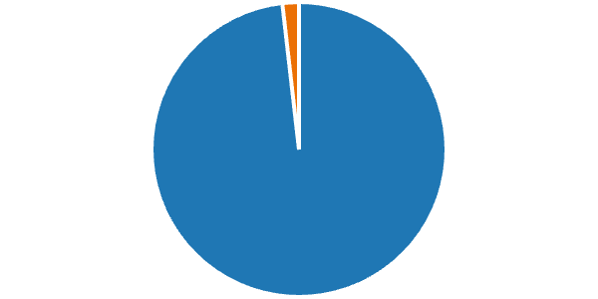
For people with TB
Would you consider screening for other conditions or providing other non-TB services?
No
4 (2%)
Yes
217 (98%)

Slide 45
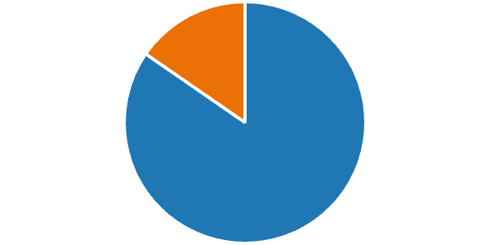
For household contacts
Would you consider screening for other conditions or providing other non-TB services:
No
34 (15%)
Yes
187 (85%)

Slide 46
Conclusions & questions
TB does not affect an individual in isolation
  Should TB research / programmes consider the household as a unit of analysis and intervention?
Social protection improves TB-specific outcomes
  What about other potential outcomes (e.g. education)?
TB-affected households experience multi-dimensional deprivation and vulnerability
  Should measures other than catastrophic costs be used?
TB-affected household members also have other unmet health needs
  Should TB contact tracing interventions offer other services that identify / address these needs?

Slide 47
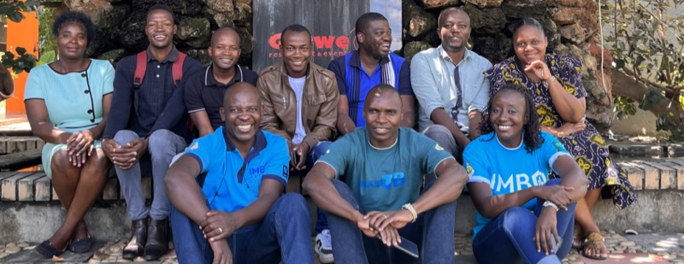










Slide 48
Methods: Integrated health check
Total household members
N = 700
Eligible people with TB
N = 272
Excluded (N = 67)
Died (N = 4)
Lost to follow up (N = 7)
Not recruited in eligible window (N = 29)
Withdrew from study (N = 27)
Did not participate (N= 188)
Busy with work (N = 29)
Died (N = 18)
Moved away (N = 52)
Not interested (N = 27)
Not reachable (N = 19)
TBC (N = 43)
Eligible for study
N = 633 (90%)
Did not participate (N = 232)
Did not attend visit (N = 116)
Telephone visit (N = 38)
?Protocol deviation (N = 11)
Participated in health check
N = 84 (31%)
Participated in health check
N = 483 (69%)
Visit 1
N = 234
Visit 2
N = 78
Visit 3
N = 157
Notes:
These numbers were updated 7th September 2023
Use the Participant Calendar Google Sheet to update

Slide 49
Results: Demographics
Characteristic | Overall N = 553 | Index case N = 84 | Household contact N = 469
Sex
Male | 215 (39%) | 46 (55%) | 169 (36%)
Female | 338 (61%) | 38 (45%) | 300 (64%)
Age, years | 30 (19–43) | 38 (29–44) | 28 (17–42)
Age category
<18 years | 119 (22%) | 0 (0%) | 119 (25%)
18-39 years | 260 (47%) | 47 (56%) | 213 (45%)
40+ years | 174 (31%) | 37 (44%) | 137 (29%)
Education
Illiterate/No education completed | 1 (0.2%) | 0 (0%) | 1 (0.2%)
Any primary school | 134 (24%) | 13 (15%) | 121 (26%)
Any secondary school | 392 (71%) | 66 (79%) | 326 (70%)
Any College/Vocational | 26 (4.7%) | 5 (6.0%) | 21 (4.5%)
Currently pregnant | 23 (7.4%) | 2 (5.9%) | 21 (7.6%)
Unknown | 243 | 50 | 193
Notes:
25% HHC are adolescents

Slide 50
Characteristic | Overall N = 553 | Index case N = 84 | Household contact N = 469
Current smoker | 45 (8.1%) | 5 (6.0%) | 40 (8.5%)
AUDIT category
Alcohol dependence | 33 (6.9%) | 10 (12%) | 23 (5.9%)
Harmful drinking | 22 (4.6%) | 4 (4.8%) | 18 (4.6%)
Non-harmful drinking | 92 (19%) | 17 (20%) | 75 (19%)
Non-drinker | 329 (69%) | 53 (63%) | 276 (70%)
Severe food insecurity | 158 (29%) | 29 (35%) | 129 (28%)
History of mine work | 31 (5.8%) | 12 (20%) | 19 (4.1%)
History of living in SA
No | 446 (84%) | 47 (77%) | 399 (85%)
Yes | 84 (16%) | 14 (23%) | 70 (15%)
History of inprisonment | 20 (3.8%) | 7 (11%) | 13 (2.8%)

