Slide 1
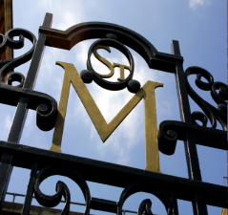
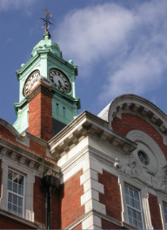
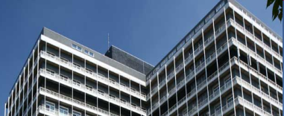
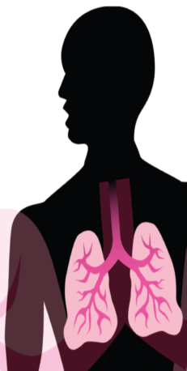
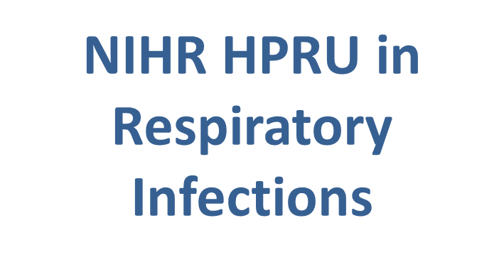
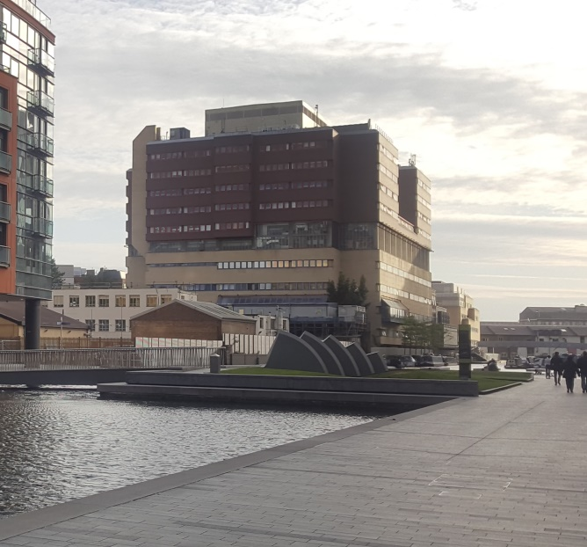



Ocular Tuberculosis
Liverpool TB Research Group
Onn Min Kon

Slide 2
51y old male Afghani
Recurrent unilateral uveitis
Otherwise asymptomatic
PMHx: hypercholesterolaemia
No known TB contact or previous Rx
Examination unremarkable
CRP<5
Chest radiograph: unremarkable
Tuberculin Skin Test 26mm induration

Slide 3
Back to case…
Is this man’s uveitis TB- related?
If so, what is his underlying systemic TB disease: active or latent?
If we immunosuppress him (may be necessary to treat his uveitis) does he need TB Rx?

Slide 4
Back to case…
Is this man’s uveitis TB-related? Maybe
If so, what is his underlying systemic TB disease: active or latent? Probably latent TB
If we immunosuppress him (may be necessary to treat his uveitis) does he need TB Rx? Probably 3/12 rifampicin & isoniazid

Slide 5
Diagnosing TB-related uveitis
Long standing perception: a normal CXR and negative symptom screen could exclude active TB disease in TB-related uveitis
However…

Slide 6
Additional tests
Quantiferon Gold-in-Tube: Positive
CT-PET: FDG- avid Lymphadenopathy (right paratracheal)

Slide 7
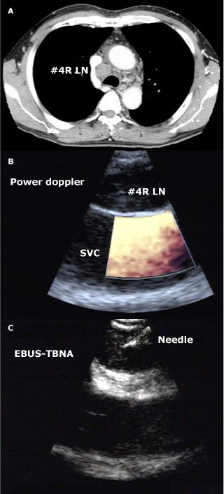
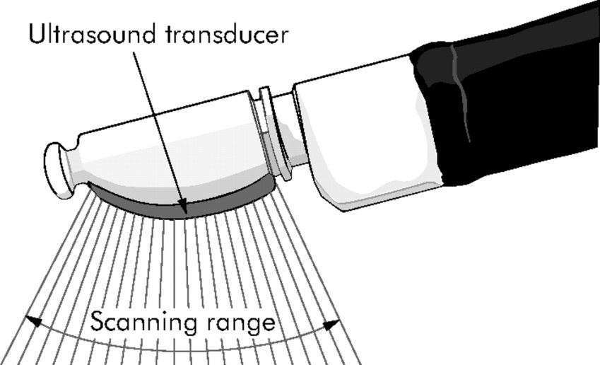
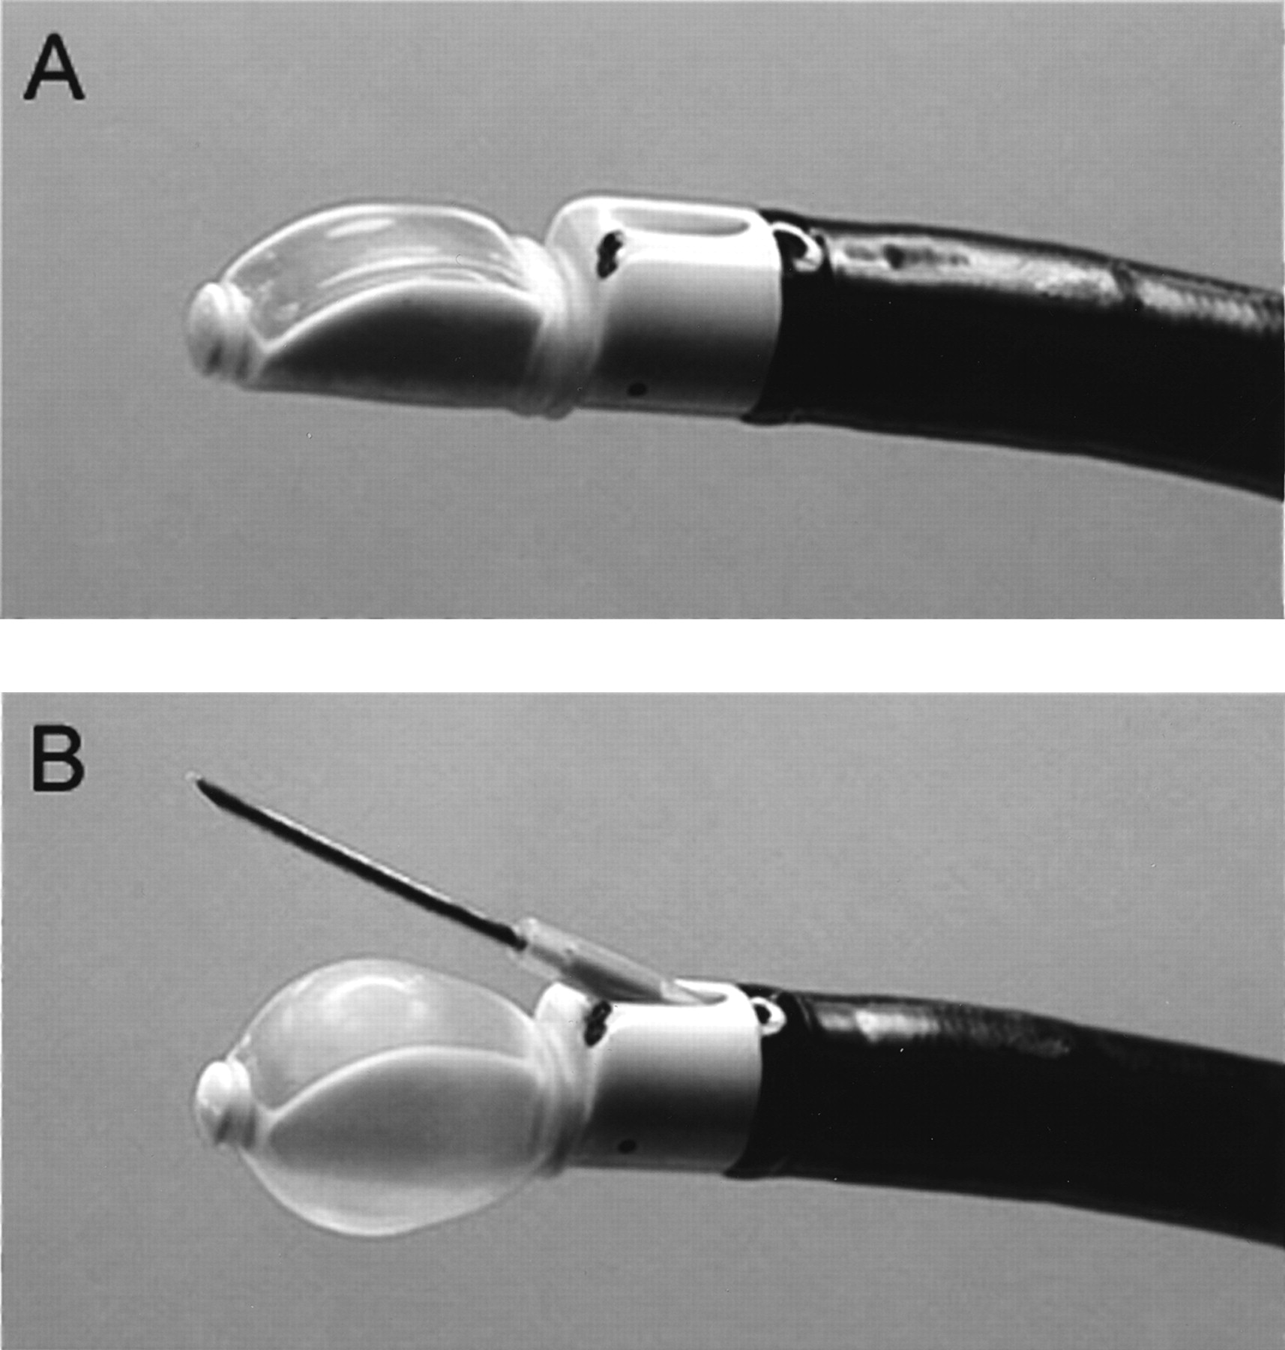
Mr CK - Additional tests
EBUS-TBNA: Granulomatous lymphadenitis
TB culture: Positive at 74 days

Slide 8
Back to Mr CK…
Is this man’s uveitis TB-related? Yes likely
If so, what is his underlying systemic TB disease: active or latent? Active (silent intrathoracic) ‘Subclinical’ TB disease
If we immunosuppress him (may be necessary to treat his uveitis) does he need TB Rx? Yes – full active treatment

Slide 9
22 year old male Feb 2019
Bilateral pan uveitic presentation - Sept 2018 – eye drops only - currently quiescent –
  Granulomatous uveitis
  No vitritis. Peripheral neovascular tufts with sclerosed vessels and ? sunbursts ? sickle ? Eales
Positive Quantiferon
HIV negative
Normal Chest X Ray
Born Somalia - UK aged 2 - Kenya 2009-2015
Father PTB 10 years?
Cervical adenopathy aged 10 - no treatment
Hayfever - peripheral blood eosinophilia
Asymptomatic otherwise

Slide 10
Progress
CT chest - calcific nodes R hilum and subcarinal? activity
Non caseating granuloma on EBUS/ TB PCR and smear negative
Culture positive at 22 days - fully sensitive

Slide 11
41 year old GP seen Dec 2019
Retinal vasculitis/ Pan-uveitis - left eye - symptoms since Nov 2019
Positive Quantiferon
Normal CXR
Childhood asthma
Bilateral knee meniscectomies
Gout
Dexamethasone eye drops qds
No respiratory or systemic symptoms
No palpable nodes

Slide 12
Progress
PET: 14mm left level II node intense PET avidity SUVmax 10.7
4mm left upper posterior triangle SUVmax 5.1
Referred for US Fine needle aspiration
Sonographically normal left jugulodigastric node
Non necrotising granulomas
TB PCR trace positive
Cultures negative
Treated 9 months 2RHZM/7RH
Ocular disease now off all treatment

Slide 13
28 year old gentleman
Bilateral panuveitis with right vitreous haemorrhage
Bilateral panuveitis with right vitreous haemorrhage 31st May 2021
UK born
Works in St Mungo’s
?Haemoptysis/ LRTI on Indian trip 2019
CXR bulky left hilum
IGRA positive
HIV neg

Slide 14
Progress
EBUS TBNA – subcarinal and left hilar nodes samples
  Non necrotising granulomas
  TB PCR neg
  Culture positive 19 days – fully sensitive
BAL negative
TB therapy – DILI so prolonged
Eyes quiescent during treatment

Slide 15
What is Ocular TB?
Primary infection = usually airborne
Spread to eye = usually haematogenous (rarely direct – orbit, adnexa)
Disease pathology may involve:
MTB invasion of ocular tissue / host inflammatory response
Delayed Type Hypersensitivity to MTB with viable organisms (remote or local)
DTH to MTB antigens in the ‘absence of viable’ organisms – i.e. post treatment DTH

Slide 16
TB Hypersensitivity Syndromes
Poncet’s Disease
Erythema Nodosum
Bazin’s Disease
Uveitis

Slide 17
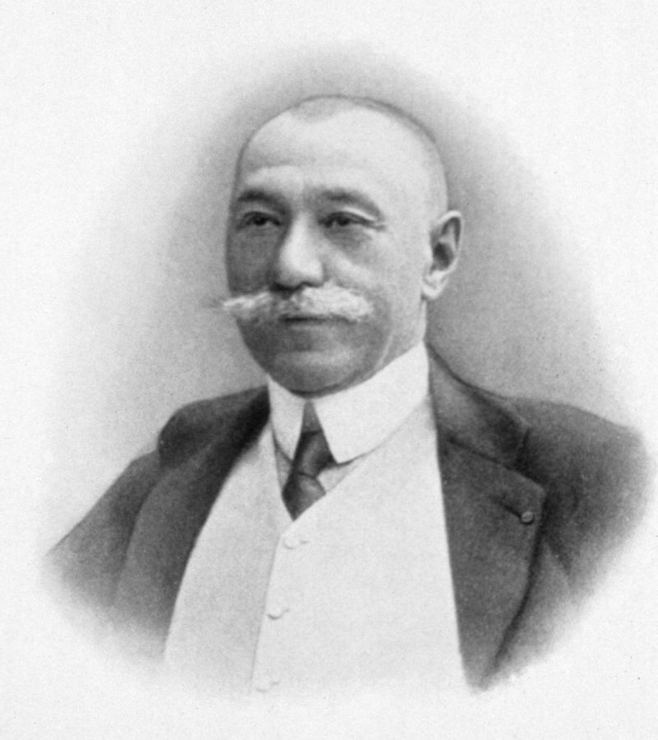
Poncet A. (1897) De la polyarthrite tuberculeus deformante ou pseudo-rheumatisme chronique tuberculeux. Congr Fr Chir. 732
?Charcot 1864/ Lancereaux 1871
Poncet’s Disease
Antonin Poncet
28 March 1849 – 16 September 1913 French surgeon
In 1897 described
  12 patients with tuberculosis
  symmetric
  inflammatory polyarthritis
  No evidence of infection in the joints

Slide 18
Erythema Nodosum
Panniculitis
Type 4 delayed hypersensitivity
Associated diseases
-TB (primary)
- Sarcoidosis
- Streptococcal A infections
- Inflammatory Bowel Disease
- Pill
- Fungal infections
(i.e. can be non infectious)

Slide 19
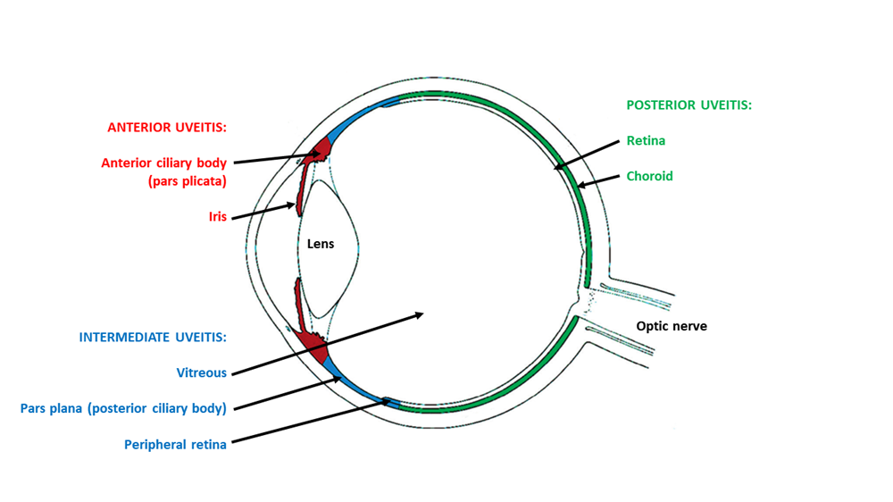
Ocular TB phenotypes
Typical phenotypes include:
Peripheral occlusive retinal vasculitis (Eales Disease)
Choroidal granulomas
Serpiginous or serpiginous-like chorioretinopathy
‘Atypical’ phenotypes include uveitides:
non-granulomatous anterior uveitis
intermediate uveitis
non-occlusive retinal vasculitis
Uvea
- pigmented layer that lies between the inner retina and the outer fibrous layer (sclera and cornea)
- includes the iris, ciliary body, and choroid

Slide 20
Bacteria localise in tissues with high oxygen tension:
Choroid, Ciliary body (i.e. the uvea)
RPE is the most suited among various ocular cell types to harbour MTB within the eye
Alveolar macrophage- like properties (phagocytosis, TLRs, complement receptors)
Organisms sequestered within RPE may cause recurrences
Paucibacillary nature of disease
    Low yield of AFB from ocular tissues / fluids
    Cultures have very low yield and take 6-8 weeks
    PCR amplification of MTB DNA: variable sensitivities, not standardised
    Management decisions generally not dependent on isolating organism (world wide)

Slide 21
The Collaborative Ocular Tuberculosis Study (COTS)-1
Report 3: Polymerase Chain Reaction in the Diagnosis and Management of Tubercular Uveitis: Global Trends
PCR) of ocular ﬂuids in management of TB anterior, intermediate, posterior, and panuveitis
COTS-1 (25 centers, n = 962)
59 (6.13%) patients PCR of intraocular ﬂuids (18 females; 53 Asian Indians)
- 26 patients were PCR negative (18 males)
- 8 patients with negative PCR had systemic TB
Anti-TB therapy was given in 18 negative and 31 positive PCR cases (n= 49)
At 1-year follow-up persistence/worsening of inﬂammation prevalence in
- ﬁve patients with positive PCR (15.15%)
- three with negative PCR (11.54%)
Conclusions:
PCR is not commonly preformed for diagnosing intraocular TB
Positive/negative results may not inﬂuence management/treatment outcomes in real practice
Ocular Immunology & Inﬂammation, 2017; 00(00): 1–9

Slide 22
Imaging
Chest radiograph
Rate of abnormalities found 17-33% [Damato 2017 ; Sanghvi 2011; Krassas 2018]
Retrospective study from London [Sethi BTS poster 2017] 33% had an abnormal CXR (none of active TB)
COTS-1 cohort (Agrawal IOVS 2018) CXR had a “suggestive pulmonary lesion” in 27% (189/702)
CT thorax
more sensitive than CXR in identifying TB
superior in distinguishing active and latent disease and can identify mediastinal and hilar lymph nodes (which seem to be frequently associated with OTB).
COTS-1 retrospective study of 945 patients diagnosed with TB uveitis in multiple international eye centres, evidence of TB
  was seen on CT chest in 68.6% (109/159) of patients,
  on CXR only in 26.9% (189/702) of patients
Positron emission tomography CT (PET-CT)
Extrapulmonary Sites
Activity in normal sized nodes

Slide 23
PET-CT in Ocular TB - Manalan et al/ BTS 2020
Methods:
  All patients referred to the TB unit at ICHNT with suspected ocular TB 2010-2020
Results:
  107 patients were referred between 2010 and 2020
  35 patients had normal chest radiograph at start of treatment episode
  55/107 had PET-CT imaging and 49/107 CT thorax
  PET-CT 36/55 (65%) demonstrated avidity of which 22/36 (61%) identified additional extra-thoracic sites
  CT thorax - 22/49 (45%) demonstrated mediastinal lymphadenopathy
Conclusion:
  In suspected OTB with a normal chest radiograph commonly demonstrate abnormalities in CT or CT-PET imaging
  Most common radiological abnormality mediastinal lymphadenopathy
  CT PET identifies additional extra-thoracic sites for lymph node sampling

Slide 24
Epidemiology of OTB
India 0.6% of all uveitis patients in South India (1995) to 10.1% in North India (2004)
  Agarwal A, Aggarwal K, Gupta V. Eye (Lond). 2019 Jan;33(1):50-65.
Portugal 1.6% of all EPTB
  I Sanches, A Carvalho, R Duarte - Revista Portuguesa de Pneumologia 2015
UK BOSU study – Shirley et al Eye 2020
  Incidence OTB for United Kingdom is 0.73 per million population per annum
  A risk factor for ocular TB is immigrant status with the origin of birth for 71% of the patients being a non-UK country
  83% of patients complete resolution of symptoms at 12 months follow-up

Slide 25
National Healthcare Group Eye Institute, Tan Tock Seng Hospital, Singapore;
Moorfields EyeHospital, London, England;
Advanced Eye Centre, Postgraduate Institute of Medical Education and Research, Chandigarh, India;
LV Prasad Eye Institute, Hyderabad, India;
Singapore National Eye Centre, Singapore;
Department of Clinical Ophthalmology & Eye Health, Central Clinical School, Save Sight Institute, The University of Sydney, Sydney, Australia;
Ocular Immunology Unit, Department of Ophthalmology, Arcispedale-IRCCS Arcispedale Santa Maria Nuova, Reggio Emilia, Italy;
Sankara Nethrayala, Chennai, India;
Shroff Eye Centre,NewDelhi, India;
Dr Shroff’s Charity Eye Hospital Daryaganj, NewDelhi, India;
Narayana Nethralaya, Bangalore, India;
Department of Ophthalmology, Fattouma B ourguiba University Hospital, Faculty of Medicine, University of Monastir, Tunisia;
University of Manchester, United Kingdom;
Istanbul Faculty of Medicine, Department of Ophthalmology, Istanbul University, Turkey;
Prabha Eye Clinic & Research Centre, Vittala International Institute of Ophthalmology, Bangalore, India;
LV Prasad Eye Institute, Bhubaneswar, India;
Bristol Eye Hospital, Bristol, England;
King Khaled Eye Specialist Hospital, Riyadh, Kingdom
of Saudi Arabia;
University of Pierre and Marie Curie, Paris,
France; Luigi Sacco Hospital, University of Milan, Italy;
Department of Ophthalmology, Northwestern University, Feinberg School of Medicine, Chicago, Illinois;
Centre for Ophthalmic Specialised Care & University of Laussane, Laussane, Switzerland;
Medical University of Vienna, Vienna, Austria;
Ramón y Cajal University Hospital, Madrid, Spain;
University
of Thessaloniki, Thessaloniki, Greece.
COTS – Collaborative Ocular TB Study 2004-2014
25 centres
Most patients had bilateral involvement - 471 of 801 [58.8%]
Common signs
vitreous haze - 523 of 1153 [45.4%]
retinal vasculitis - 374 of 874 [42.8%]
choroidal involvement - 419 of 651 [64.4%]
Most patients - no known history (498 of 661 [75.3%]) of systemic TB
Treatment failure developed in 102 of the 801 patients (12.7%)
JAMA Ophthalmol. doi:10.1001/jamaophthalmol.2017.4485
Published online October 26, 2017. Corrected on December 21, 2017.

Slide 26
A UK cohort:
A retrospective cohort study of patients treated with anti-tuberculous therapy for
presumed ocular tuberculosis
2010 and 2014 Birmingham and Midland Eye Centre
54 patients were identified as having uveitis related to ocular TB
Most treated with RHZE / RH
Good outcomes - Flare free:
- 94% of patients at 6 months
- 86% were flare free at 12 months
Duration of delay to treatment (> 8 months) did not affect success of treatment
Flares post-ATT treatment for both < 8 months and > 8 months were significantly lower than pre-ATT (Wilcoxon signed rank P = 0.000, P = 0.000 respectively)
Damato et al. Journal of Ophthalmic Inflammation and Infection (2017) 7:23

Slide 27
Duration of anti-tubercular therapy in uveitis associated with latent tuberculosis: case control study
Retrospective review of all consecutive uveitis
patients seen at single, tertiary institution over 9 years Singapore
  Uveitis consistent with TB
  positive TST with other causes ruled out
  Minimum of 6 months follow-up after
182 eligible patients
46 received ATT of > 6 month’s duration
18 patients defaulted and received <6 months treatment
Patients who completed > 6 months ATT less likely to develop recurrence
(OR 0.09; 95% CI 0.01 to 0.76; p = 0.027)
(adjusted for patient demographics, location of uveitis and corticosteroid)
Marcus Ang et al. Br J Ophthalmol 2012;96:332e336.

Slide 28
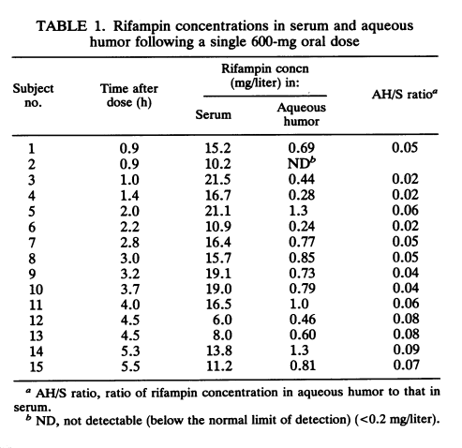
Rifampicin Ocular Penetration
The penetration of rifampin into human aqueous humor was determined in 15 patients undergoing elective cataract surgery
Between 0.9 and 5.5 h after administration of a single 600-mg oral dose,
concentrations ranged from 6.0 to 21.5 mg/liter in serum and from less than 0.2 to 1.3 mg/liter in aqueous humor
*Rif breakpoint: 1.0 microgram/ml (mg/L) - WHO
Outman W et al. Antimicrob Agents Chemother . 1992 Jul;36(7):1575-6.

Slide 29
Drug penetration – Moxifloxacin
Br J Ophthalmol 2005;89:628–631. doi: 10.1136/bjo.2004.050054
35 patients undergoing cataract surgery
two doses of 400 mg of oral moxifloxacin with a 12 hour interval
Mean moxifloxacin levels in the anterior chamber
  1.20 (SD 0.35) mg/ml at the 2 hours group
  1.22 (0.48) mg/ml at the 4 hours group
  1.20 (0.45) mg/ml at the 6 hours group
  1.58 (0.38) mg/ml at the 8 hours group
  1.37 (0.44) mg/ml at the 10 hours group
  1.23 (0.55) mg/ml at the 12 hours group
The mean ratio of aqueous to serum moxifloxacin level was 38%
Moxifloxacin penetrates well into the anterior chamber of the human uninflamed eye after oral administration, reaching early significant levels, which are maintained for at least 12 hours

Slide 30
Highlighted areas:
Investigations
- at the discretion of the treating doctor
plain chest radiograph
Chest CT
FDG
2. The use of ethambutol (E) and moxifloxacin (M)
3. The duration of treatment –
no prospective randomised trials comparing outcomes from 6, 9 or 12 months of ATT
Eye is sanctuary site and prolonged treatment (of 9 or 12 months) of clinical sense

Slide 31
BTS Clinical Statement for the diagnosis and management of Ocular Tuberculosis
Professor Onn Min Kon, Chair
Dr Nicholas Beare, representing the Royal College of Ophthalmologists
Dr David Connell
Dr Erika Marie Damato
Dr Tom Gorsuch
Dr Guy Hagan
Dr Felicity Perrin
Mr Harry Petrushkin
Dr Jessica Potter
Dr Charanjit Sethi
Professor Miles Stanford
https://www.brit-thoracic.org.uk/quality-improvement/clinical-statements/ocular-tb/
*In press BMJ Open Respiratory Research 2022

Slide 32
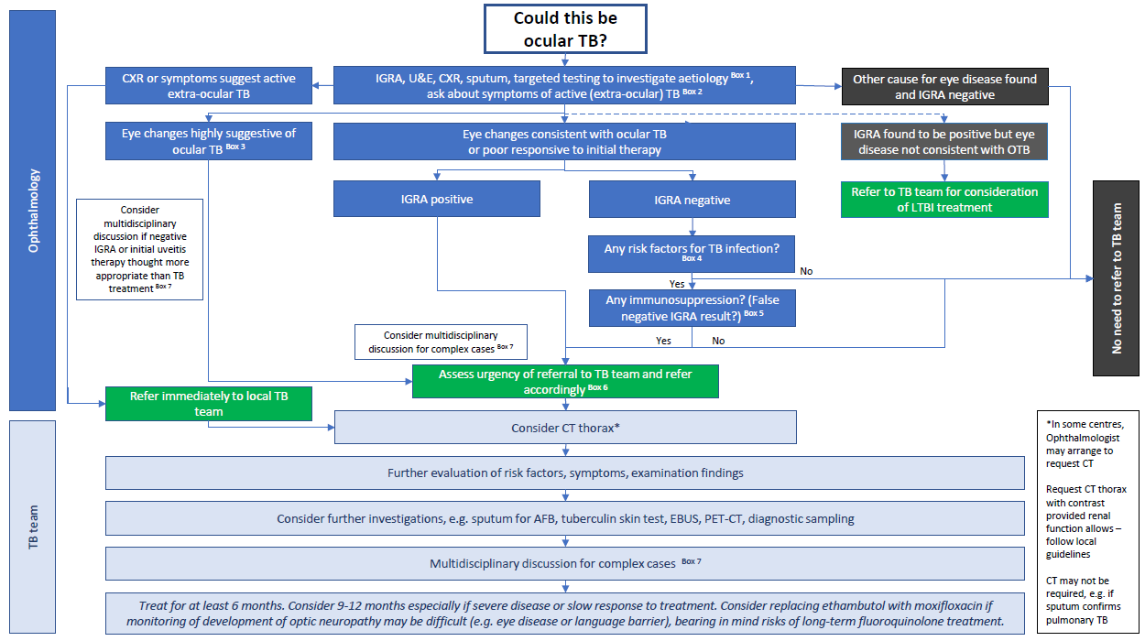

Slide 33
Clinical Practice Points 1
•Immediate referral to a TB service is recommended if there is sight-threatening disease or suspicion of disseminated / pulmonary TB. Other presentations can be generally seen within four weeks, or two weeks if on high-dose steroids.
•Patients suspected of having OTB, should have an urgent chest X-ray requested by ophthalmology.
•Consider CT thorax with contrast to guide sampling (for example induced sputum , bronchoscopy or EBUS) in patients with suspected OTB.
•The role of PET-CT to guide sampling is unclear, but it may detect additional areas of TB in extrapulmonary sites or within normal sized intrathoracic nodes. PET-CT may therefore be considered where it is available.

Slide 34
Clinical Practice Points 2
The TST and IGRAs are useful immunological tools in identifying individuals with prior TB infection and are an additional and useful tool in a composite approach to diagnosing presumed ocular TB alongside ocular phenotype, epidemiology and imaging.
IGRAs may be associated with false negative results in active TB and should not be used as the sole tool to rule out ocular TB.
IGRAs have the advantage of the single clinic visit and increased specificity but where available, a combination of both IGRAs and skin tests may offer the best sensitivity.

Slide 35
Clinical Practice Points 3
Standard regime ATT should be given for OTB (unless alternative drug sensitivities are available), in conjunction with a specialist team with experience treating OTB. Services should consider setting up regional MDTs which includes specialists in uveitis and TB.
ATT should be given for at least 6 months. Teams should consider giving treatment for longer (9-12 months), especially if there is slow improvement in eye disease or disease is severe initially.
It is reasonable to replace ethambutol with a fluoroquinolone (moxifloxacin or levofloxacin). This decision should be made in conjunction with a specialist in OTB (or MDT). Consideration should be made of potential adverse effects of fluoroquinolones (QTc prolongation, tendon rupture and aortic aneurysm rupture).

Slide 36
Clinical Practice Points 4
When the uveitis is thought to be associated with TB, the evidence from non-randomised data is that most patients benefit with a reduction in uveitis activity and reduction of relapse rates (and therefore need for immunosuppression) compared to no TB treatment.
Consider withholding TB treatment when the evidence for TB exposure is separate to the cause of the uveitis, for example old TB changes or incidental IGRA and a clear alternative cause for uveitis. This should also take into account the risks of TB treatment in the individual.
Cases where the risk/benefit of TB treatment is unclear should ideally be discussed in an MDT setting involving the uveitis and TB specialists and where appropriate the patient, including the risks of immunosuppression and potential visual loss.

Slide 37
SUMMARY
  Need high diagnostic suspicion of OTB in:
      Immigrants from high incidence countries
      General risk factors for TB
      Typical OTB phenotypes - peripheral occlusive retinal vasculitis, choroidal granulomas and ampiginous choroidopathy
      Granulomatous anterior uveitis should be regarded with suspicion in patients from TB endemic areas or with other TB risk factors
  Most no respiratory or constitutional symptoms
  CXR generally not indicative of pulmonary TB
  May be evidence of subclinical TB remote to the eye
    - FDG-PET has potential additional yield over CT imaging
    - activity in normal-sized thoracic nodes and also extra-thoracic sites
  Treatment
  Some evidence for > 6 months
  ?Moxifloxacin in place of ethambutol - VA monitoring/ better CNS penetrance

Slide 38
Acknowledgements
Clinical Statement Group
Professor Onn Min Kon, Chair
Mr Nicholas Beare
  representing the Royal College of Ophthalmologists
Dr David Connell
Dr Erika Marie Damato
Dr Tom Gorsuch
Dr Guy Hagan
Dr Felicity Perrin
Mr Harry Petrushkin
Dr Jessica Potter
Dr Charanjit Sethi*
Professor Miles Stanford
British Thoracic Society
  Sally Welham
Imperial College
  Mirae Park
  Kavina Manalan
  Hannah Jarvis
  Ajit Lalvani
  Trevor Hansel
  David Connell
  Kevin Kow
TB clinic Imperial College Healthcare NHS Trust
*Ocular Images courtesy of Dr Charanjit Sethi

