Slide 1
Migrant Screening for tuberculosis: from clinical observation to policy implementation
Professor Manish Pareek
Chair in Infectious Diseases
University of Leicester
mp426@le.ac.uk

Slide 2
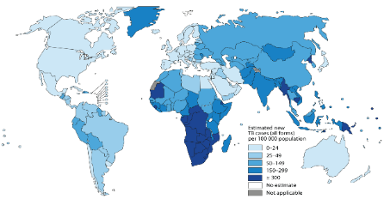
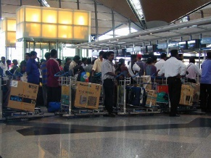
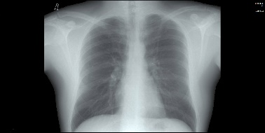
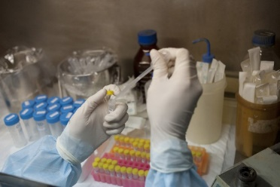


Areas to cover today…
Epidemiology
Migration
Active TB screening
Illustrative cases
Latent TB screening
Policy implications
Future direction

Slide 3
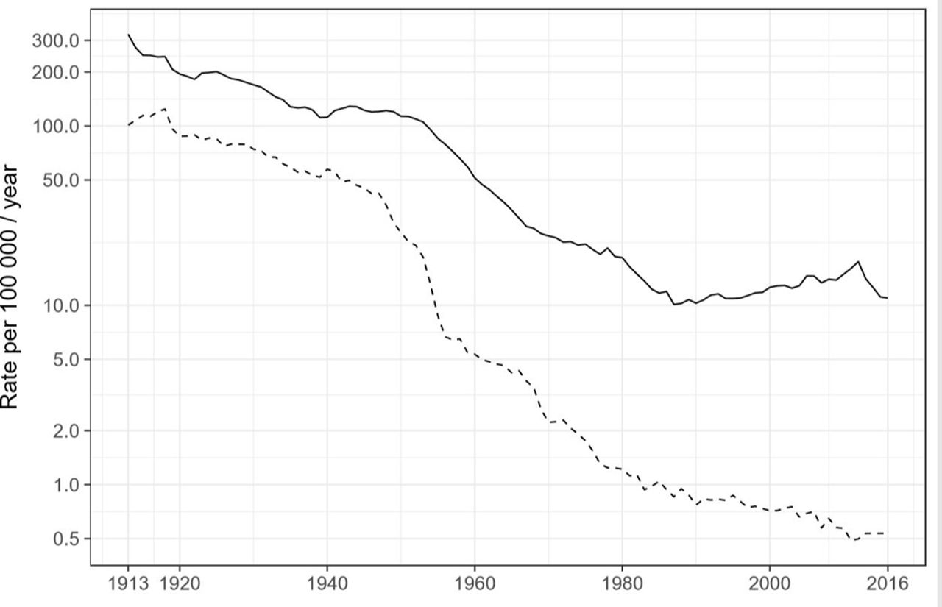
Temporal changes in UK TB burden
Incidence
Mortality
Source: Thomas et al Thorax 2018

Slide 4
Public health central in UK TB control
Incidence
Mortality
Source: Thomas et al Thorax 2018

Slide 5
Public health central in UK TB control
Housing and hygiene
Drug therapy
Pasteurisation
BCG
Incidence
Mortality
Source: Thomas et al Thorax 2018

Slide 6
Increasing TB incidence: multiple factors
Incidence
Mortality
Source: Thomas et al Thorax 2018

Slide 7
Increasing TB incidence: multiple factors
Migration
Underserved populations
Incidence
Mortality
Source: Thomas et al Thorax 2018

Slide 8
Methods of TB control
Housing and hygiene
Drug therapy
Pasteurisation
Contact tracing
BCG
Migrant screening
Incidence
Mortality
Source: Thomas et al Thorax 2018

Slide 9
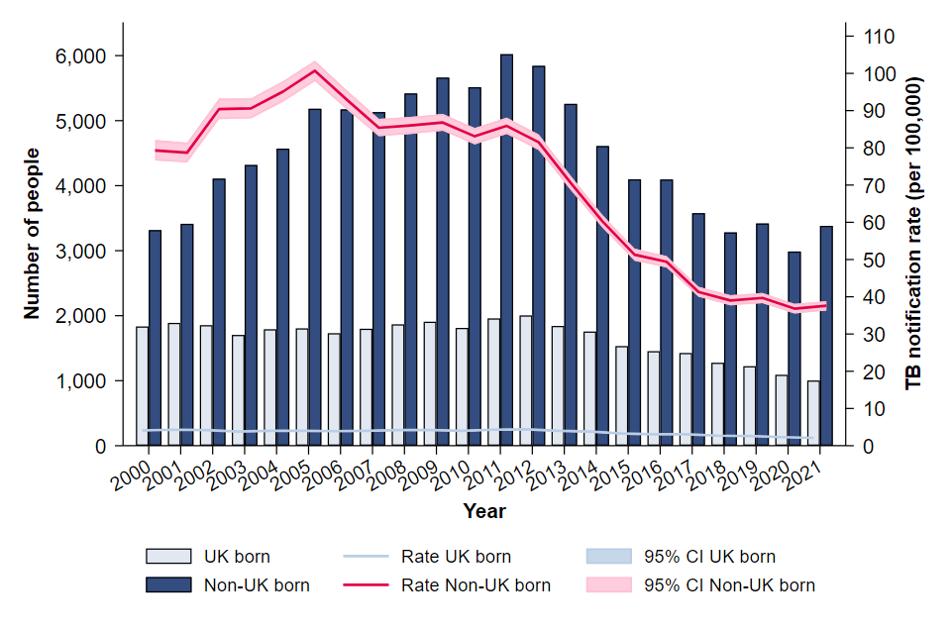
TB mainly affects the foreign-born in the UK

Slide 10
TB mainly a disease of foreign-born in the UK
Source: PHE 2018

Slide 11
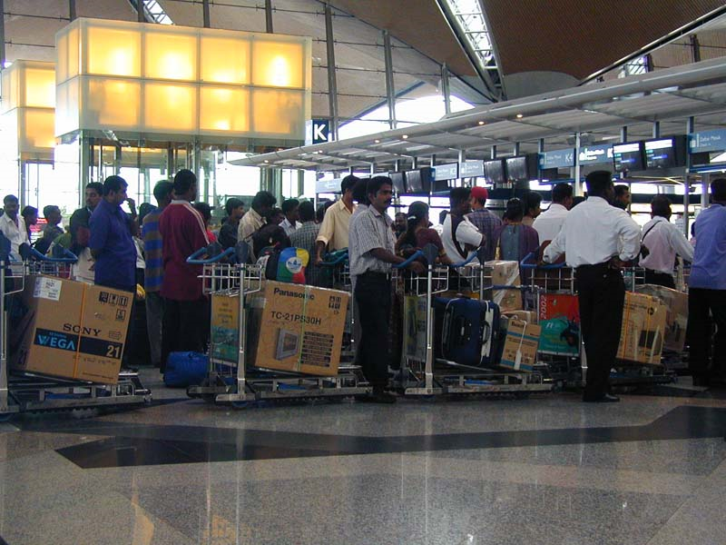
What determines TB epidemiology in the UK?
Reason: Synergistic impact of migration and reactivating latent tuberculosis infection

Slide 12
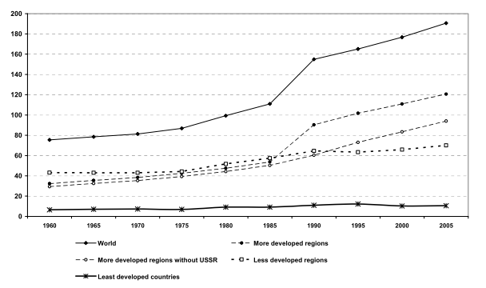
Evolving migration patterns during the
20th/21st century
Source: IOM 2005

Slide 13
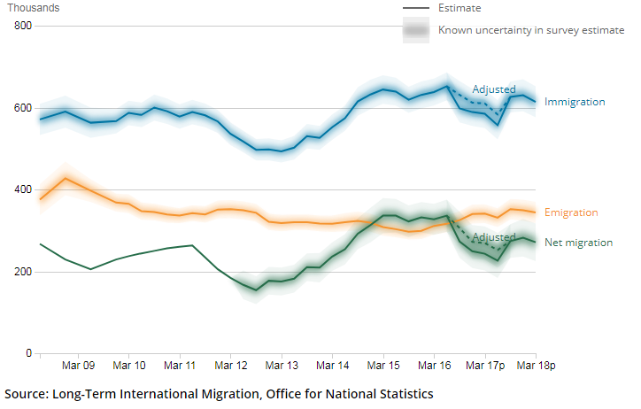
Migration to the UK
Source: ONS 2018

Slide 14
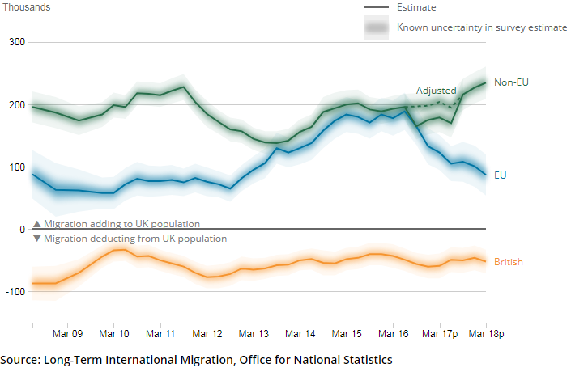
Migration to the UK: region of birth
Source: ONS 2018

Slide 15
Migration to the UK: region of birth
Source: ONS 2018

Slide 16
Migration to the UK: region of birth
Source: ONS 2018

Slide 17
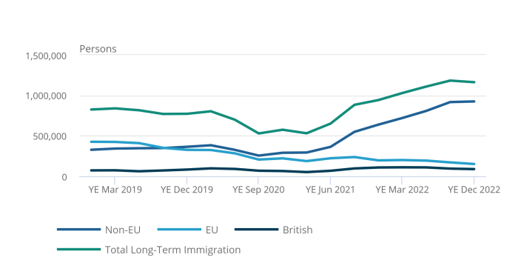
Migration to the UK: latest
Source: ONS 2023

Slide 18
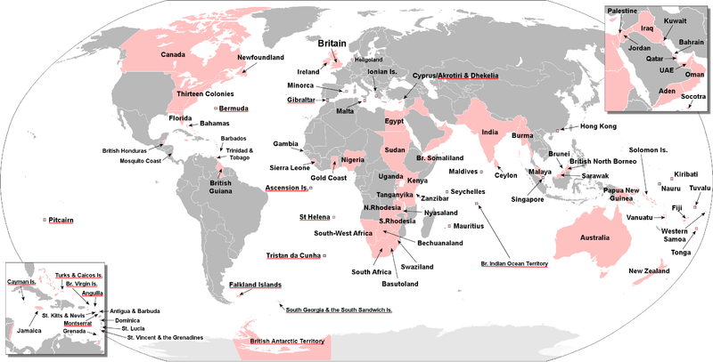
Migration to UK influenced by its past

Slide 19
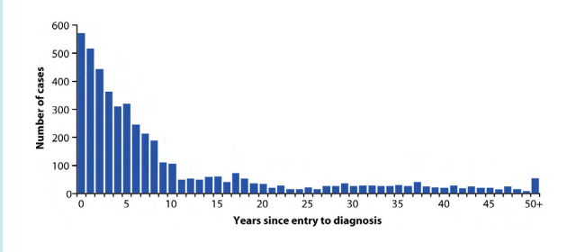
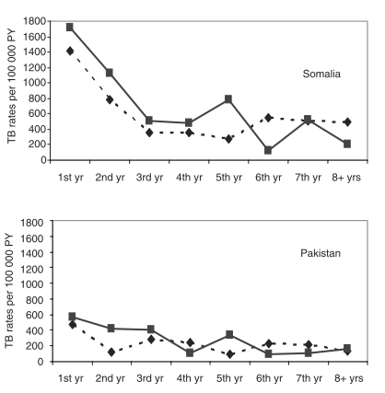
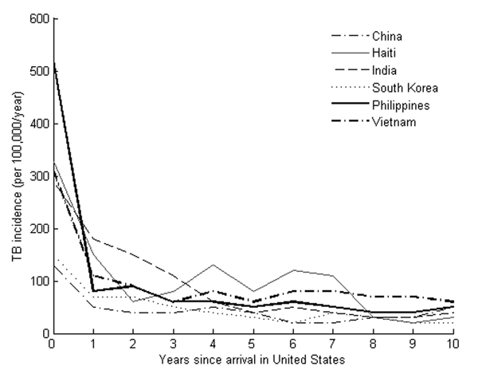
Reactivation of LTBI plays critical role
Data suggests little active TB at time of migration
High rates in initial years after migration (new-entrants)
Molecular studies: limited community transmission
Sources: HPA 2011, Ormerod 1998, Cohen 2001

Slide 20
To recap…
TB cases in the foreign-born make up a significant proportion of TB burden
Combined impact of migration and reactivation of pre-existing latent TB infection
High rates within the first 5 years after entry

Slide 21
Case

Slide 22
EY
25 year from Ethiopia
UK arrival July 2018
Asylum seeker, lives in shared accommodation
QuantiFERON positive in primary care
Dry cough but no other symptoms

Slide 23
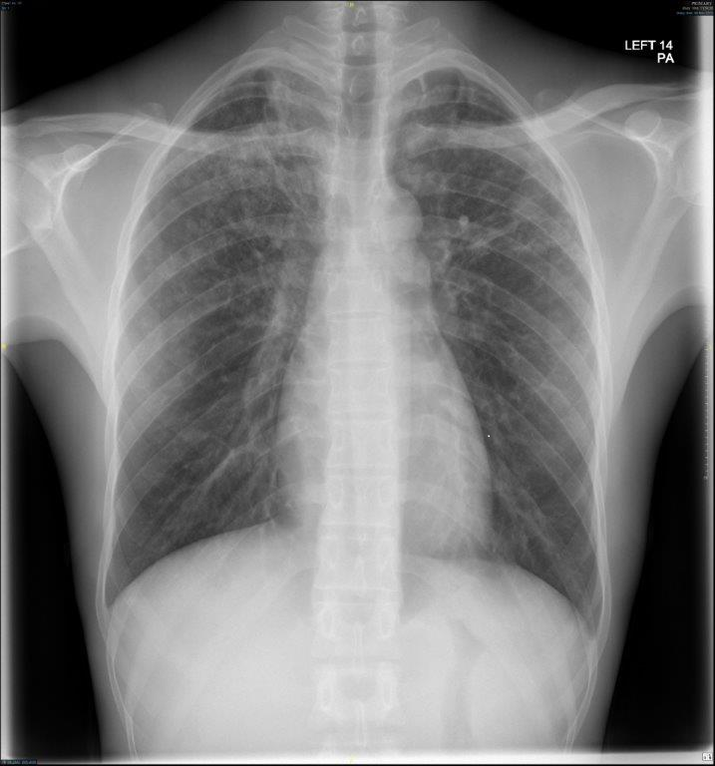

Slide 24
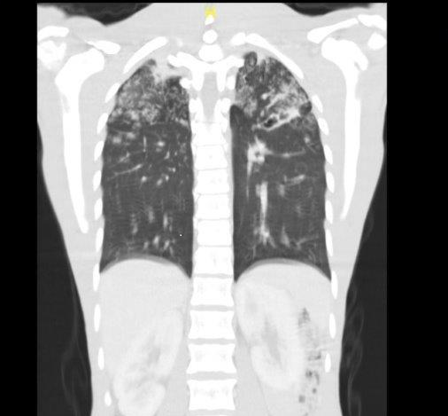

Slide 25
EY
Sputum Xpert positive; No Rif resistance
Started on treatment in hospital
Made good recovery

Slide 26
Simplified migrant flows

Slide 27
Multiple screening points in the migration process

Slide 28
Multiple screening points in the migration process

Slide 29
Multiple screening points in the migration process

Slide 30
Multiple screening points in the migration process

Slide 31
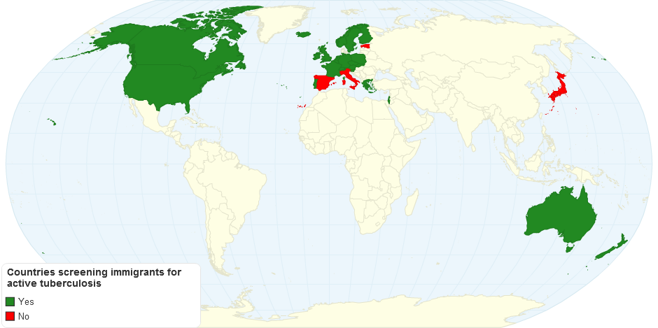
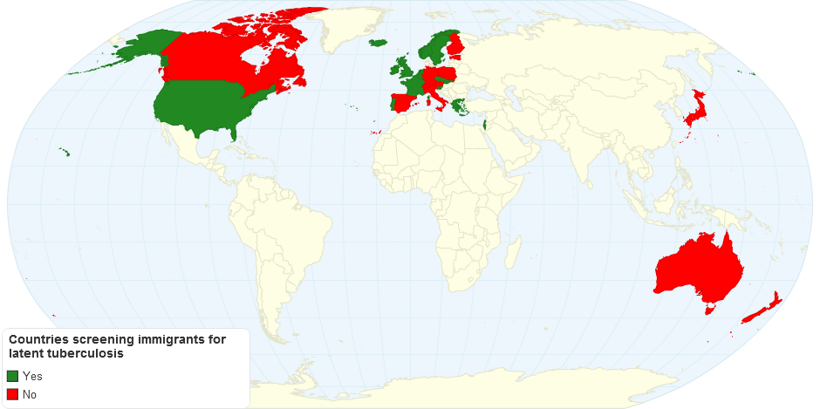
High-income countries prioritise screening for active TB rather than latent TB
25/29 (86.2%)
- active TB
16/29 (55.1%)
- latent TB
Source: Pareek M 2012

Slide 32
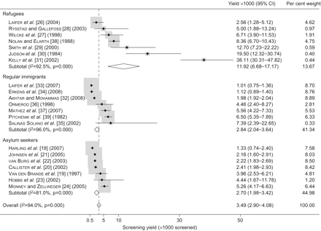
…But screening yields for active tuberculosis are highly variable
Source: Arshad et al 2010

Slide 33
…But screening yields for active tuberculosis are highly variable
Yield 0.35%
Source: Arshad et al 2010

Slide 34
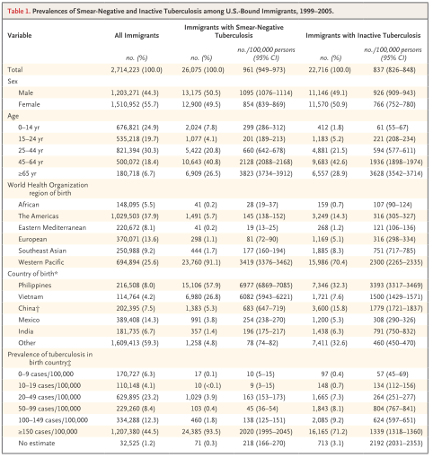
Pre-arrival screening yields for active tuberculosis may be higher
Source: Liu et al 2009

Slide 35
Pre-arrival screening yields for active tuberculosis may be higher
Yield 0.96%
Source: Liu et al 2009

Slide 36
Pre-arrival screening yields for active tuberculosis may be higher
Yield 0.96%
Yield 0.019%-3.4%
Source: Liu et al 2009

Slide 37
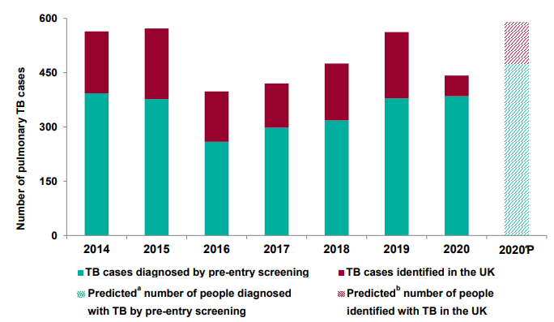
Increasing diagnosis of TB as part of pre-arrival UK programme
Source: UKHSA 2021

Slide 38
Studies/documents which have examined migrant screening for tuberculosis
Author | Year | Location | Aim of study/analysis | Tools assessed | Empirical data | Model type (Decision-analysis (DA) or Markov (M)) | Assessment of cost-effectiveness
Dasgupta | 2000 | Canada | Compare CXR and TST in screening migrants | CXR and TST | Yes | DA and M | $/ active TB case averted
Schwartzman | 2000 | Canada | Compare CXR and TST in screening migrants from hypothetical high, medium and low TB burden settings | CXR and TST | No | DA and M | $/ active TB case averted
Khan | 2002 | USA | Compare TST versus no screening for latent TB in recent migrants from different world regions | TST vs No screening | No | DA | $/ active TB case averted
NICE | 2006 | UK | Compare no screening versus TST, IGRA or TST+IGRA as screening tools for latent TB in recent migrants | TST, IGRA, TST+IGRA | No | DA | £/QALY loss averted
Oxlade | 2007 | Canada | Compare no screening versus TST, IGRA or TST+IGRA as screening tools for latent TB in recent migrants | CXR, TST, IGRA, TST+IGRA | No | DA | $/ active TB case averted
NICE | 2011 | UK | Compare no screening versus TST, IGRA or TST+IGRA as screening tools for latent TB in recent migrants | TST, IGRA, TST+IGRA | No | DA | £/QALY loss averted
Pareek | 2011 | UK | Compare no screening versus IGRA screening at different incidence thresholds | IGRA | Yes | DA | £/ active TB case averted
Linas | 2011 | USA | Compare no screening vs TST, IGRA or TST+IGRA as screening tools for latent TB in migrants | TST vs IGRA | No | M | $/Life year gained
Pareek | 2012 | UK | Compare no screening versus TST, IGRA or TST+IGRA as screening tools for latent TB in recent migrants. Assessment of screening threshold and where to screen also. | TST, IGRA, TST+IGRA | Yes | DA | $/ active TB case averted

Slide 39
Cost-effectiveness of migrant screening for active tuberculosis

Slide 40
Is it cost-effective to screen migrants for active tuberculosis?
Author | Year | Location | Aim of study/analysis | Tools assessed | Empirical data | Model type (Decision-analysis (DA) or Markov (M)) | Assessment of cost-effectiveness
Dasgupta | 2000 | Canada | Compare CXR and TST in screening migrants | CXR and TST | Yes | DA and M | $/ active TB case averted
Schwartzman | 2000 | Canada | Compare CXR and TST in screening migrants from hypothetical high, medium and low TB burden settings | CXR and TST | No | DA and M | $/ active TB case averted

Slide 41
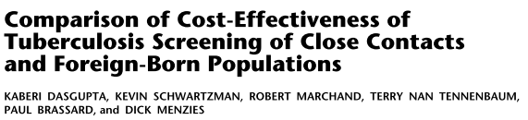
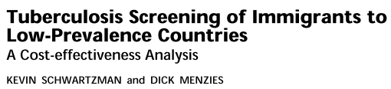
Unclear whether it is cost-effective to screen migrants for active tuberculosis
Author | Year | Location | Aim of study/analysis | Tools assessed | Empirical data | Model type (Decision-analysis (DA) or Markov (M)) | Assessment of cost-effectiveness
Dasgupta | 2000 | Canada | Compare CXR and TST in screening migrants | CXR and TST | Yes | DA and M | $/ active TB case averted
Schwartzman | 2000 | Canada | Compare CXR and TST in screening migrants from hypothetical high, medium and low TB burden settings | CXR and TST | No | DA and M | $/ active TB case averted
Conclusion: Not cost-effective to screen migrants for active TB using chest radiographs
Conclusion: Cost-effective to screen migrants from high prevalence countries for active TB using chest radiographs

Slide 42
Unclear whether it is cost-effective to screen migrants for active tuberculosis
Author | Year | Location | Aim of study/analysis | Tools assessed | Empirical data | Model type (Decision-analysis (DA) or Markov (M)) | Assessment of cost-effectiveness
Dasgupta | 2000 | Canada | Compare CXR and TST in screening migrants | CXR and TST | Yes | DA and M | $/ active TB case averted
Schwartzman | 2000 | Canada | Compare CXR and TST in screening migrants from hypothetical high, medium and low TB burden settings | CXR and TST | No | DA and M | $/ active TB case averted
Limited data but differences in conclusions relate to differences in parameters and model structure
Conclusion: Not cost-effective to screen migrants for active TB using chest radiographs
Conclusion: Cost-effective to screen migrants from high prevalence countries for active TB using chest radiographs

Slide 43
Case

Slide 44
SB
23 year from Pakistan
UK arrival April 2018
Married and joining family
CXR in Pakistan was normal
QuantiFERON positive in primary care
Asymptomatic

Slide 45
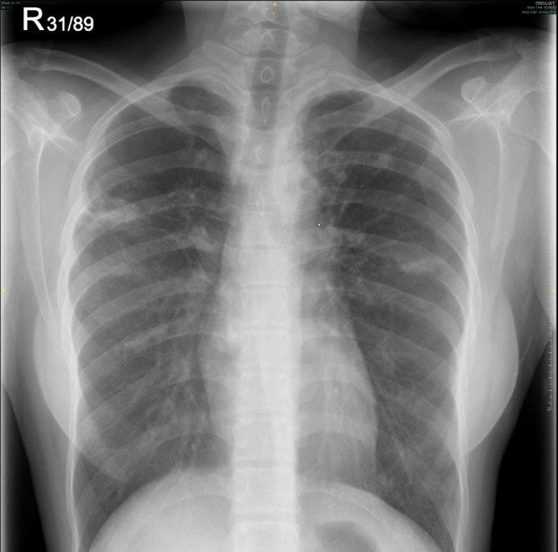

Slide 46
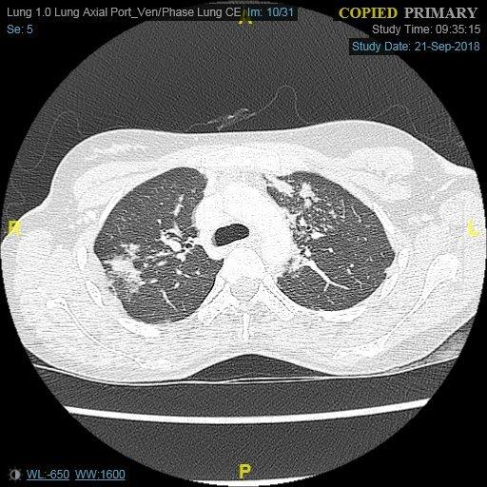

Slide 47
SB
No cough; Bronchoscopy performed
Xpert positive and no Rif resistance
Started standard ATT

Slide 48
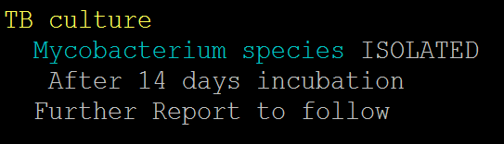
SB
No cough; Bronchoscopy performed
Xpert positive and no Rif resistance
Started standard ATT

Slide 49
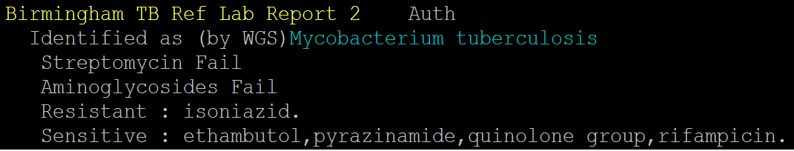
SB

Slide 50
Screening migrants for latent tuberculosis

Slide 51
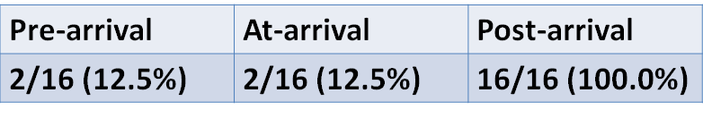
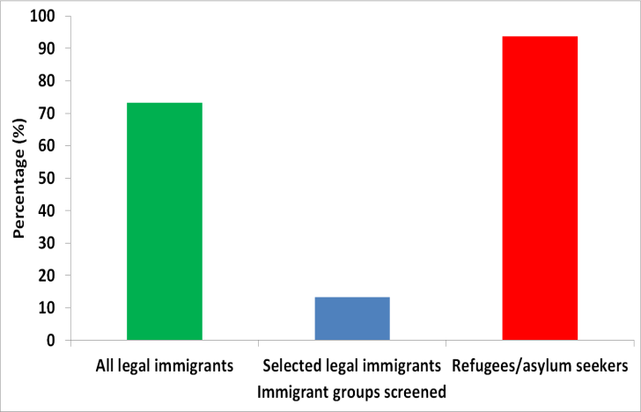
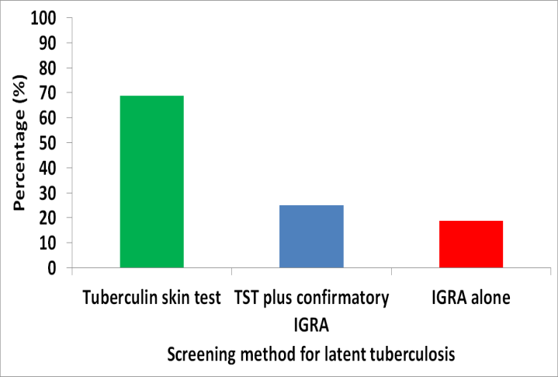
High-income countries display heterogeneity in screening for latent TB
Where?
Who is screened?
How is screening undertaken?
Source: Pareek M 2012

Slide 52
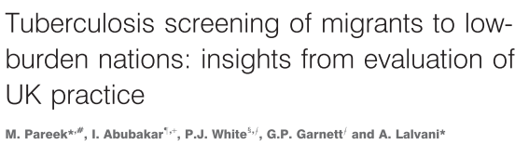
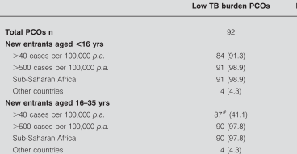
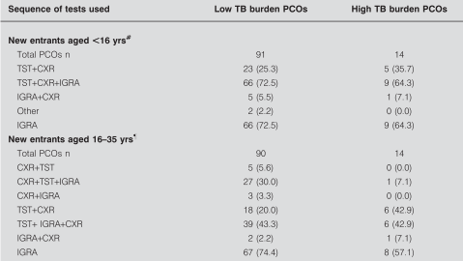
UK: Screening practices for latent TB in migrants are also highly variable
Pareek M et al Eur Resp J 2011

Slide 53
UK: Screening practices for latent TB in migrants are also highly variable
Heterogeneity in who to screen and how to screen
Pareek M et al Eur Resp J 2011

Slide 54

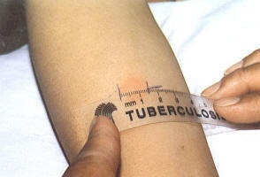
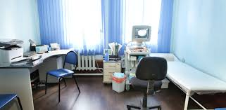
Issues to consider when implementing migrant screening
Who to screen?
How to screen?
Where to screen?

Slide 55
Issues to consider when implementing migrant screening
Who to screen?
How to screen?
Where to screen?

Slide 56
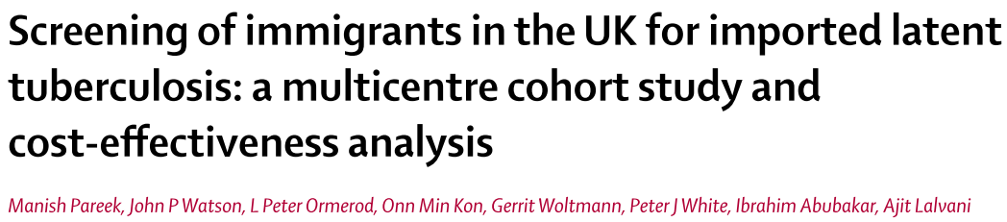

Which migrant groups to screen: evidence from the United Kingdom

Slide 57
Which migrant groups to screen: evidence from the United Kingdom
Epidemiologically – screen those at increased risk

Slide 58
Progression rates also important
Low progression rates in both migrants and contacts

Slide 59
Cost-effectiveness of migrant screening for latent tuberculosis: who to screen?
Author | Year | Location | Type of data | Migrants to target for screening |  |  | Conclusion on cost-effectiveness
 |  |  |  | Regions/Countries of origin | Age | Time since arrival
Schwartzman | 2000 | Canada | Model and literature | High/intermediate and low prevalence of active TB, latent TB and HIV | Only 20 year olds | Not stated | Screen migrants from high prevalence settings
Khan | 2002 | USA | Model and literature | Different countries and world regions | >18 years | Not stated | Screen migrants from high TB burden countries and regions
Oxlade | 2007 | Canada | Model and literature | Low, intermediate and high incidence of smear positive pulmonary tuberculosis | Not stated | Not stated | Screen migrants from high TB incidence settings
Pareek | 2011 | UK | Empirical data, model simulation and literature | Screening thresholds determined by TB incidence in country of origin (increments of 50/100,000) | <16 and 16-35 years | ≤5 years | Screen all migrants <35 years arriving from countries with TB incidence ≥250 or ≥150/100,000 resident ≤5 years
Linas | 2011 | USA | Model and literature | Not stated | Various age groups considered: 6-14, 15-24, 25-44, 45-64, 65+ years | <5 years and >5 years | Screen foreign-born <65 years irrespective of time since arrival in the US
Pareek | 2012 | UK | Empirical data, model simulation and literature | Screening thresholds determined by TB incidence in country of origin (increments of 50/100,000) | 16-35 years | ≤5 years | Screen migrants from countries with TB incidence ≥250 or ≥150/100,000 resident ≤5 years

Slide 60
Cost-effectiveness of migrant screening for latent tuberculosis: who to screen?
Author | Year | Location | Type of data | Migrants to target for screening |  |  | Conclusion on cost-effectiveness
 |  |  |  | Regions/Countries of origin | Age | Time since arrival
Schwartzman | 2000 | Canada | Model and literature | High/intermediate and low prevalence of active TB, latent TB and HIV | Only 20 year olds | Not stated | Screen migrants from high prevalence settings
Khan | 2002 | USA | Model and literature | Different countries and world regions | >18 years | Not stated | Screen migrants from high TB burden countries and regions
Oxlade | 2007 | Canada | Model and literature | Low, intermediate and high incidence of smear positive pulmonary tuberculosis | Not stated | Not stated | Screen migrants from high TB incidence settings
Pareek | 2011 | UK | Empirical data, model simulation and literature | Screening thresholds determined by TB incidence in country of origin (increments of 50/100,000) | <16 and 16-35 years | ≤5 years | Screen all migrants <35 years arriving from countries with TB incidence ≥250 or ≥150/100,000 resident ≤5 years
Linas | 2011 | USA | Model and literature | Not stated | Various age groups considered: 6-14, 15-24, 25-44, 45-64, 65+ years | <5 years and >5 years | Screen foreign-born <65 years irrespective of time since arrival in the US
Pareek | 2012 | UK | Empirical data, model simulation and literature | Screening thresholds determined by TB incidence in country of origin (increments of 50/100,000) | 16-35 years | ≤5 years | Screen migrants from countries with TB incidence ≥250 or ≥150/100,000 resident ≤5 years
Screen (recent) migrants from high TB burden settings but which age-groups to screen is less clear

Slide 61
Issues to consider when implementing migrant screening
Who to screen?
How to screen?
Where to screen?

Slide 62
Issues to consider when implementing migrant screening
Who to screen?
How to screen?
Where to screen?

Slide 63
The LTBI testing merry go around
TST
TST + IGRA (if TST positive)
IGRA alone
TST/ TST+IGRA/ IGRA
Source: NICE 2006-2016

Slide 64
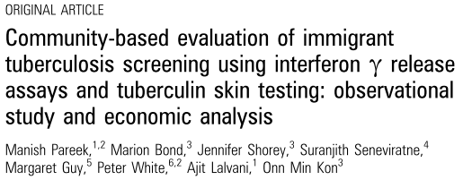

Community-based LTBI screening with single-step IGRA practicable and cost-effective
Community-based comparison of different screening methods in Westminster, London
Source: Pareek M et al Thorax 2012

Slide 65
PREDICT
Low positive predictive value
High negative predictive value
Need better tests

Slide 66
Cost-effectiveness of migrant screening for latent tuberculosis: how to screen?
Author | Year | Location | Tools assessed | Incidence threshold assessed | Empirical data | Model type (Decision-analysis (DA) or Markov (M)) | Assessment of cost-effectiveness | Conclusion on cost-effectiveness
Schwartzman | 2000 | Canada | CXR and TST | No | No | DA and M | $/ active TB case averted | CXR
NICE | 2006 | UK | TST, IGRA, TST+IGRA | Yes | No | DA | £/QALY loss averted | TST+IGRA
Oxlade | 2007 | Canada | CXR, TST, IGRA | No | No | DA | $/ active TB case averted | CXR
NICE | 2011 | UK | TST, IGRA, TST+IGRA | No | No | DA | £/QALY loss averted | TST+IGRA or IGRA
Pareek | 2011 | UK | IGRA | Yes | Yes | DA | $/ active TB case averted | IGRA
Linas | 2011 | USA | TST vs IGRA | No | No | M | $/Life year gained | IGRA
Pareek | 2012 | UK | TST, IGRA, TST+IGRA | Yes | Yes | DA | $/ active TB case averted | IGRA

Slide 67
Cost-effectiveness of migrant screening for latent tuberculosis: how to screen?
Author | Year | Location | Tools assessed | Incidence threshold assessed | Empirical data | Model type (Decision-analysis (DA) or Markov (M)) | Assessment of cost-effectiveness | Conclusion on cost-effectiveness
Schwartzman | 2000 | Canada | CXR and TST | No | No | DA and M | $/ active TB case averted | CXR
NICE | 2006 | UK | TST, IGRA, TST+IGRA | Yes | No | DA | £/QALY loss averted | TST+IGRA
Oxlade | 2007 | Canada | CXR, TST, IGRA | No | No | DA | $/ active TB case averted | CXR
NICE | 2011 | UK | TST, IGRA, TST+IGRA | No | No | DA | £/QALY loss averted | TST+IGRA or IGRA
Pareek | 2011 | UK | IGRA | Yes | Yes | DA | $/ active TB case averted | IGRA
Linas | 2011 | USA | TST vs IGRA | No | No | M | $/Life year gained | IGRA
Pareek | 2012 | UK | TST, IGRA, TST+IGRA | Yes | Yes | DA | $/ active TB case averted | IGRA
Use single-step IGRA
Little data on which IGRA to use

Slide 68
Issues to consider when implementing migrant screening
Who to screen?
How to screen?
Where to screen?

Slide 69
Issues to consider when implementing migrant screening
Who to screen?
How to screen?
Where to screen?

Slide 70
Lower TB incidence in migrants:
Pre-entry tuberculosis screening
Early primary care registration
LTBI screening

Slide 71
Cost-effectiveness of migrant screening for latent tuberculosis: where to screen?
Author | Year | Location | Aim of study/analysis | Tools assessed | Empirical data | Model type (Decision-analysis (DA) or Markov (M)) | Assessment of cost-effectiveness
Dasgupta | 2000 | Canada | Compare CXR and TST in screening migrants | CXR and TST | Yes | DA and M | $/ active TB case averted
Schwartzman | 2000 | Canada | Compare CXR and TST in screening migrants from hypothetical high, medium and low TB burden settings | CXR and TST | No | DA and M | $/ active TB case averted
Khan | 2002 | USA | Compare TST versus no screening for latent TB in recent migrants from different world regions | TST vs No screening | No | DA | $/ active TB case averted
NICE | 2006 | UK | Compare no screening versus TST, IGRA or TST+IGRA as screening tools for latent TB in recent migrants | TST, IGRA, TST+IGRA | No | DA | £/QALY loss averted
Oxlade | 2007 | Canada | Compare no screening versus TST, IGRA or TST+IGRA as screening tools for latent TB in recent migrants | CXR, TST, IGRA, TST+IGRA | No | DA | $/ active TB case averted
NICE | 2011 | UK | Compare no screening versus TST, IGRA or TST+IGRA as screening tools for latent TB in recent migrants | TST, IGRA, TST+IGRA | No | DA | £/QALY loss averted
Pareek | 2011 | UK | Compare no screening versus IGRA screening at different incidence thresholds | IGRA | Yes | DA | £/ active TB case averted
Linas | 2011 | USA | Compare no screening vs TST, IGRA or TST+IGRA as screening tools for latent TB in migrants | TST vs IGRA | No | M | $/Life year gained
Pareek | 2012 | UK | Compare no screening versus TST, IGRA or TST+IGRA as screening tools for latent TB in recent migrants. Assessment of screening threshold and where to screen also. | TST, IGRA, TST+IGRA | Yes | DA | $/ active TB case averted

Slide 72
Cost-effectiveness of migrant screening for latent tuberculosis: where to screen?
Author | Year | Location | Type of data | Screening locational assessed | Conclusion
Pareek | 2012 | UK | Empirical data, model simulation and literature | Community-based screening post-arrival | Community-based screening is cost-effective
Screen post-arrival
Community-based setting

Slide 73
Post-arrival, community-based screening facilitates wider migrant health programmes
TB screening
HIV testing
Post-arrival screening
Non-communicable diseases – Hypertension/
Diabetes
Hepatitis B/C
Vaccinations/
Maternal health
Immigrant screening

Slide 74
Translation of evidence to policy

Slide 75
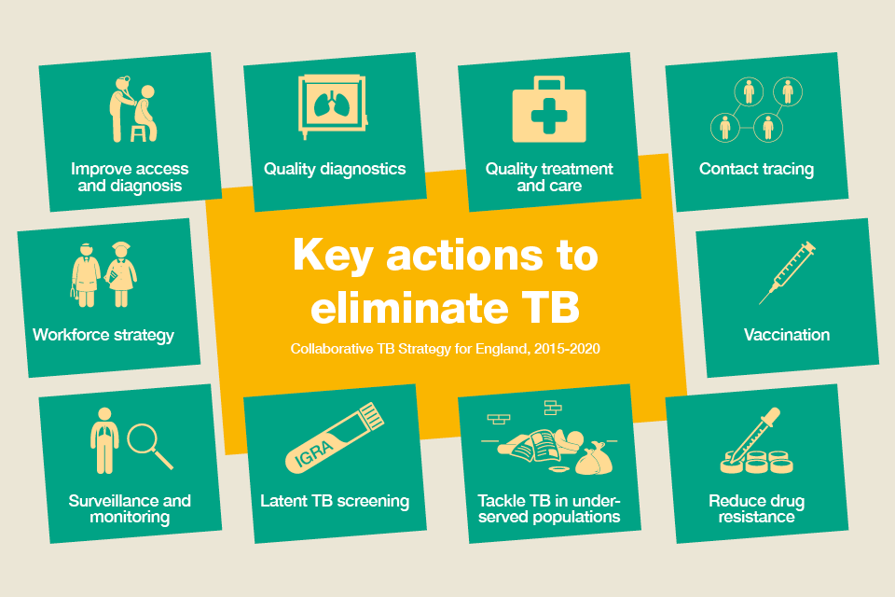
Multiple elements in the strategy

Slide 76
Migrant screening integral to the strategy
Prevention

Slide 77
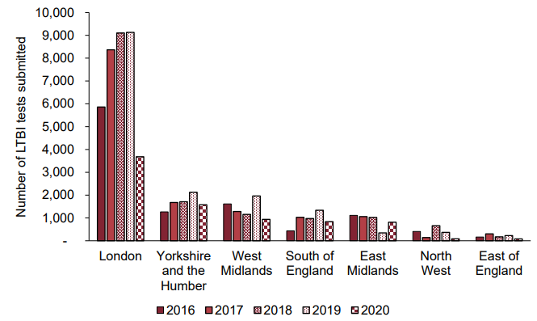
Progress mixed…
Source: UKHSA 2021

Slide 78
COVID has disrupted LTBI programmes but…

Slide 79
Implementing LTBI screening is difficult

Slide 80
Overcoming drop-offs in the cascade of care

Slide 81
Overcoming drop-offs in the cascade of care

Slide 82
Overcoming drop-offs in the cascade of care

Slide 83
Does it have any impact?
Reduction in TB rates multifactorial
Source: Thomas et al Thorax 2018

Slide 84
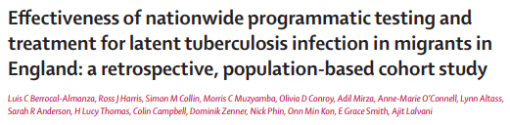
Does it have any impact?
LTBI screening – resulted in lower risk of future TB
IGRA + increased risk of TB diagnosis
LTBI treatment reduced future TB risk by 85%
Source: Berrocal-Almanza et al Lancet Public Health 2022

Slide 85

Need more data
Need to better target – new vs existing tools?
Better understand what patients think and how to reduce drop offs
Balance coverage vs targeting
Broader migrant health agenda
Source: Pareek et al Lancet Public Health 2022, Baggaley et al Lancet Public Health 2022

Slide 86
Current and future research/clinical programmes
COMBAT-ID
PRISM-ID
TARGET-ID
Primary care/educational screening/pharmacy
Multi-disease (including infection) testing
Comparing high-risk vs targeted programmes
Acceptability
Single-stop migrant clinic
Health-economic analysis/modelling
UK-wide
Primary-care
Multi-infection testing
Use of machine learning
Acceptability/qualitative studies
Health-economic analysis

Slide 87
Concluding statements
Foreign-born individuals disproportionately bear the TB burden in high-income countries
Reactivation of latent TB important
Migrant screening likely to comprise multiple elements
  Pre-arrival screening for active TB
  Targeted post arrival screening for LTBI
    Migrants from intermediate/high burden settings
    Single-step IGRA
Need better tools and new treatment pathways

Slide 88
Thank you
Any questions/comments?
mp426@le.ac.uk

