Slide 1
Pooling sputum specimens to increase testing capacity for TB diagnosis during the COVID-19 pandemic
Presented by Vibol Iem, PhD candidate
Primary Supervisors: Dr Tom Wingfield, Pr Luis Cuevas

Slide 2
Background
Tuberculosis (TB) is an ancient disease that remains a major public health concern, being the leading cause of death by a single infectious agent before the emergence of the coronavirus (COVID-19) pandemic, ranking above HIV/AIDS
The global COVID-19 pandemic has limited access to molecular TB diagnostics and National Programmes are struggling to maintain essential services
TB burden remains high and treatment coverage is yet sub optimal, related to limited access to, and low quality of health services for a large portion of the population living in remote rural areas of the country

Slide 3
Introduction
Molecular WHO-recommended rapid diagnostic tests (mWRDs) such as Xpert MTB/RIF and Xpert Ultra for presumptive TB
Individual testing is highly specific and sensitive
Expansive
Complicated
Lengthy
Resources consuming
An alternative to individual testing is pooled testing.

Slide 4
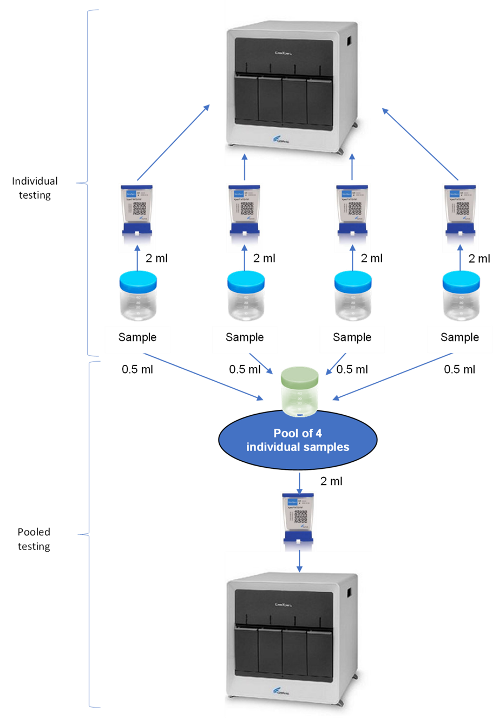
Introduction

Slide 5
Research Question and Objectives
Can the pooled testing help increase affordability and testing capacity with a reliable performance similar to individual testing?
Objectives:
To evaluate whether combining four specimens of people with presumptive TB and testing the pool with Xpert MTB/RIF or Xpert Ultra would result in the same accuracy as testing samples individually
To evaluate whether pooled testing would increase the affordability of Xpert testing in Lao PDR and whether the approach would result in assay cost and processing time savings
To assess the changes in the assays cycle threshold (CT) values in the pool

Slide 6
Methodology
Literature systematic review on GeneXpert-based testing of pooled sputum samples sensitivity and specificity compared to testing individual samples.
Cross-sectional studies
2 surveys during PCF (in 2020 and 2021) in Vientiane (Lao PDR)
2 surveys during ACF (in 2020 and 2021) in high TB burden areas of Lao PDR.
1 survey for Covid-19 diagnosis
Sputum samples of four individuals were pooled and tested with Xpert-MTB/RIF (2020) or Xpert-Ultra (2021) for TB and Xpert Xpress SARS CoV-2 for Covid-19
Pooled and individual results were compared to determine the level of agreement, the reasons for discrepancy and potential cartridge savings
Bench evaluation: dilution of selected positive samples to describe the change in CT values.

Slide 7
Results
Systematic Review
2-sample pools Sensitivity 94%(95%CI, 89.0%–98.0%) with Xpert MTB/RIF (2 studies)
4-sample pools Sensitivity 91% with Xpert MTB/RIF (2 studies)
98% with Xpert Ultra (2 studies)
Specificity 99%–100% (2 studies)
Cartridge savings 27%–31%
Pooling had a higher level of agreement if pools were tested with Xpert Ultra
The method can result in significant cartridge savings
Very limited number of studies
Cuevas LE, Santos V, Lima SVMA, Kontogianni K, Bimba J, Iem V, et al. Systematic Review of Pooling Sputum as an Efficient Method for Xpert MTB/RIF Tuberculosis Testing during the COVID-19 Pandemic. Emerging Infectious Disease journal. 2021;27(3):719. doi: 10.3201/eid2703.204090.

Slide 8
Results
Xpert MTB/RIF and Xpert Ultra surveys (Passive case finding)
Xpert MTB/RIF survey (2020)
77/81 pools containing ≥1 positive sample tested MTB-positive Sens 95.1% (95%CI, 87.8%-98.6%)
129/129 pools containing MTB-negative samples tested MTB-negative Spec 100% (95%CI, 97.2%-100%)
98.1% agreement (Kappa: 0.959)
Xpert-Ultra survey (2021)
70/70 pools containing ≥ 1 MTB-positive sample tested MTB-positive Sens 100% (95%CI, 94.9%-100%)
140/140 pools containing MTB-negative samples tested MTB-negative Spec 100% (95%CI, 97.4%-100%)
100% agreement (Kappa: 1)
Cartridge savings (cartridge costs)
Xpert-MTB/RIF 38.3%
Xpert-Ultra 41.7%
Iem V, Chittamany P, Suthepmany S, Siphanthong S, Somphavong S, Kontogianni K, et al. Pooling sputum for Xpert MTB/RIF and Xpert Ultra testing during the COVID-19 pandemic in Lao People’s Democratic Republic. PLOS Global Public Health. 2022;2(4):e0000116. doi: 10.1371/journal.pgph.0000116.

Slide 9
Results
Xpert MTB/RIF and Xpert Ultra surveys (Active Case Finding)
Xpert MTB/RIF survey (2020)
25/28 pools containing ≥1 positive sample tested MTB-positive Sens 89% (95%CI, 72.8%-96.3%)
81/81 pools containing MTB-negative samples tested MTB-negative Spec 100% (95%CI, 95.5%-100%)
97.3% agreement (Kappa: 0.925)
Xpert-Ultra survey (2021)
32/32 pools containing ≥ 1 MTB-positive sample tested MTB-positive Sens 100% (95%CI, 89.3%-100%)
77/77 pools containing MTB-negative samples tested MTB-negative Spec 100% (95%CI, 95.3%-100%)
100% agreement (Kappa: 1)
Cartridge savings (cartridge costs)
Xpert-MTB/RIF 52%
Xpert-Ultra 46%
Iem V, Chittamany P, Suthepmany S, Siphanthong S, Siphanthong P, Somphavong S, et al. Pooled testing of sputum with Xpert MTB/RIF and Xpert Ultra during tuberculosis active case finding campaigns in Lao People’s Democratic Republic. BMJ Global Health. 2022;7(2):e007592. doi: 10.1136/bmjgh-2021-007592

Slide 10
Results
Pooling with Xpert Xpress SARS-CoV-2
361 (92.1%) pools were negative and 31 (7.9%) positive
29/31 (93.5% (95%CI 77–99%) positive pools were confirmed by individual testing
In 2/31 (6.5%) all individual samples tested negative, suggesting contamination of the pool
Pools with one positive sample had higher CT values (lower RNA concentrations) than the respective individual samples, indicating a dilution effect, suggesting an increased risk of false negative results with dilutions >1:10
Pooling saved 67% of cartridges, substantially increasing testing capacity
The national program adopted pooling to programmatically screen for SARS-CoV-2
Iem V, Xangsayarath P, Chittamany P, Suthepmany S, Siphanthong S, Paboriboune P, et al. Pooling samples to increase testing capacity with Xpert Xpress SARS-CoV-2 during the Covid-19 pandemic in Lao People’s Democratic Republic. In Press

Slide 11
Discussions
Perfect agreement between individual and pooled Xpert Ultra (Xpert Ultra sensitivity > Xpert MTB/RIF)
A few discrepancies between individual and pooled testing with Xpert MTB/RIF among pauci-bacillary samples with low bacilli loads
Pooled testing not reliable to detect Rifampicin resistance. No clinical management impact as all positive pools are re-tested individually
False-positive pools for COVID-19 (human error, cross-contamination). No clinical management impact as all positive pools are re-tested individually

Slide 12
Limitations
Xpert MTB/RIF and Xpert Ultra were not available at the same time in the country
Small sample size
Expected number of participants attending the TB campaigns,
Capacity of staff to conduct the study in addition to their routine activities
Number of spare cartridges for research purposes
Cost analysis limited to cartridges costs savings only

Slide 13
Future directions
Conduct a formal cost-effectiveness analysis of the pooled testing in detecting MTB
Systematic review
Include all potential savings
Add more evidence on the pooled testing performance for TB diagnosis
In a variety of settings (prisons, migrant population, …)
At all health system level
On other platform endorsed by the WHO (e.g. Truenat )
Add more evidence on the pooled testing performance for Covid-19 diagnosis
Combine pooled testing with SARS-CoV-2 Ag-RDTs
On other platform + all Nucleic Acid Detection Tests endorsed in the WHO Emergency Use Listing for In vitro diagnostics (IVDs) Detecting SARS-CoV-2

Slide 14
Conclusions
The pooling method replicates individual testing and has high sensitivity and specificity for Xpert MTB/RIF and Xpert Ultra, with the latter resulting in full agreement between individual and pooled testing.
Pooled testing resulted in significant cartridge savings and more efficient testing within the pandemic.
In a context where countries experience stock-outs or procurement delays in laboratory commodities during times of crisis such as during the COVID-19 pandemic, the pooling method may be considered as an interim option to strengthen testing capacity and to achieve the WHO End TB strategy targets in resource-limited settings.

Slide 15
Acknowledgements
Partners:
National Tuberculosis Control Center, Vientiane, Lao People's Democratic Republic
National Center for Laboratory and Epidemiology Vientiane, Lao People's Democratic Republic
Liverpool School of Tropical Medicine, Liverpool, United Kingdom
University of Gothenburg, Health Economics and Policy Unit, School of Public Health and Community Medicine, Gothenburg, Sweden
Institut d'Investigació Germans Trias i Pujol, CIBER Enfermedades Respiratorias, and Universitat Autònoma de Barcelona, Spain
WHO Collaborating Centre for Tuberculosis and Social Medicine, Department of Global Public Health, Karolinska Institutet, 17177 Solna, Sweden
Stop TB Partnership, Innovations and Grants, Geneva, Switzerland
Funders:
Ministry of Health of Lao PDR
Global Fund to Fight AIDS, Tuberculosis and Malaria
TB REACH, Stop TB Partnership grant supported by Global Affairs Canada (STBP/TBREACH/GSA/2020-04)
National Institute for Health Research Health Protection Research Unit in Emerging and Zoonotic Infections,
Centre of Excellence in Infectious Diseases Research, and the Alder Hey Charity;
Wellcome Trust, UK (209075/Z/17/Z); the Medical Research Council, Department for International Development, and Wellcome Trust, UK (Joint Global Health Trials, MR/V004832/1), the Medical Research Council, UK (MR/V028618/1); the Academy of Medical Sciences, UK; and the Swedish Health Research Council, Sweden.

Slide 16
THANK YOU FOR YOUR ATTENTION

